Slide 1
Xavier pilot Program to Support Female Students in Science, Technology, Engineering, Mathematics and Philosophy (STEMP)
Members
Heidrun Schmitzer & Laura Wessels - Physics
Supaporn Kradtap Hartwell- Chemistry
Liz Johnson - Computer Science
Dena Morton & Aimee Schwab-McCoy – Mathematics
Eleni Tsalla & Michelle Brady - Philosophy

Slide 2
Facts & Statistics
STEMP field | Nation wide | Xavier
Physics | Under 20% female students earned BS degree in Physics | 9 female students out of 56 majors
Chemistry | 49% female BS chemistry degrees, but only 39% of those continued Ph.D. education, and only 37% Ph.D. pursue career in Chemistry | More than 50% female majors, but less than half plan to pursue career in Chemistry
Mathematics | 26% females hold computer and mathematical careers | 23 of 64 students are women only 6 of 25 actuarial science students being female
Computer science
 |  | 17% females in the major
Philosophy | 33% females in the major (survey from 56 institutions in the USA which represents 3,443 philosophy majors) | 1 female student out of 18 majors
K. Hutchinson, Fiona Jenkins (eds.), Women in Philosophy: What needs to Change, Oxford University Press, 2013
M. Paxton, C. Figdor, V. Tiberius, Quantifying the Gender Gap: An Empirical Study of the Underrepresentation of Women in Philosophy, Hypatia vol. 27, no. 4, Fall 2012

Slide 3
Objectives
Raise awareness of challenges that females in STEMP fields may be facing in their future careers.
Support female students in STEMP majors with necessary tools to continue from graduation into the career path of their choice and remain in the fields.
Educate male colleagues and peers about the gender inequity issues so as to increase their support on the advancement of a women friendly environment in the STEMP departments.

Slide 4
Engagement of Xavier STEMP female students in the national effort to address the problem. Inviting speakers to Xavier and supporting Xavier students to attend conferences and programs on promoting gender diversity in STEMP fields are the means to promote this aspect of the project.
Skill-building Opportunities. Organization of career building
workshops at Xavier is an important complement to the education
of STEMP female students.
Collaboration between STEMP female faculty and students to
collect and disseminate information about the problem of female
underrepresentation in STEMP disciplines. The creation of a
website to collect and share resources is a central objective of this
part of the project.

Slide 5
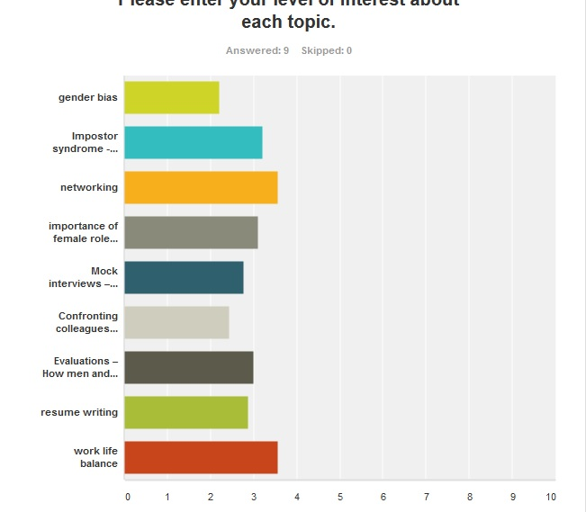
Survey for students’ issues of interest
Gender bias
Impostor syndrome
Networking
Female role
Mock interviews
Confronting colleagues
Evaluation men vs women
Resume writing
Work-Life balance
0 10 20 30 40 50 60 70 80 90 100
% Response

Slide 6
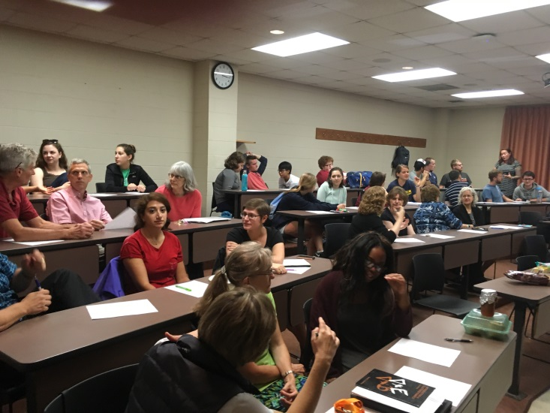
Activities Summary
Activities conducted in Fall 2016 & Spring 2017 are based on the survey results of students’ interest
3 invited speakers on
- Imposter syndrome
- Work-Life balance
- What I wish I’d known
1 workshop on networking
2 students attended Conferences for Undergraduate Women in Physics
1 student attended Conference for Undergraduate Women in Mathematics

Slide 8
Networking workshop
We’ll help you get started.
Open to all: In this discussion, we will help you identify your network and be prepared to take advantage when opportunities present themselves to you.
Lindner 103
Mon. 3pm 10/10/16

Slide 10
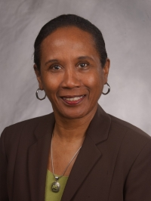
Faculty in Science, Math, CS, Chemistry and Philosophy present:
What I Wish I'd Known…
a "lessons learned" talk
by
Dr. Janice Walker
a woman in a STEM field
and the leader of Xavier’s College of Arts and Science for many years
Location: Lindner Hall 103
Day: April 10, 2017
Time: 5.00-7.00 pm
Dinner will be provided.
This event is sponsored by the Women of excellence giving circle and open to all.

Slide 11
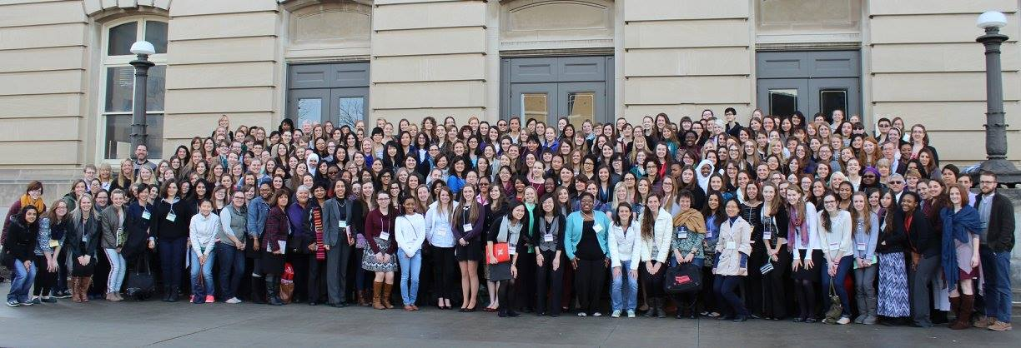
19th Annual Nebraska Conference for Undergraduate Women in Mathematics February 3-5, 2017
NCUWM's overall goal is to arm participants with knowledge, self-confidence and a network of peers to help them become successful mathematicians. The conference provides role models, insider knowledge and an opportunity to present original research. The focus is to encourage and mentor undergraduate women to pursue graduate study in mathematics and seek mathematical careers. Conference participants also have a chance to learn about life in graduate school from the perspective of current women graduate students representing math departments from across the country.

Slide 12
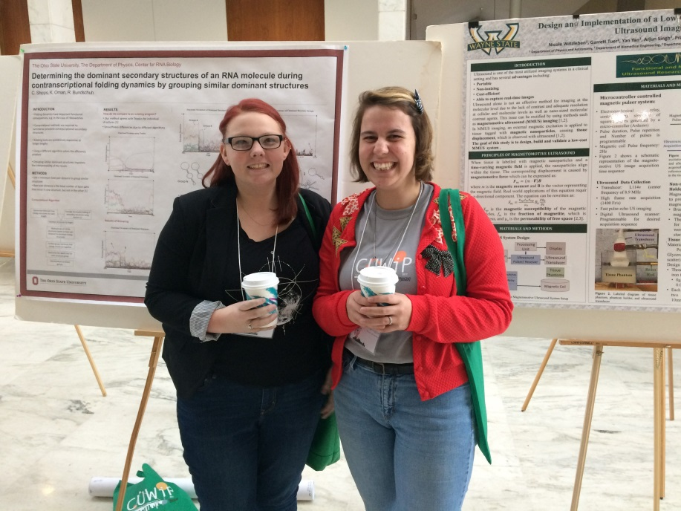
Conferences for Undergraduate Women in Physics (CUWiP) January 13-15, 2017
The goal of APS CUWiP is to provide you with information, resources, and motivation to support your pursuit of a physics major and a career in physics. The conferences will offer inspirational talks by female physicists, student poster or presentation sessions, workshops and panel discussions on topics such as summer research, grad school, physics careers, and professional development, as well as opportunities for networking and informal mentoring.

Slide 13
Plans for web site contents
Research and reports on issues related to disciplines with female underrepresentation
resources for scholarships and internships for female students in each discipline
resources for career development and mental support

Slide 14
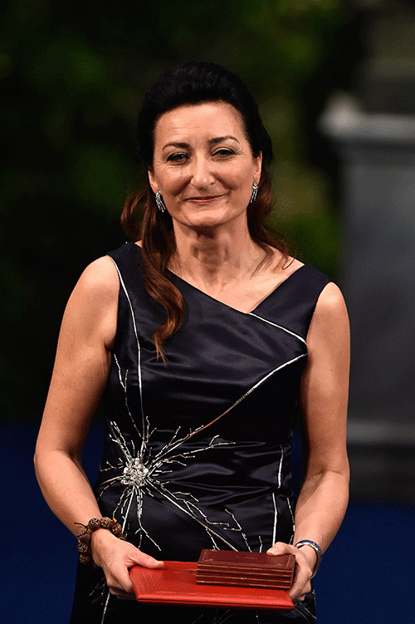
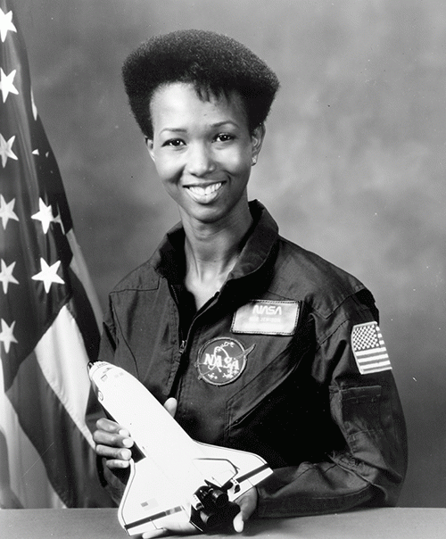
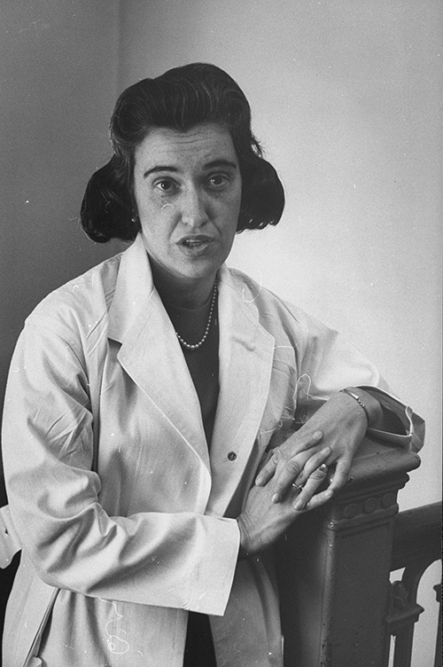
Inspiration from Women in STEMP fields
May-Britt Moser: Neurologist who was awarded the 2014 Nobel Prize for Physiology or Medicine for work on the brain’s positioning system
“I’m excited because earlier I didn’t think about the issues between females and males in science. I see now that there’s so much that can stop a woman from getting a career compared to a man. With men you’re expected to do well and get the support, but for females, you have to sacrifice something in a different way from men, and I didn’t realize that earlier. I think it’s very important for other woman to see that I have had success.”
Mae Jemison, physicist and astronaut
"Don't let anyone rob you of your imagination, your creativity, or your curiosity.“
Rosalyn Yalow: Medical Physicist, awarded the Nobel prize in 1977
“We cannot expect in the immediate future that all women who seek it will achieve full equality of opportunity. But if women are to start moving towards that goal, we must believe in ourselves or no one else will believe in us; we must match our aspirations with the competence, courage and determination to succeed.”
http://empowering.hearst.co.uk/be-inspired/10-inspiring-quotes-from-women-in-science/

Slide 15
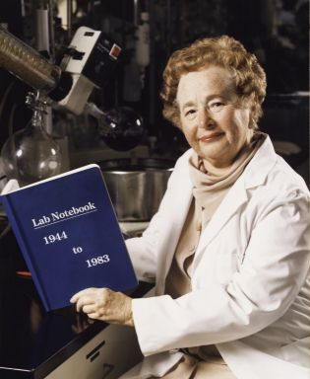
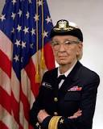
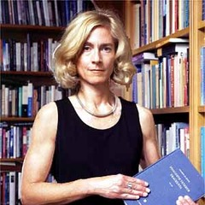
Gertrude Elion Nobel Prize-winning biochemist who developed medications to treat leukemia, malaria, meningitis, herpes, and more
"Don't be afraid of hard work. Nothing worthwhile comes easily. Don't let others discourage you or tell you that you can't do it. In my day I was told women didn't go into chemistry. I saw no reason why we couldn't."
Grace Hopper US Navy admiral and inventor of the first compiler for computer languages
"Humans are allergic to change. They love to say, "We've always done it this way." I try to fight that. That's why I have a clock on my wall that runs counter-clockwise."
Martha C. Nussbaum an American philosopher
Philosophers should be, as Seneca put it, 'lawyers for humanity'. Make what you think and feel count; the examined life has global dimensions.
http://aplus.com/a/female-scientist-quotes?no_monetization=true

