Slide 1
What are we going to do today?
Talk about the types of market research available and why companies invest their time and money into conducting it.
Work through a simple example of market research so you can experience it first-hand.

Slide 2
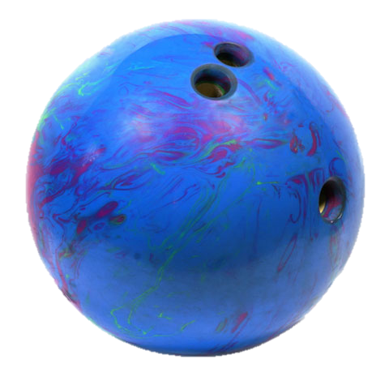
market research
The process of planning, collecting and analyzing data relevant to a marketing decision.
AKA – figuring out what the people want

Slide 3
Let’s Conduct Research!
Text
Kareneutsler155 to 37607
to join the poll

Slide 4
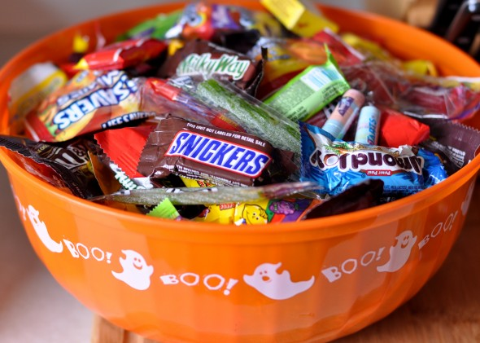
What is your favorite kind of Halloween candy?

Slide 5
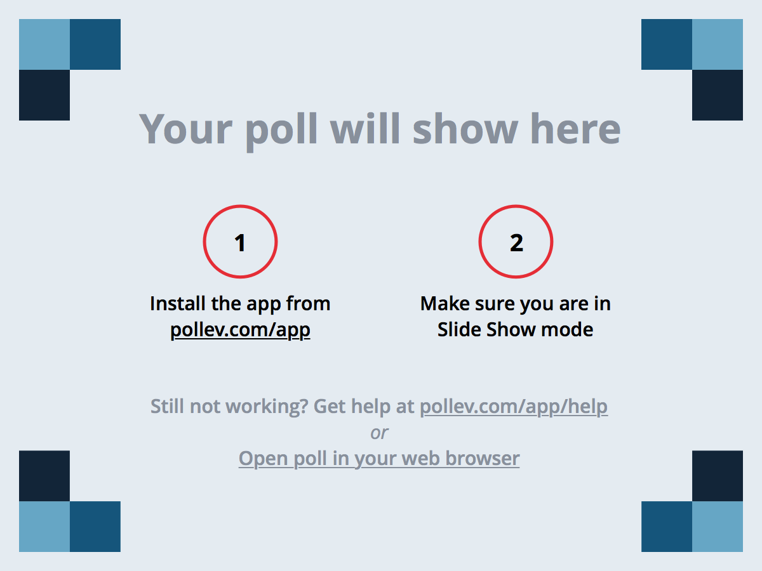
Notes:
Poll Title: Popular Candy https://www.polleverywhere.com/free_text_polls/ZY7lsgI2FsIW42w

Slide 6
How many times a day do you look at your phone?

Slide 7
Notes:
Poll Title: Phone Usage Frequency https://www.polleverywhere.com/multiple_choice_polls/PXqDsLmzD4xUOL3

Slide 8
What are you going to dress up as for Halloween?

Slide 9
Notes:
Poll Title: Halloween Costumes https://www.polleverywhere.com/free_text_polls/5cK5m9gcbtUyMji

Slide 10
Value & Satisfaction

Slide 11
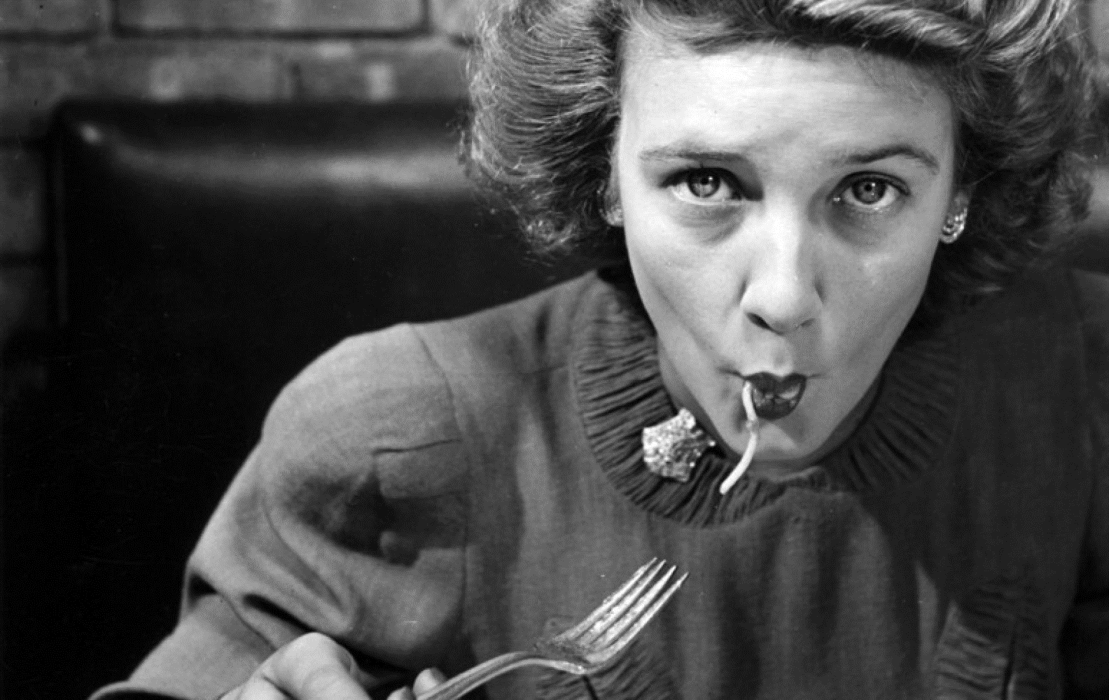
Finding and taking advantage of opportunities in
the marketplace

Slide 12
Marketing Research Problem
Identify the problem/opportunity
Plan the research design & gather secondary data
Specify the sampling procedures
Determining what information is needed and how that information can be obtained efficiently and effectively
Collect Primary Data
Analyze the Data
Prepare and Present the Report
Follow Up

Slide 13
Marketing Research Objective
Identify the problem/opportunity
Plan the research design & gather secondary data
Specify the sampling procedures
The goal statement of the marketing research
Collect Primary Data
Analyze the Data
Prepare and Present the Report
Follow Up

Slide 14
Primary Data
Identify the problem/opportunity
Plan the research design & gather secondary data
Information collected
for the first time;
used for solving the particular problem
under investigation.
Pros & Cons?
Specify the sampling procedures
Collect Primary Data
Analyze the Data
Prepare and Present the Report
Follow Up

Slide 15
Secondary Data
Identify the problem/opportunity
Plan the research design & gather secondary data
Data previously collected for any purpose other than the one at hand
Pros & Cons?
Specify the sampling procedures
Collect Primary Data
Analyze the Data
Prepare and Present the Report
Follow Up

Slide 16
Research Design
Identify the problem/opportunity
Plan the research design & gather secondary data
Specifies which research questions must be answered, how and when the data will be gathered, and how the data will be analyzed. Goal is to collect primary data.
Specify the sampling procedures
Collect Primary Data
Analyze the Data
Prepare and Present the Report
Follow Up

Slide 17
Types of Research
In-home & Executive interviews
Mall intercept interviews
Telephone Interviews
Mail Surveys
Focus Groups
Observation Research
Mystery Shoppers
Ethnographic Research
Virtual Shopping
Experiments

Slide 18
Sample Types
Identify the problem/opportunity
Plan the research design & gather secondary data
Specify the sampling procedures
Random
Convenience
Collect Primary Data
Analyze the Data
Prepare and Present the Report
Follow Up

Slide 19
Identify the problem/opportunity
Plan the research design & gather secondary data
Survey Question:
What would make you more likely to participate in class?
Specify the sampling procedures
Collect Primary Data
Analyze the Data
Prepare and Present
the Report
Follow Up

Slide 20
Notes:
Poll Title: What will incentivize you to participate? https://www.polleverywhere.com/free_text_polls/vhvtIvQDLL9aaSb

Slide 21
Log out of the poll now, please!

Slide 22
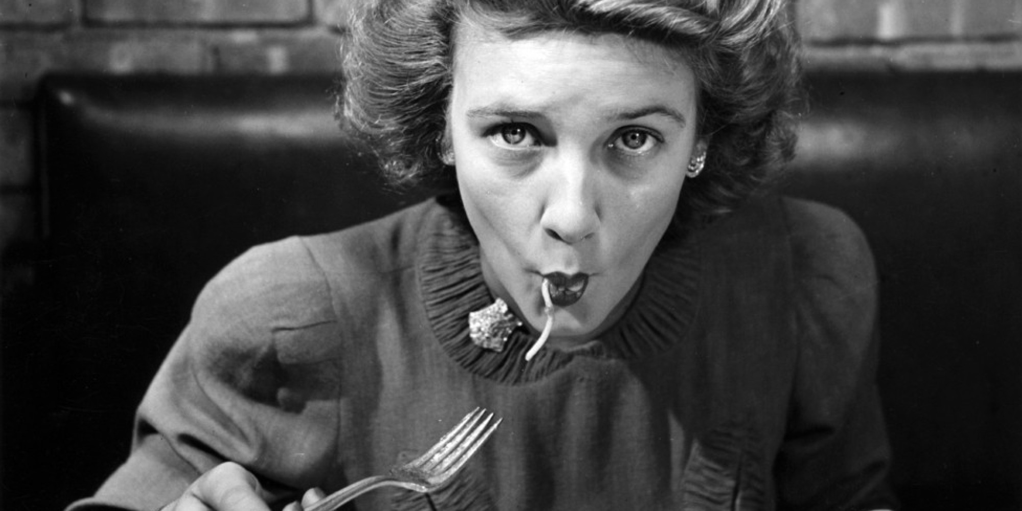
Identify the problem/opportunity
Plan the research design & gather secondary data
Specify the sampling procedures
Collect Primary Data
Analyze the Data
Prepare and Present
the Report
Follow Up

Slide 23
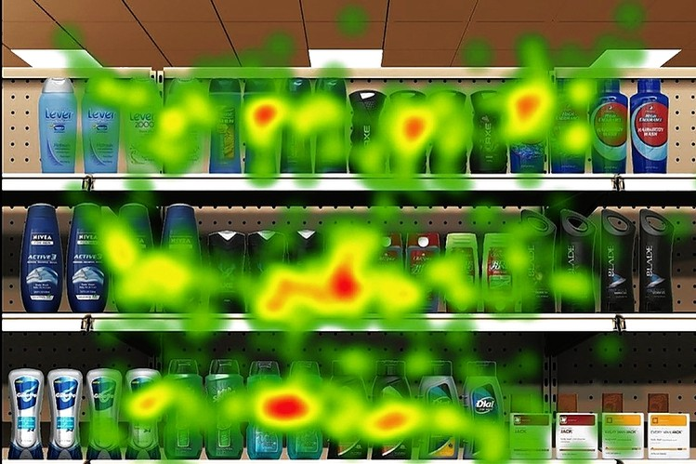
Computer–based Retina Tracking - Unilever

Slide 24
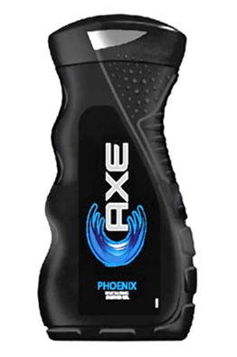
Original curvy packaging for
Axe Body Wash.UNILEVER
Unilever selected this package design after its retina testing. UNILEVER

Slide 25
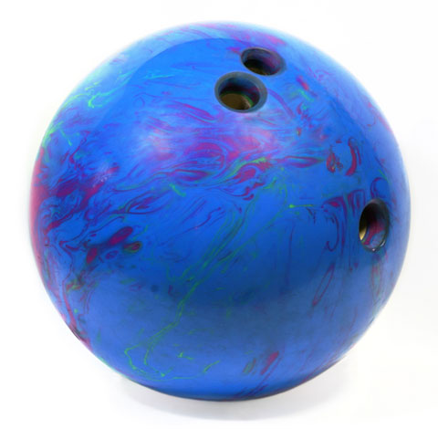
What’s the bowling ball concept of the day?

Slide 26
Questions?

