Slide 1
Welcome to Xavier GROW
(Guided Reflection on Work)
A presentation on how student employees and campus employers benefit from connecting work and academics
Xavier GROW uses and adapts materials created by the Iowa GROW® program with the permission of The University of Iowa.

Slide 2
Agenda
Xavier GROW aims
The Iowa GROW® model
The outcomes of guided reflection on work
Implementing Xavier GROW
Supervisor Resources

Slide 3
The Xavier GROW program fosters meaningful connections between learning in the classroom and learning on the job in order to contribute to student success.

Slide 4
It is based on the proven Iowa GROW® program from the University of Iowa.
GROW = Guided Reflection on Work
GROW is adapted to Xavier with the permission of the University of Iowa.

Slide 5
The Iowa GROW® Model 1 of 3
Iowa GROW® (Guided Reflection on Work) uses brief, structured conversations between student employees and their supervisors to help students connect the skills and knowledge they are gaining in the classroom with the work they are doing, and vice versa. Iowa GROW® is focused on making student employment a "high-impact activity" - one that requires students to reflect on their learning and connect their learning within and beyond the classroom.

Slide 6
The Iowa GROW® Model 2 of 3
Four quick questions
Iowa GROW® conversations are guided by four quick questions:
How is this job fitting in with your academics?
What are you learning here that’s helping you in school?
What are you learning in class that you can apply here at work?
Can you give me a couple of examples of things you’ve learned here that you think you’ll use in your chosen profession?

Slide 7

The Iowa GROW® Model 3 of 3

Slide 8
Iowa Outcomes 1 of 2
How does your campus employment support your success as a student at Iowa?
Typical Iowa student response | Iowa GROW® student responses identified the following skills:
“Earning money” | “Communication skills” “Conflict negotiation” “Ability to work effectively across differences” “Problem solving” “Time management”

Slide 9
Iowa Outcomes 2 of 2
Highlights of Iowa’s findings:
Iowa GROW® participants were more likely to agree/strongly agree that their job was helping them attain our outcomes of student employment.
Iowa GROW® participants were more likely to report that their student employment helped them gain work and career related skills, form relationships, improve their time management skills, and enhance their communication skills.
Non-GROW participants were more likely to report that the major benefit of being a student employee was simply earning money.
Iowa GROW® participants were more likely to report that they gain problem solving abilities, communication skills, and general work habits as a student employee

Slide 10
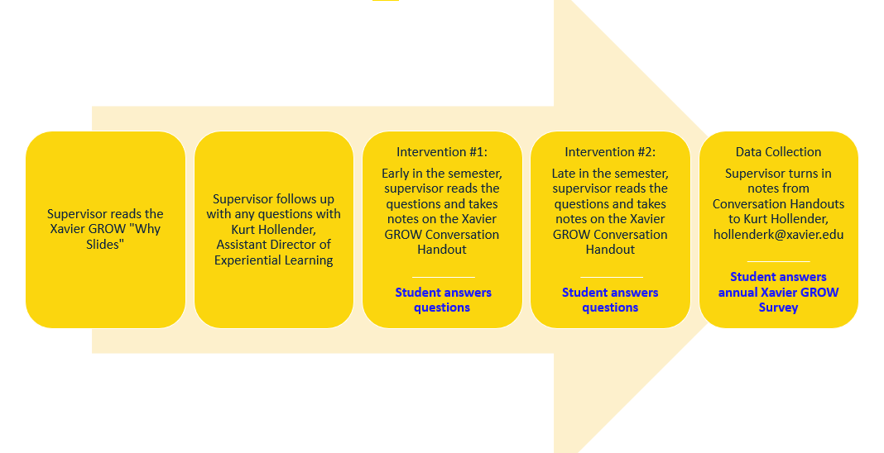
Xavier GROW Timeline

Slide 11
For questions or more information, contact Kurt Hollender at hollenderk@xavier.edu or the Student Employment Office at (513) 745-4880 and claryv@xavier.edu.
Questions?
Iowa GROW materials available here:
https://studentlife.uiowa.edu/initiatives/iowa-grow

Slide 12
Thank you to the University of Iowa for permission to use and adapt Iowa GROW® materials.

Slide 13
Supervisors are Educators

