Slide 1

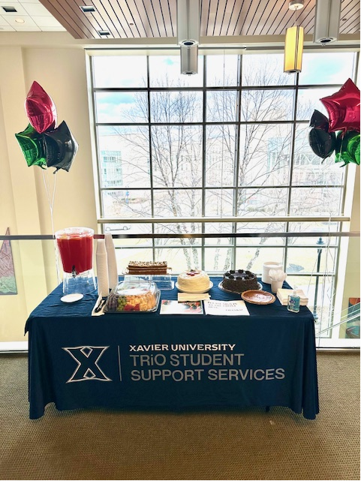
TRiO Scholars
Student Support Services
Fall 2026 Orientation
“We Coach Students to Success!”

Slide 2
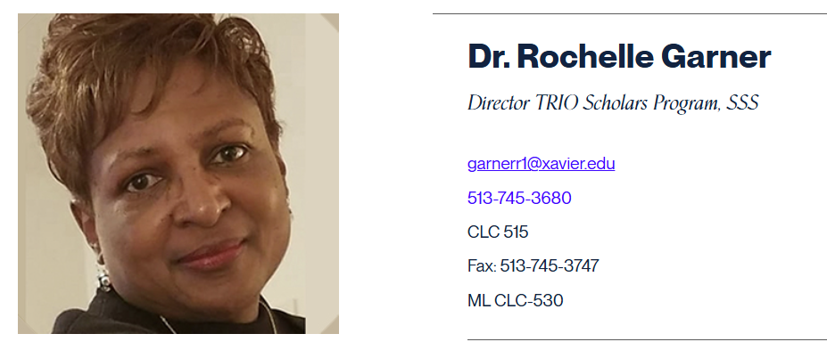
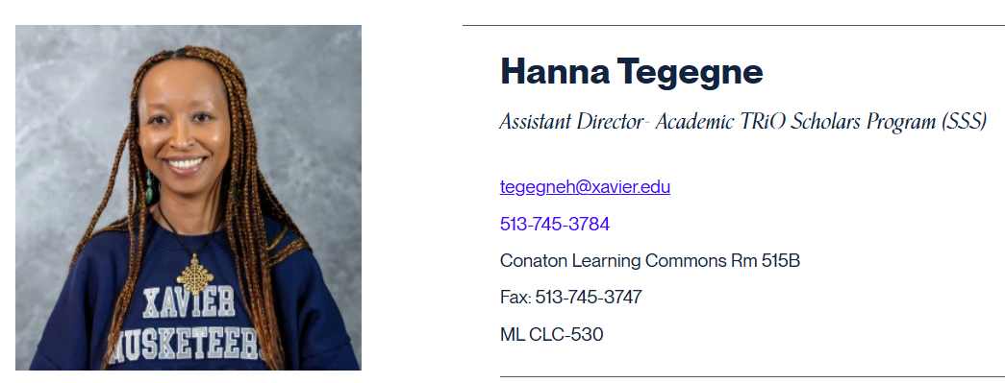
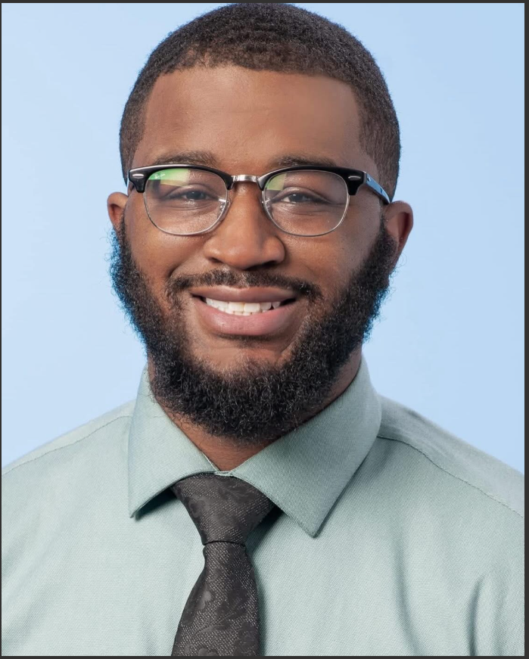
TRiO Scholars
Student Support Services
WHAT IS TRiO?
TRiO is a Student Support Service program designed to empower students to achieve their personal, educational, and career goals and thrive in the college environment.
OUR MISSION
TRiO, Student Support Services is committed to fostering a student-centered educational environment that helps program participants persist and graduate with a bachelor’s degree. The program provides academic, professional, financial, and personal support that enables students to navigate through college. The services are holistic and developmental, addressing the expressed educational needs of each student.

Slide 3

Our Office is a Fun Community Space
You are welcome to come in anytime
We provide:
--delicious snacks
--school supplies
--laptops and graphing calculators for checkout
Our staff is helpful and passionate about serving students

Slide 4


Monday-Wednesday 8:30-6:00 p.m.
Thursday-Friday 8:30-5:00 p.m.
Saturday: TBD
  Phone: 513-745-3758
  E-mail, text, or call your individual TRiO advisors
Email, text, or call your individual TRiO advisors

Slide 5

3 Advisor Meetings, 1 Faculty Meeting (Different for Probation students)
Attend 4 College Success Seminars (In-Person/Online, if you need to make up a session)
Study Table Hours –Depends on term GPA. All new students=12 hrs./ term
Community Engagement & Cultural Opportunities
Tutoring/Supplemental Instruction- Academic Support Service, CLC 5th Floor

Slide 6


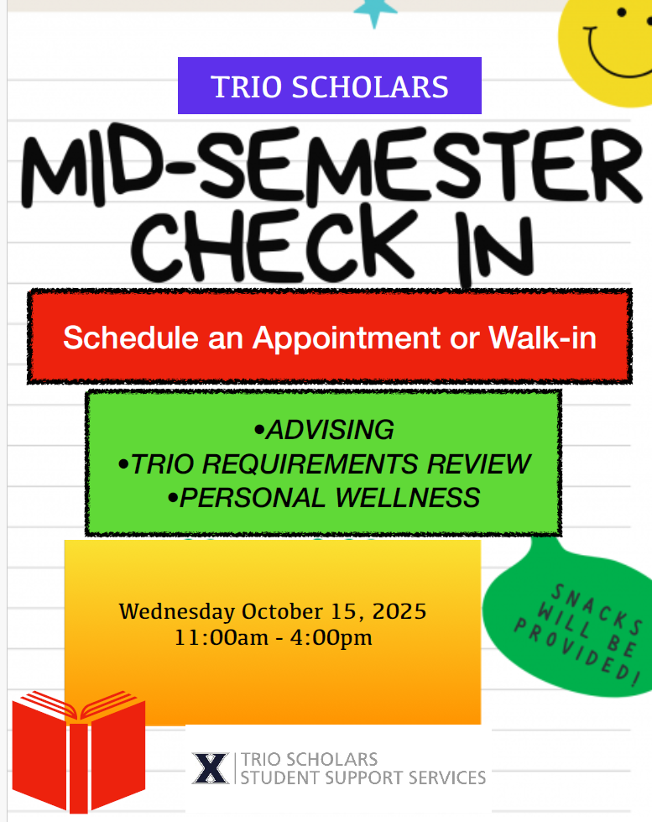




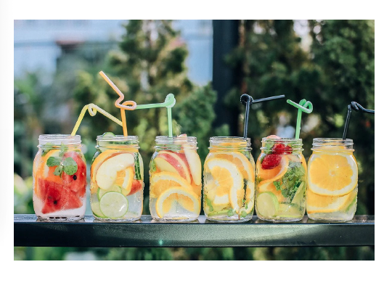

Community Engagement Opportunities

Slide 7








Slide 8

New TRiO Scholars- Schedule your first appointment to meet with your TRiO advisor/success coach to complete paperwork, etc. Sign up after orientation and/or call the office to schedule your appointment.
First Advising Appointment- All TRiO Scholars need to schedule their first appointment to meet with their advisors before Friday, September 25th.
Academic Planners- Please stop by the office to pick one up after you complete your first advising meeting.
School Supplies- Notebooks, Pencils, Pens, Highlighters, Notecards, etc. are available in the TRiO Scholars SSS office.

Slide 9

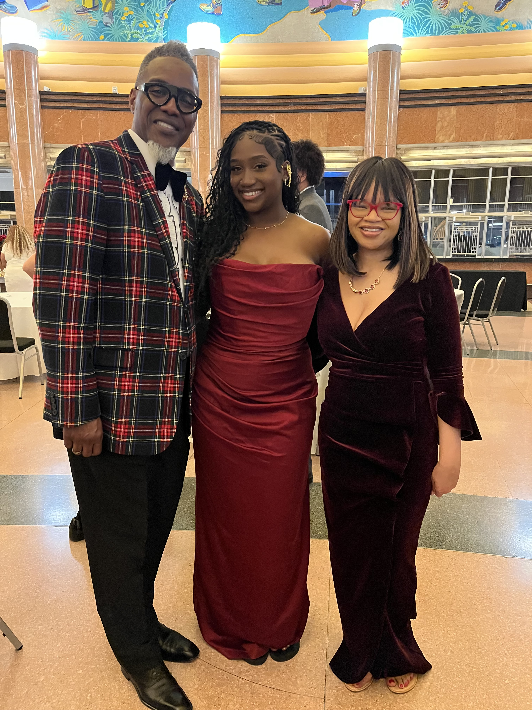

Slide 10
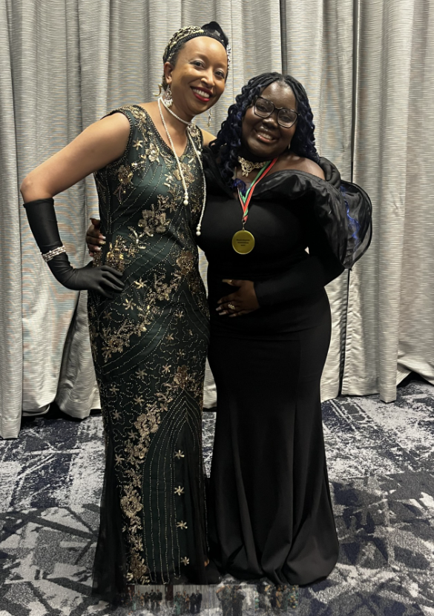
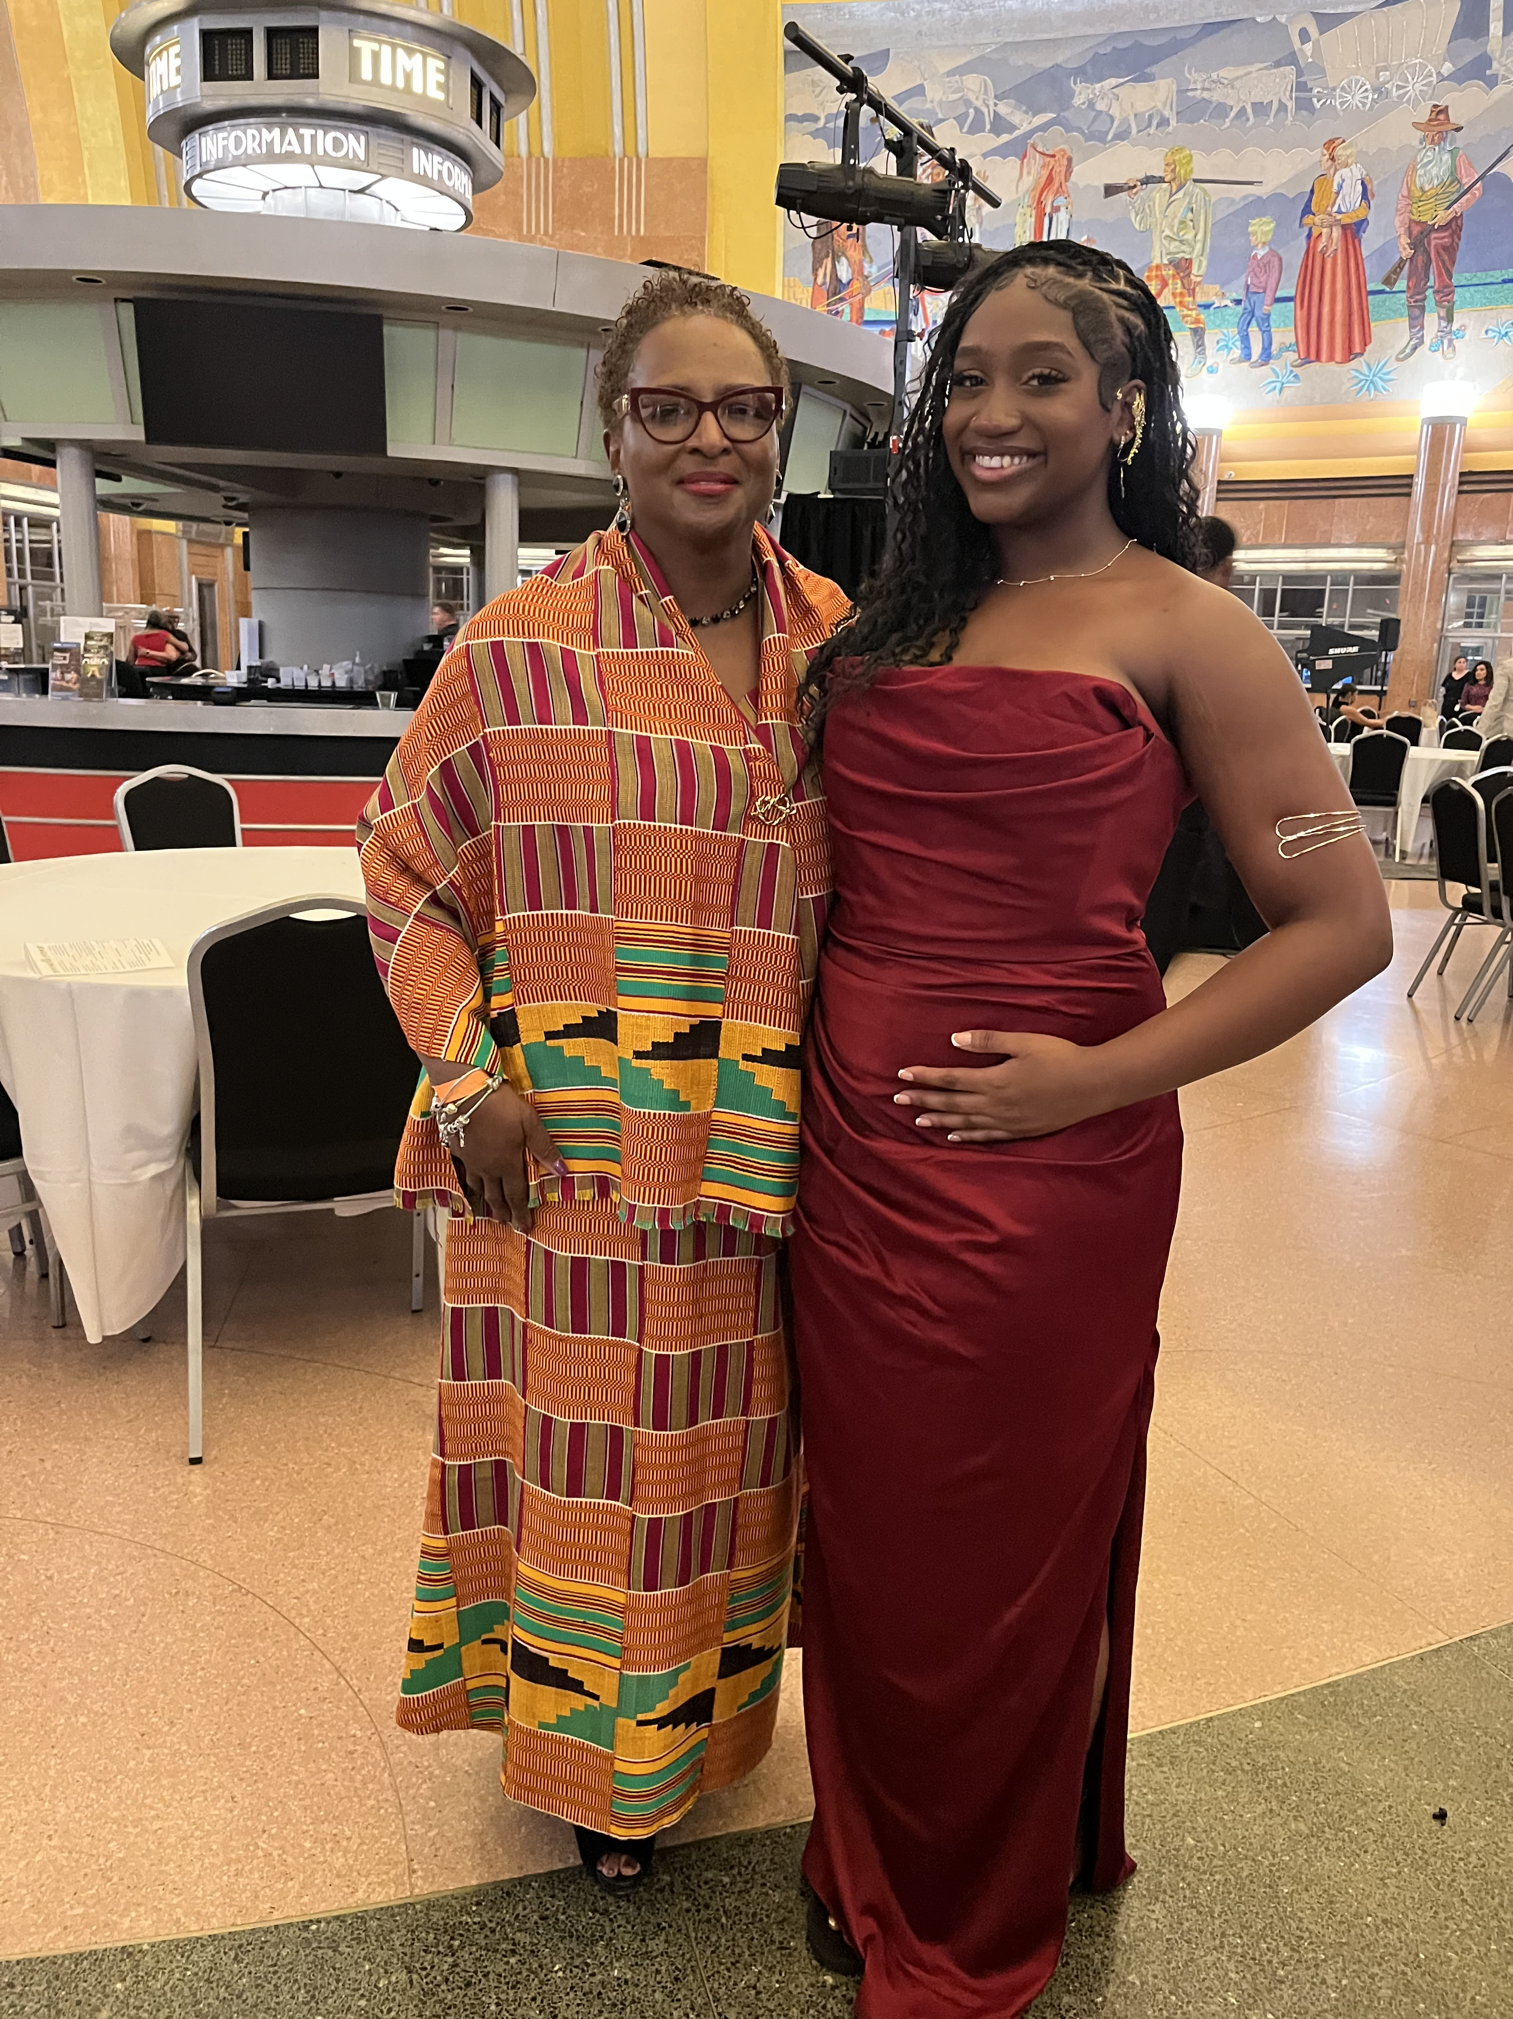
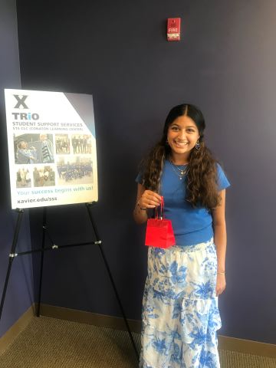
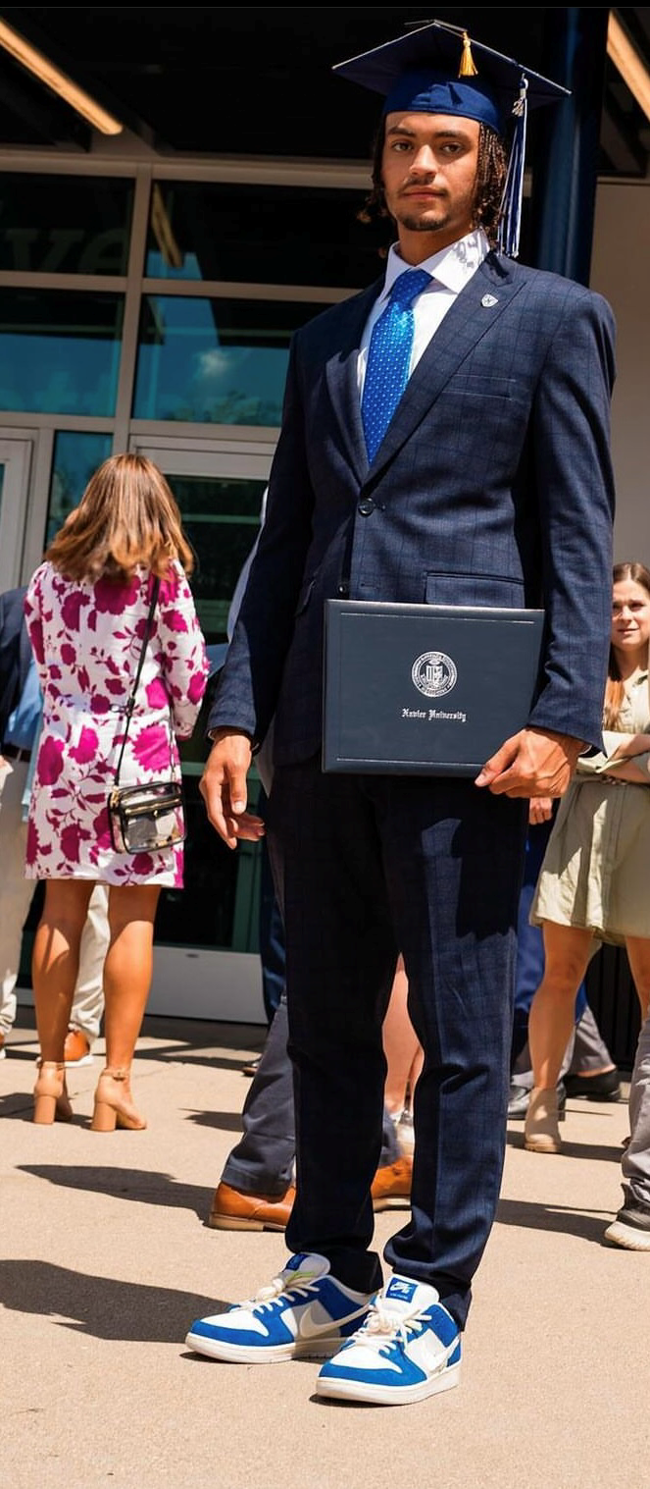

Slide 11
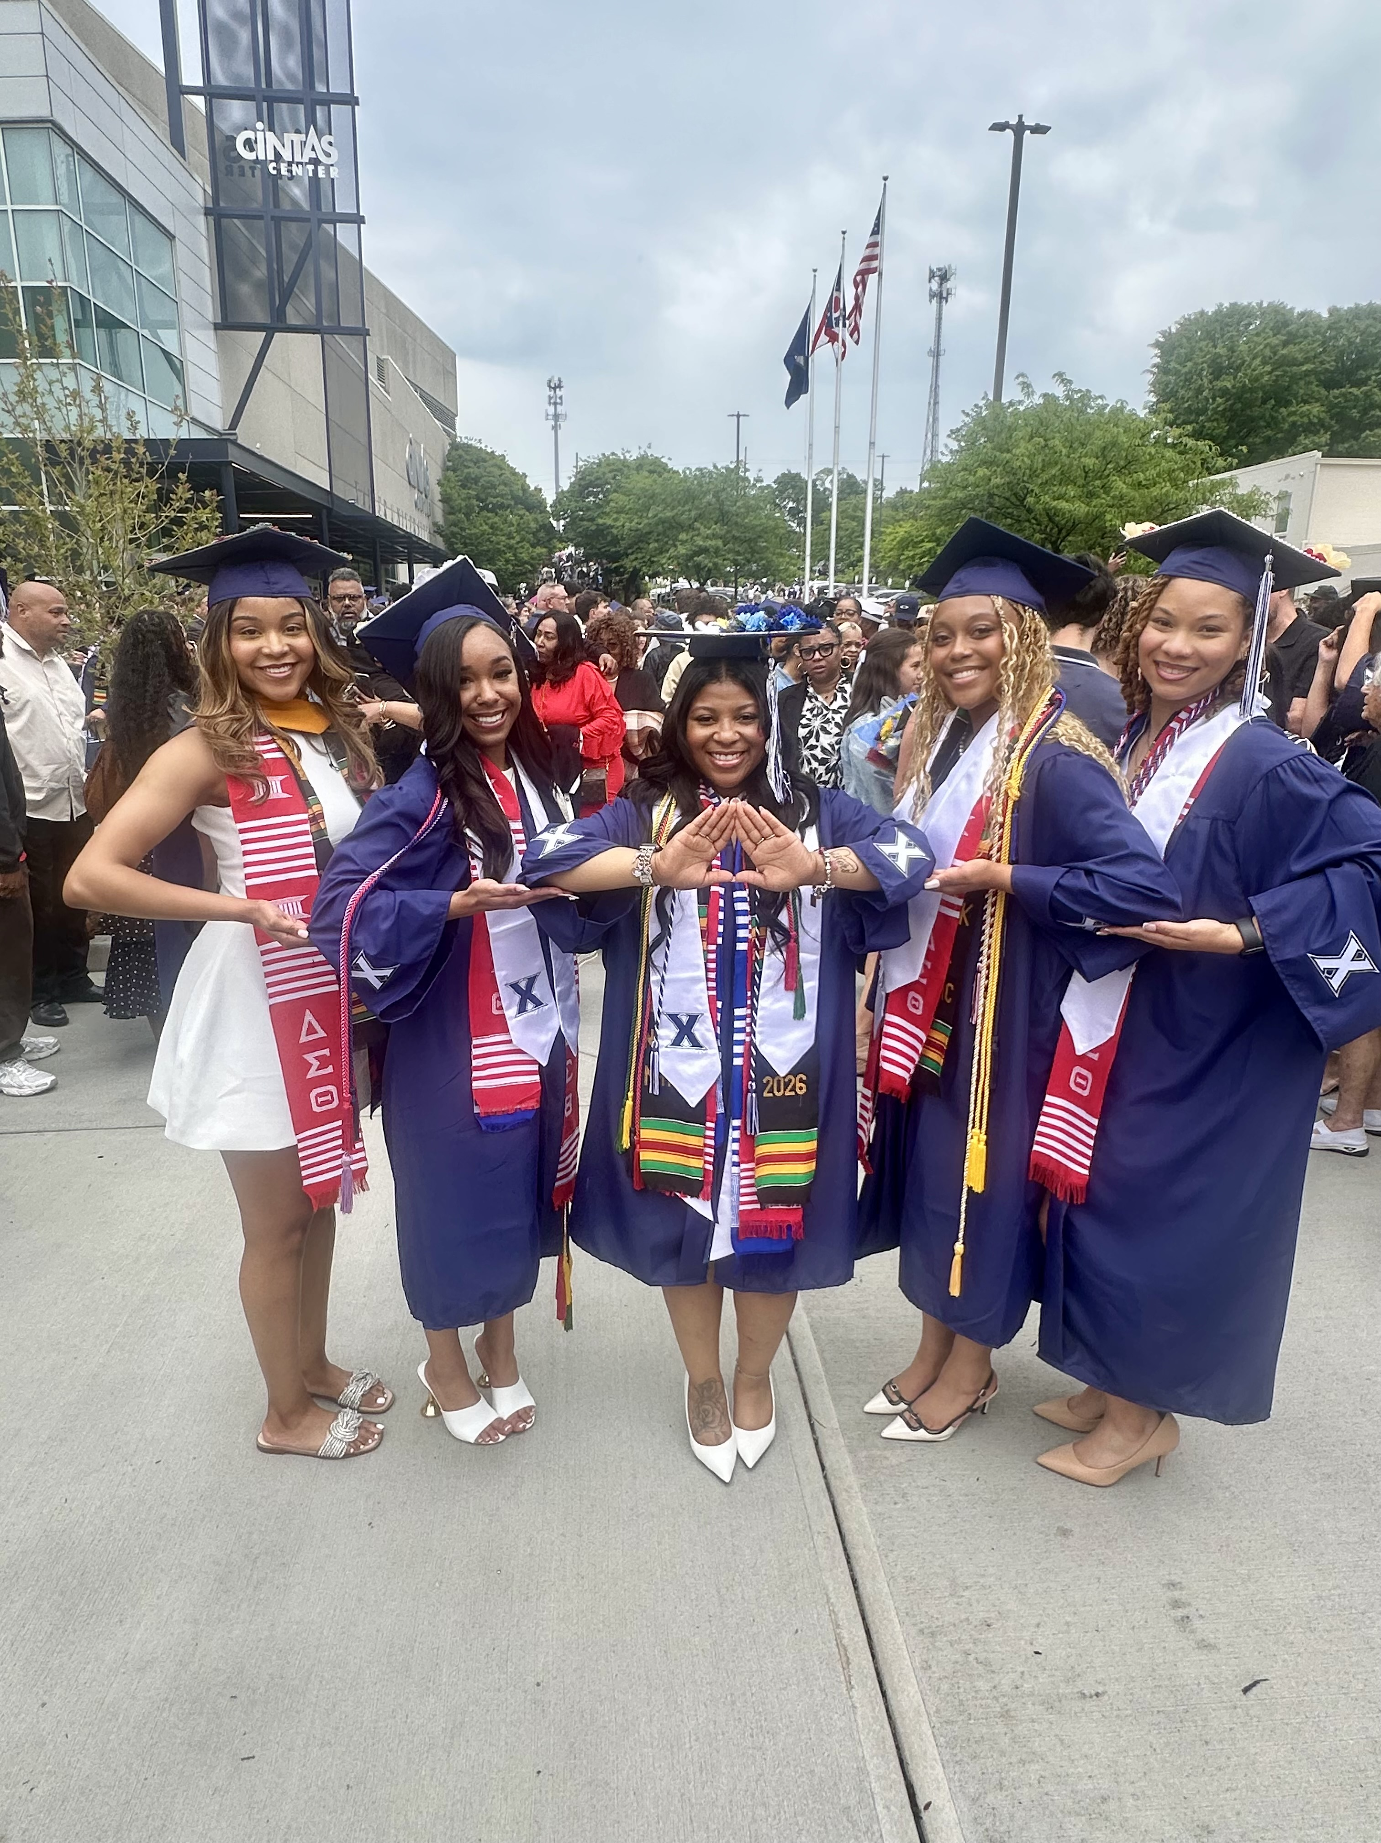
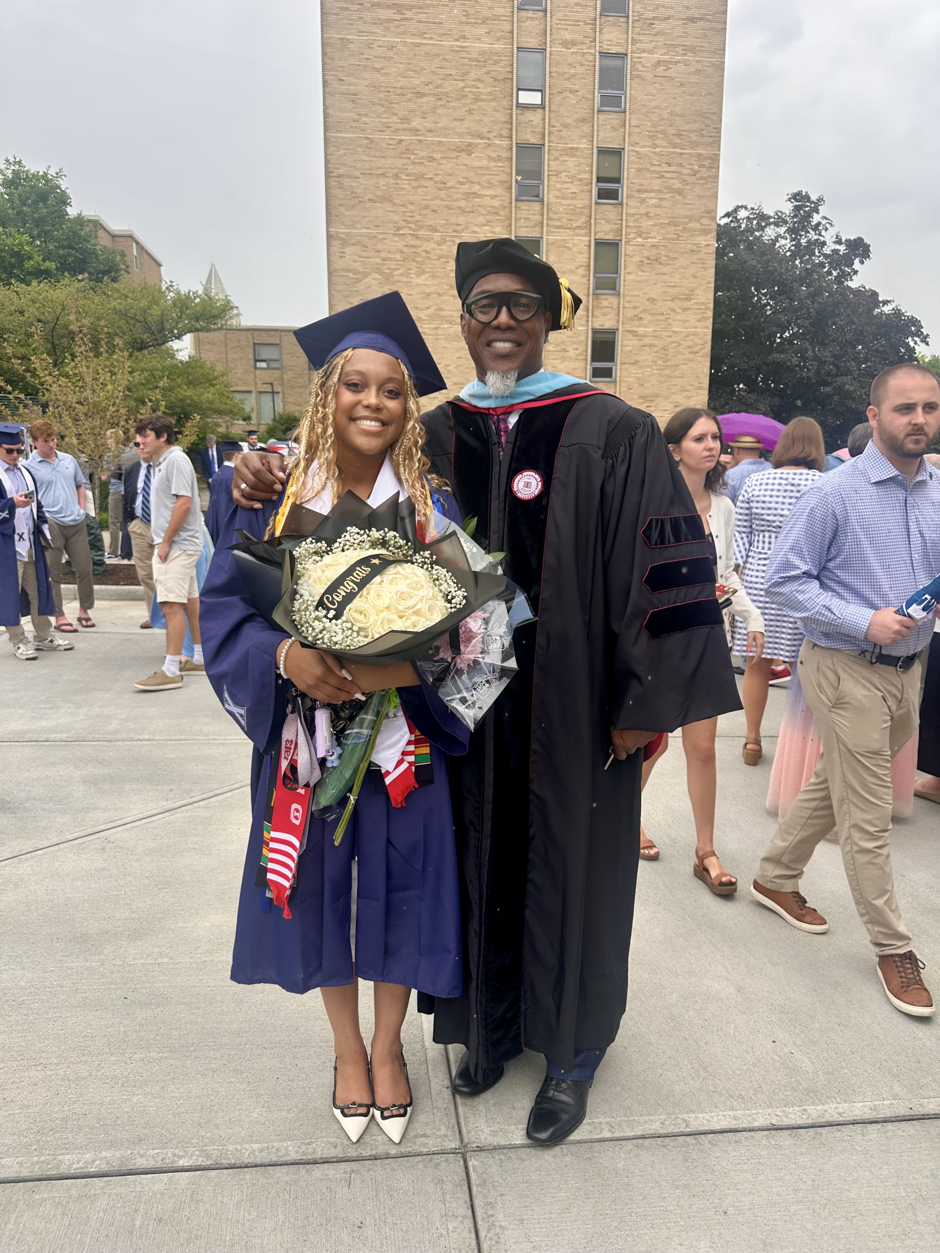

Slide 12
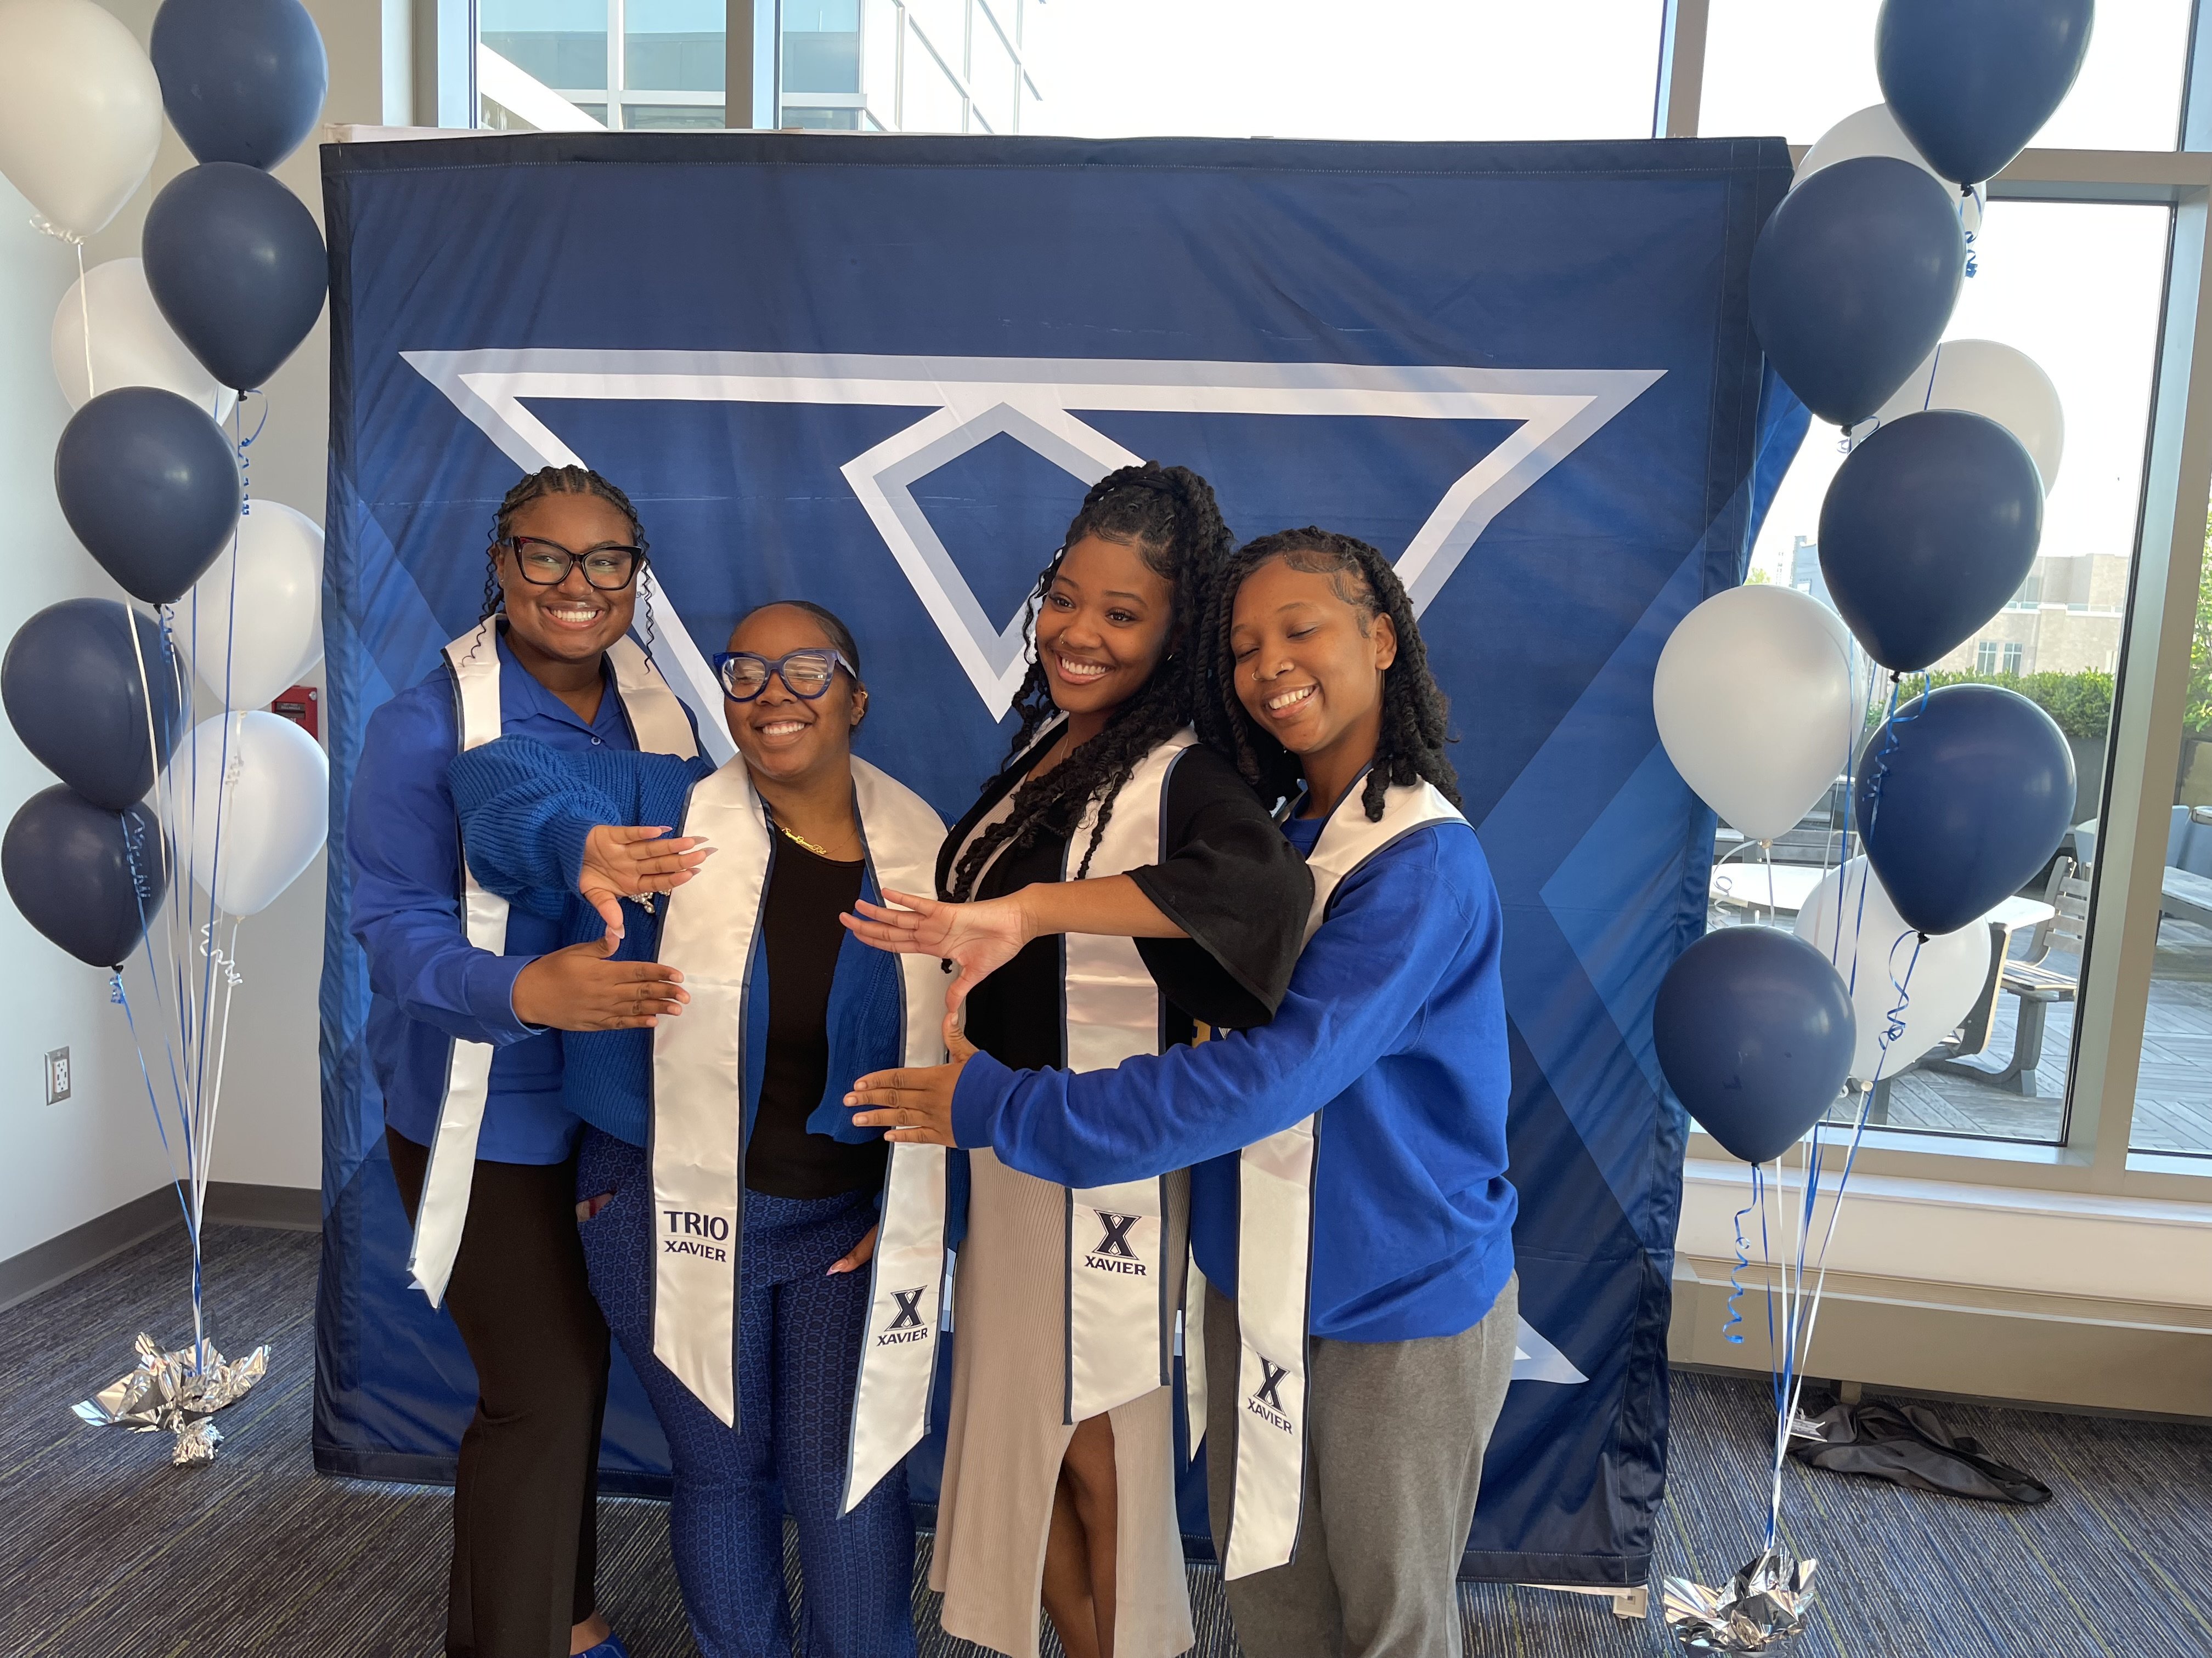
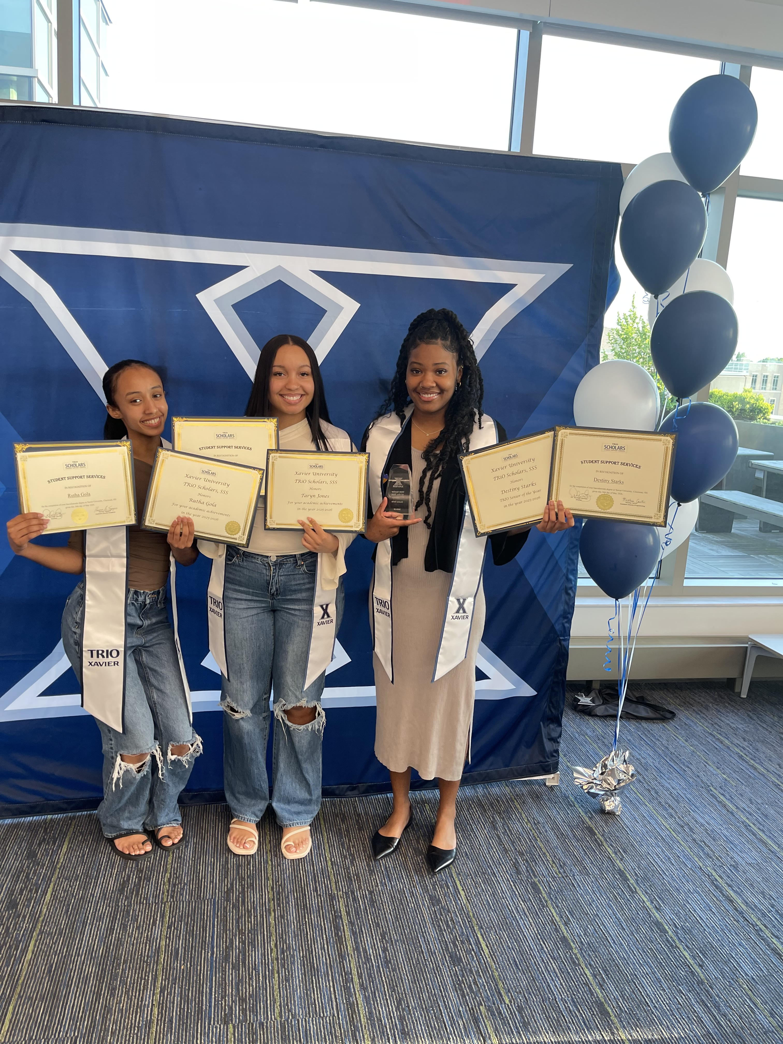

Slide 13


TRIO Scholars
“We Coach Students to Success!”

Slide 14
TRIO SCHOLARS!
Orientation Presentation Agreement
In order to receive credit for attending the Virtual Orientation Presentation, please click the link provided for signature.
https://www.xavier.edu/sss/forms/orientation-presentation-agreement

