Slide 1

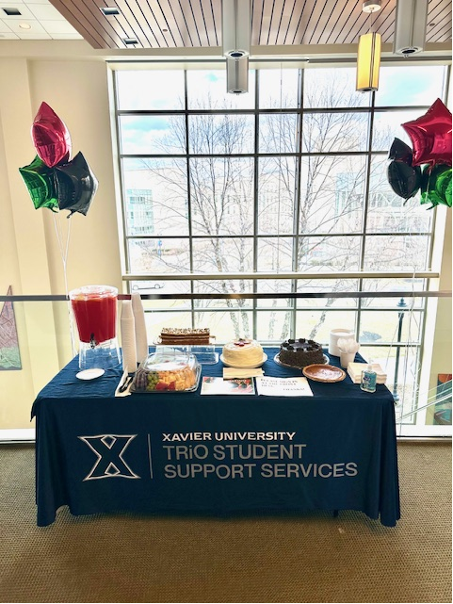
TRiO Scholars
Student Support Services
Fall 2025and Spring 2026 Orientation
“We Coach Students to Success!”

Slide 2
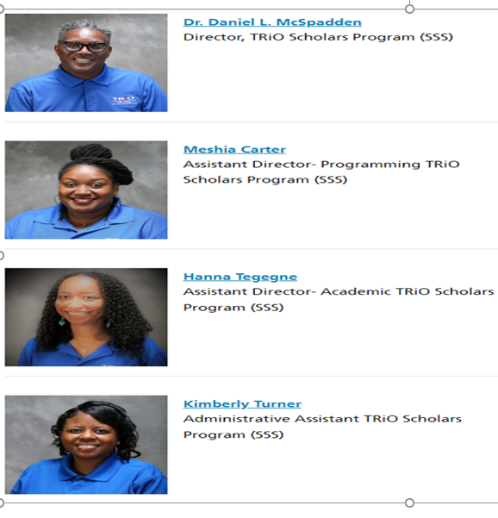
TRiO Scholars
Student Support Services
WHAT IS TRiO?
TRiO is a Student Support Service program designed to empower students to achieve their personal, career, and educational goals and thrive in the college environment.
OUR MISSION
TRiO, Student Support Services is committed to fostering a student-centered educational environment that helps program participants persist and graduate with a bachelor’s degree. The program provides academic, professional, financial, and personal support that enables students to navigate through college. The services are holistic and developmental, addressing the expressed educational needs of each student.

Slide 3

Our Office is a Fun Community Space.
You are welcome to come in anytime
We have delicious snacks
We have school supplies
We have laptops for checkout
We have a helpful and passionate staff

Slide 4

Monday-Wednesday 8:30-6:00 p.m.
Tuesday-Friday 8:30-5:00 p.m.
  Saturday: TBD Monday-Wednesday 8:30-6:00 p.m.
  Tuesday-Friday 8:30-5:00 p.m.
  Saturday: TBD
  Phone: 513-745-3758
  Email: turnerk13@xavier.edu
  E-mail, text, or call your individual TRiO advisors
Phone: 513-745-3758
Email: turnerk13@xavier.edu
E-mail, text, or call your individual TRiO advisors

Slide 5

3 Advisor Meetings, 1 Faculty Meeting (Different for Probation students)
Attend 4 College Success Seminars (In-Person/Online)
Study Table Hours –Depends on term GPA. All new students=12 hrs./ term
Community Engagement & Cultural Opportunities
Tutoring/Supplemental Instruction- Academic Support Service, CLC 5th Floor, and Tutor.com

Slide 6


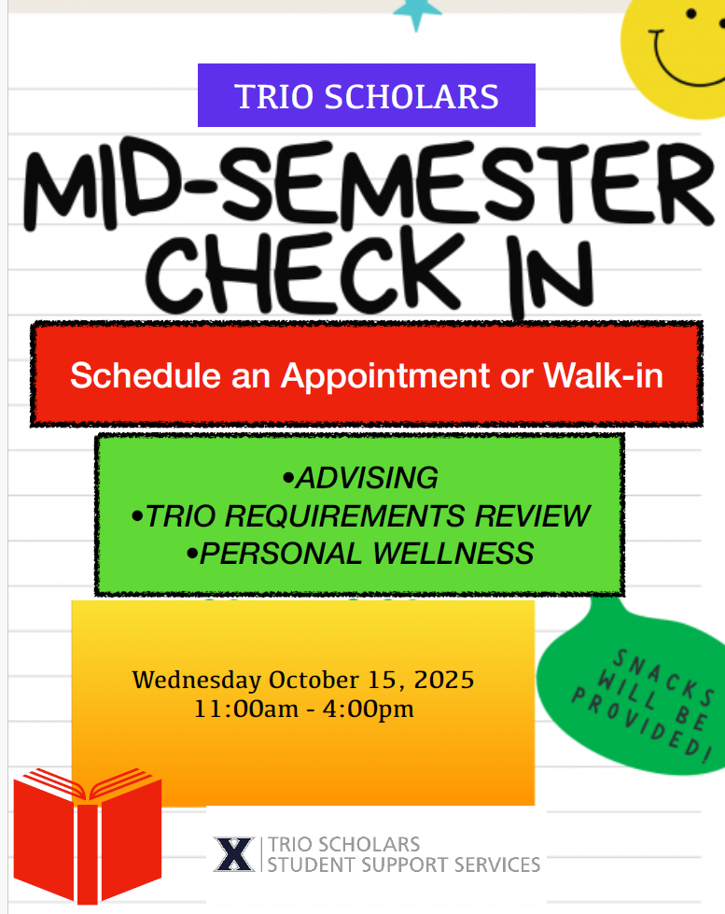




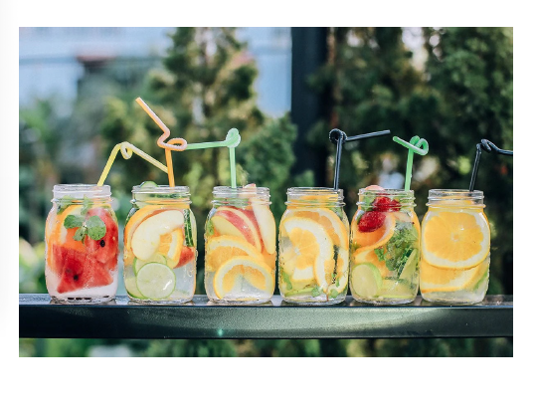
Community Engagement Opportunities

Slide 7

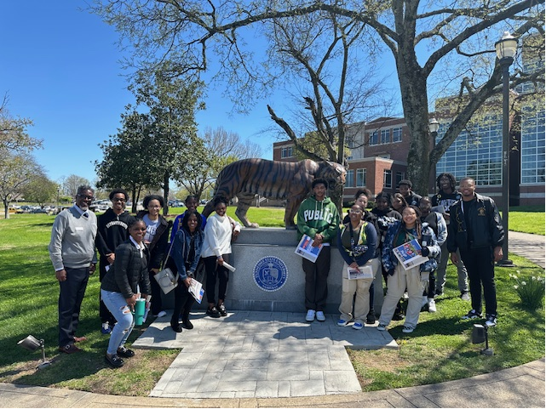
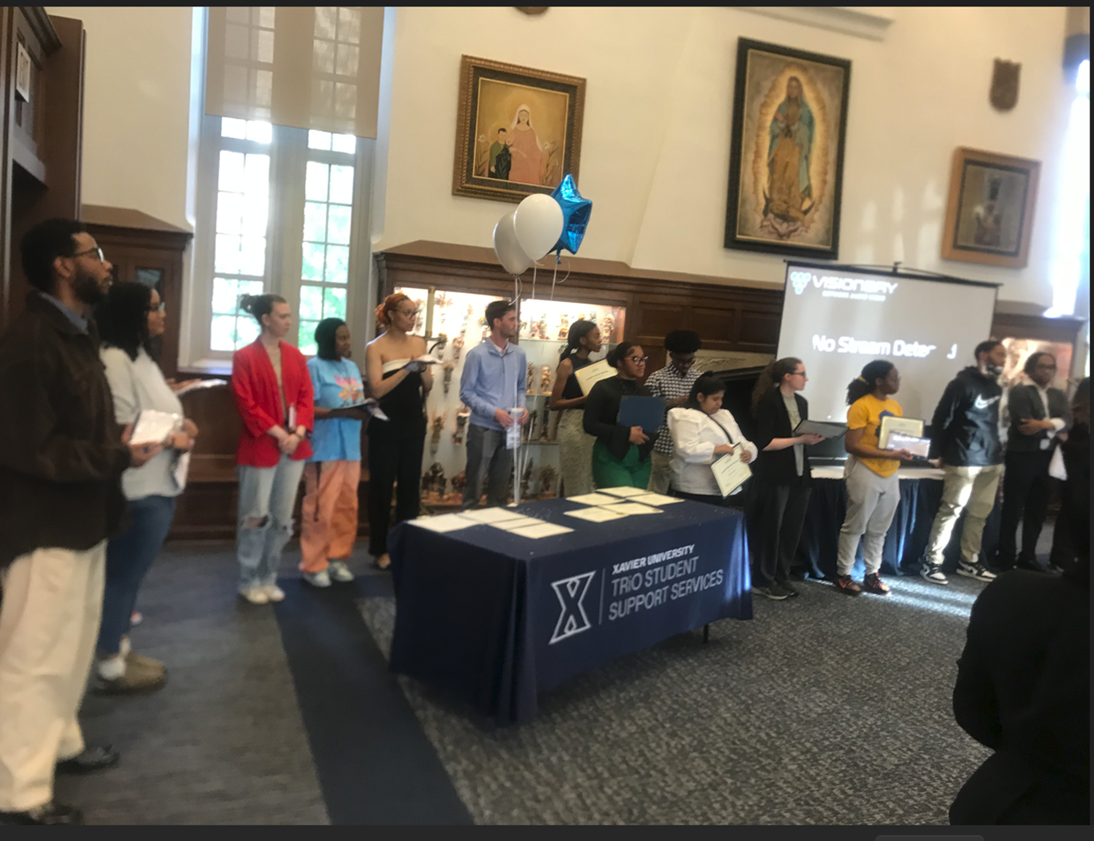

Slide 8
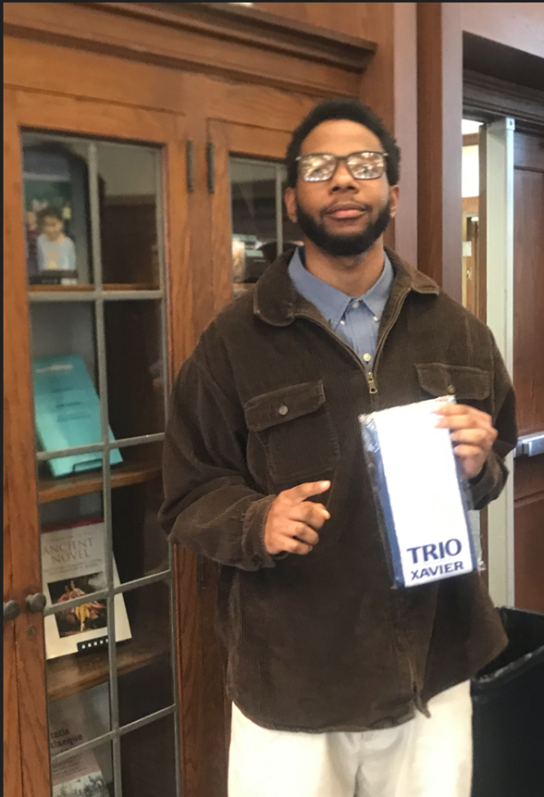
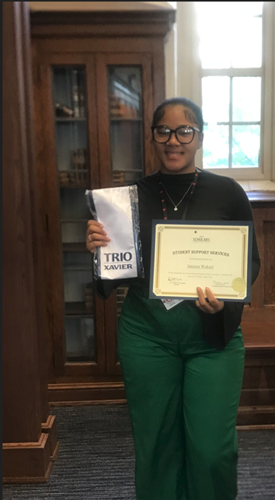
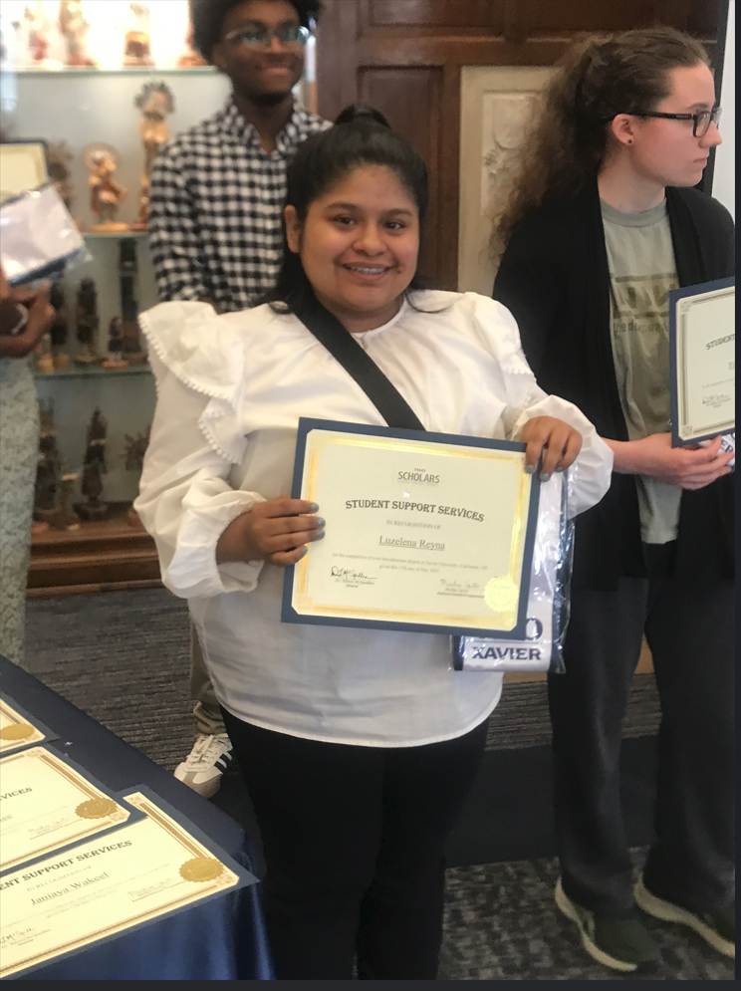
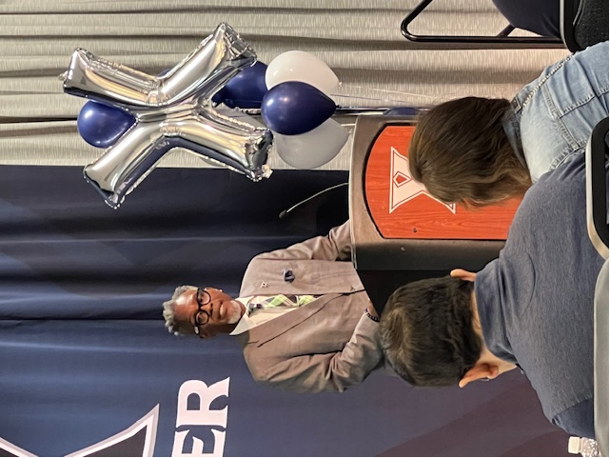
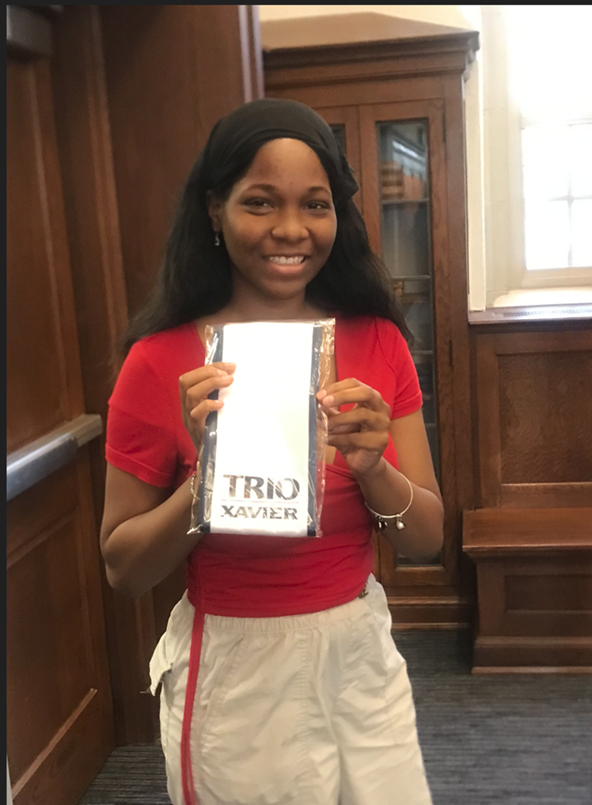

Slide 9

New TRiO Scholars- Schedule your first appointment to meet with your TRiO advisor/success coach to complete paperwork, etc. Sign up after orientation and/or call the office to schedule your appointment.
First Advising Appointment- All TRiO Scholars need to schedule their first appointment to meet with their advisors before Friday, September 26th.
Academic Planners- Please stop by the office to pick one up.
School Supplies- Notebooks, Pencils, Pens, Highlighters, Notecards, etc. available in the TRiO Scholars SSS office.

Slide 10
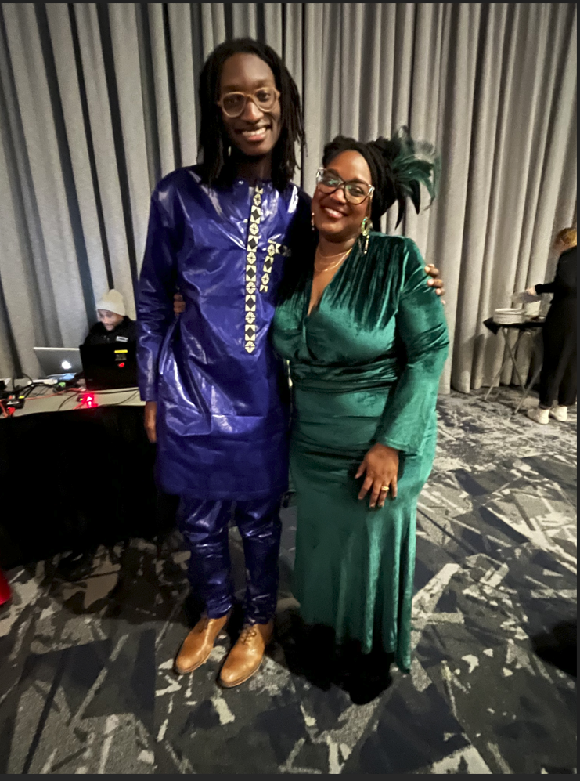
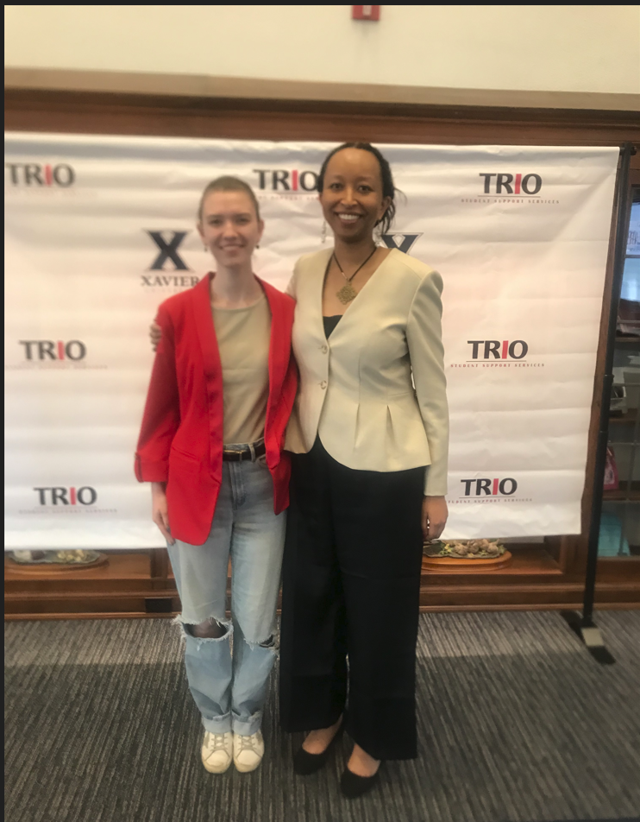


Slide 11



Slide 12
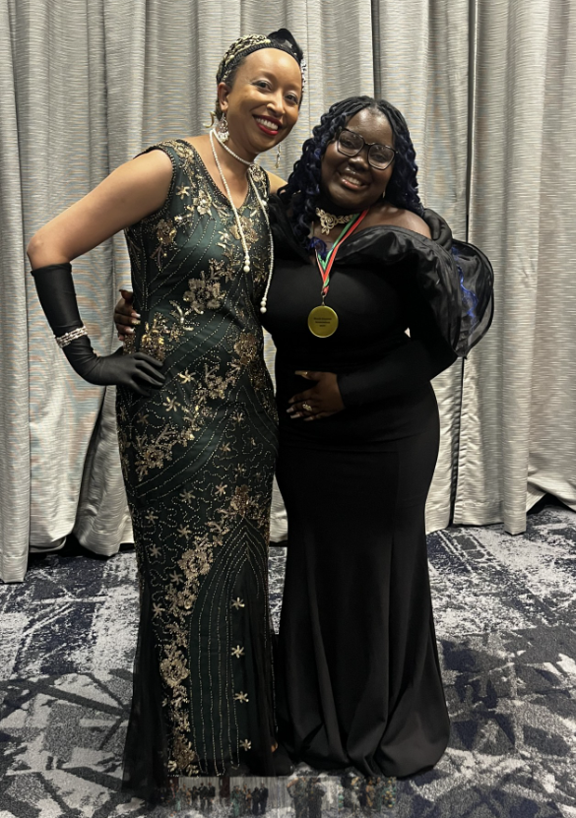


Slide 13
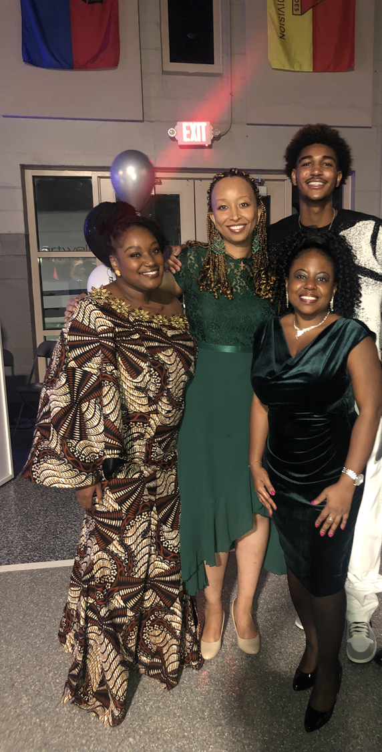
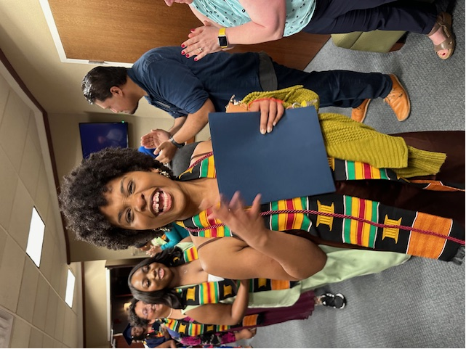

Slide 14
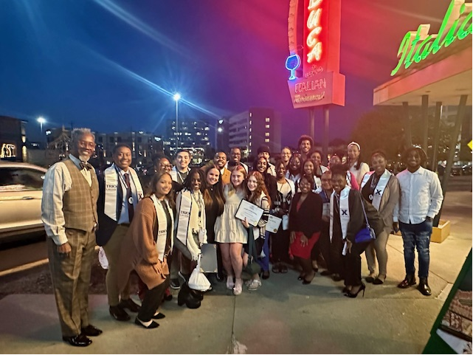

Slide 15
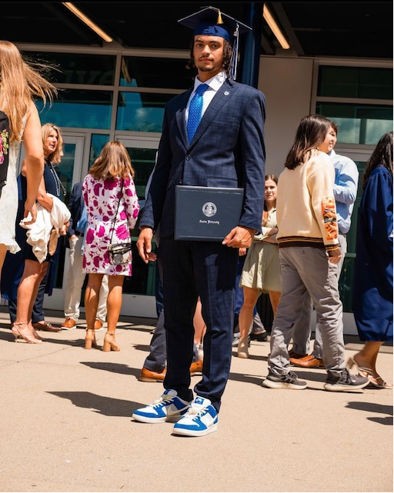

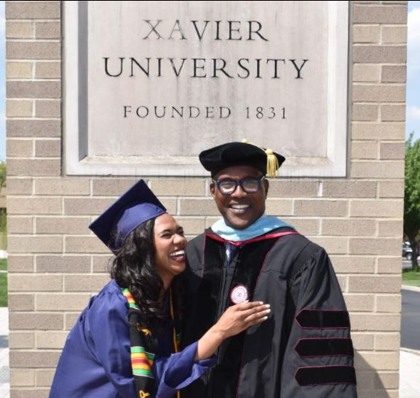
MUCH SUCCESS THIS SEMESTER!
TRIO Scholars
“We Coach Students to Success!”

Slide 16
TRIO SCHOLARS!
Orientation Presentation Agreement
In order to receive credit for attending the Virtual Orientation Presentation please click the link provided for signature.

