Slide 1
AFMIX X CAPSTONE PROJECT
Xavier Montessori Dementia Program
Kathleen Farfsing

Slide 2
Jesuit Values
Using these values to
guide our work.
Incorporating these values
into our work.
Montessori Dementia Mission Statement
To improve the quality of life for all people living with Alzheimer’s and other neurocognitive disorders through caregiver training, developing engaging activities, and designing environments based on Montessori methods that support dignity, promote independence, and contribute to a life of meaning and purpose.

Slide 3
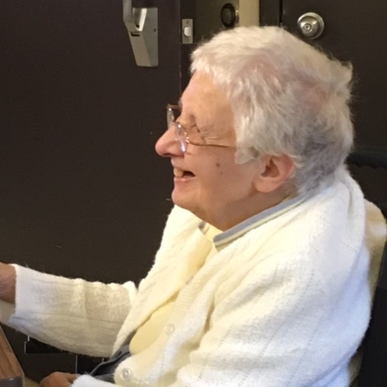
Magis
Supporting people in cognitive decline, helping them reach their full potential, giving caregivers the tools to achieve this goal.

Slide 4
is a Montessori term describing the classroom, home, or any place that helps the individual reach their full potential
THE PREPARED ENVIRONMENT
Kitwood
Pioneer in the
Field of Dementia Care
The experience of dementia will largely be determined by the physical and social environment
(Dementia Reconsidered)
Montessori
Pioneer in the
Field of Education
“The child can only develop fully by means of experience in his environment.”
(The Absorbent Mind)
Notes:
11

Slide 5
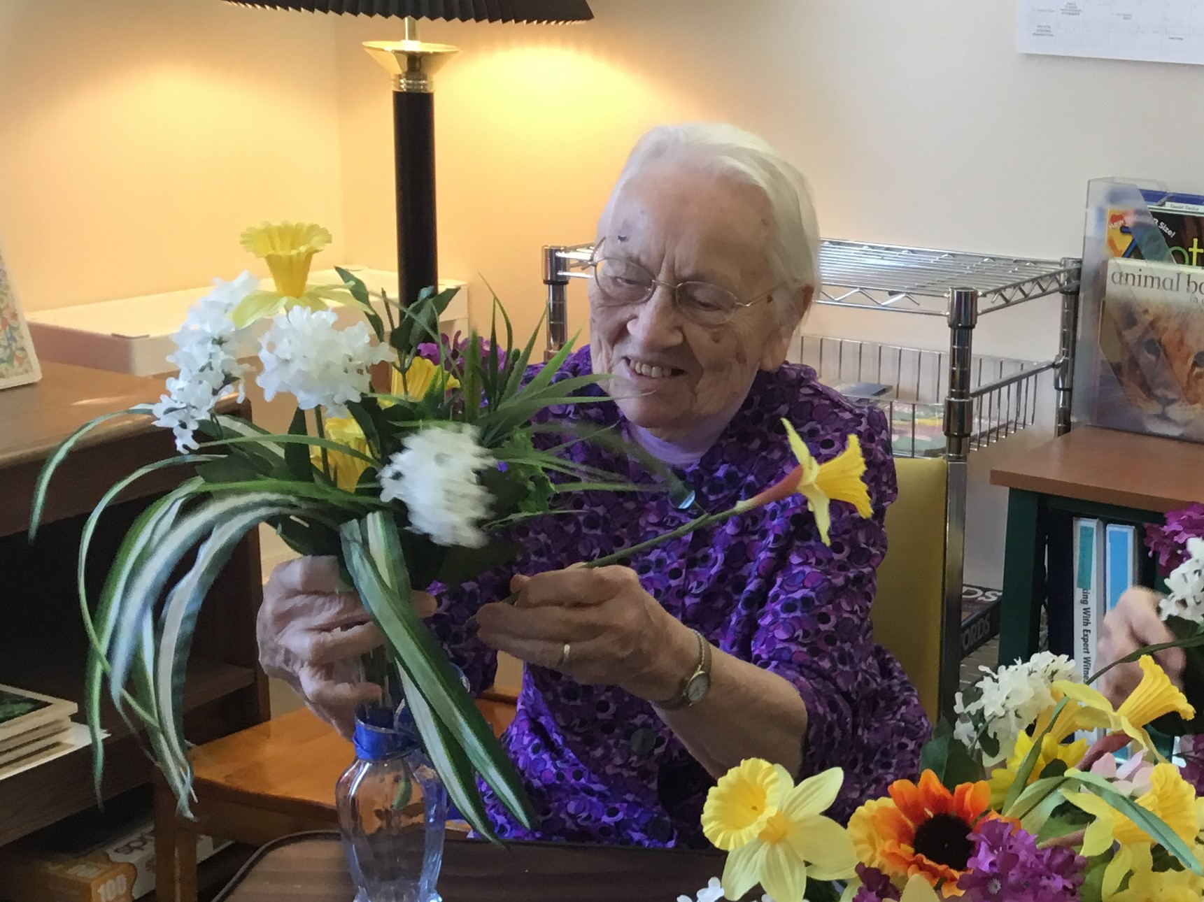
Women & Men For & With Others
The Montessori approach, once used only for children,
can help the often misunderstood and marginalized-
Elders and people with dementia.

Slide 6
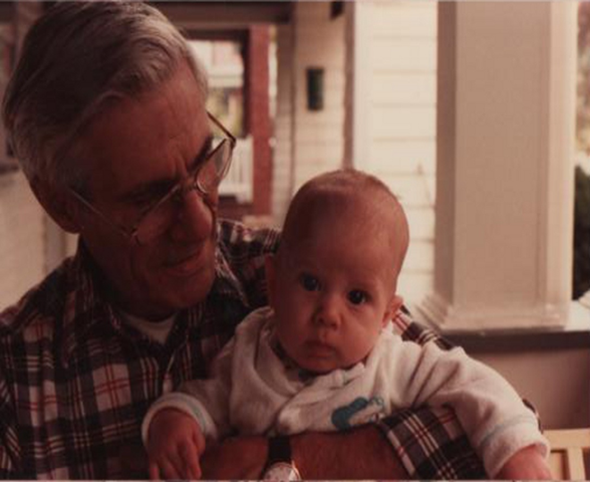
Cura Personalis
“Care for the individual person.”
From cradle to grave-
Respect the person, recognize their potential.

Slide 7
Unity of Heart, Mind, & Soul
Responding to our fundamental human needs
(physical, spiritual, emotional, cognitive)
A human being would certainly not grow to be seventy or eighty years old if this longevity had no meaning for the species. The afternoon of human life must also have a significance of its own and cannot be merely a pitiful appendage to life’s morning.”
~ Carl Jung

Slide 8
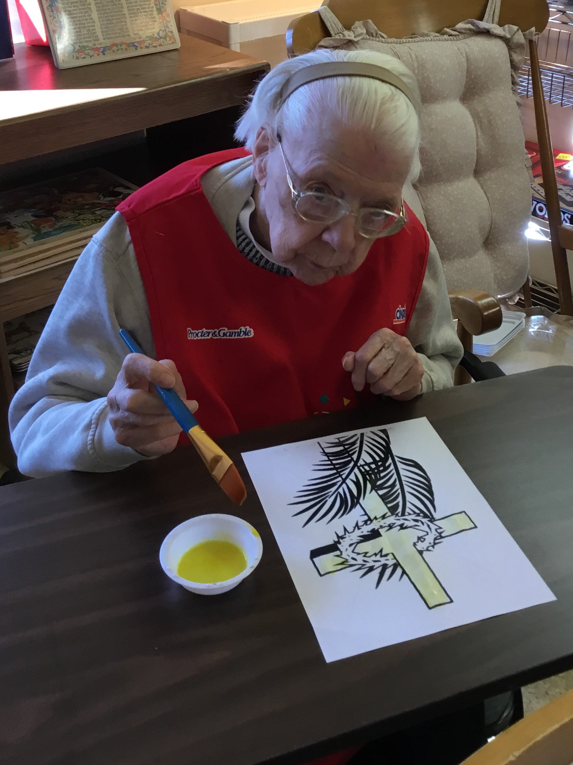
Ad Majorem Dei Gloriam
For the Greater Glory of God
Allowing HIM to lead,
following HIS path.
We never walk alone!

Slide 9
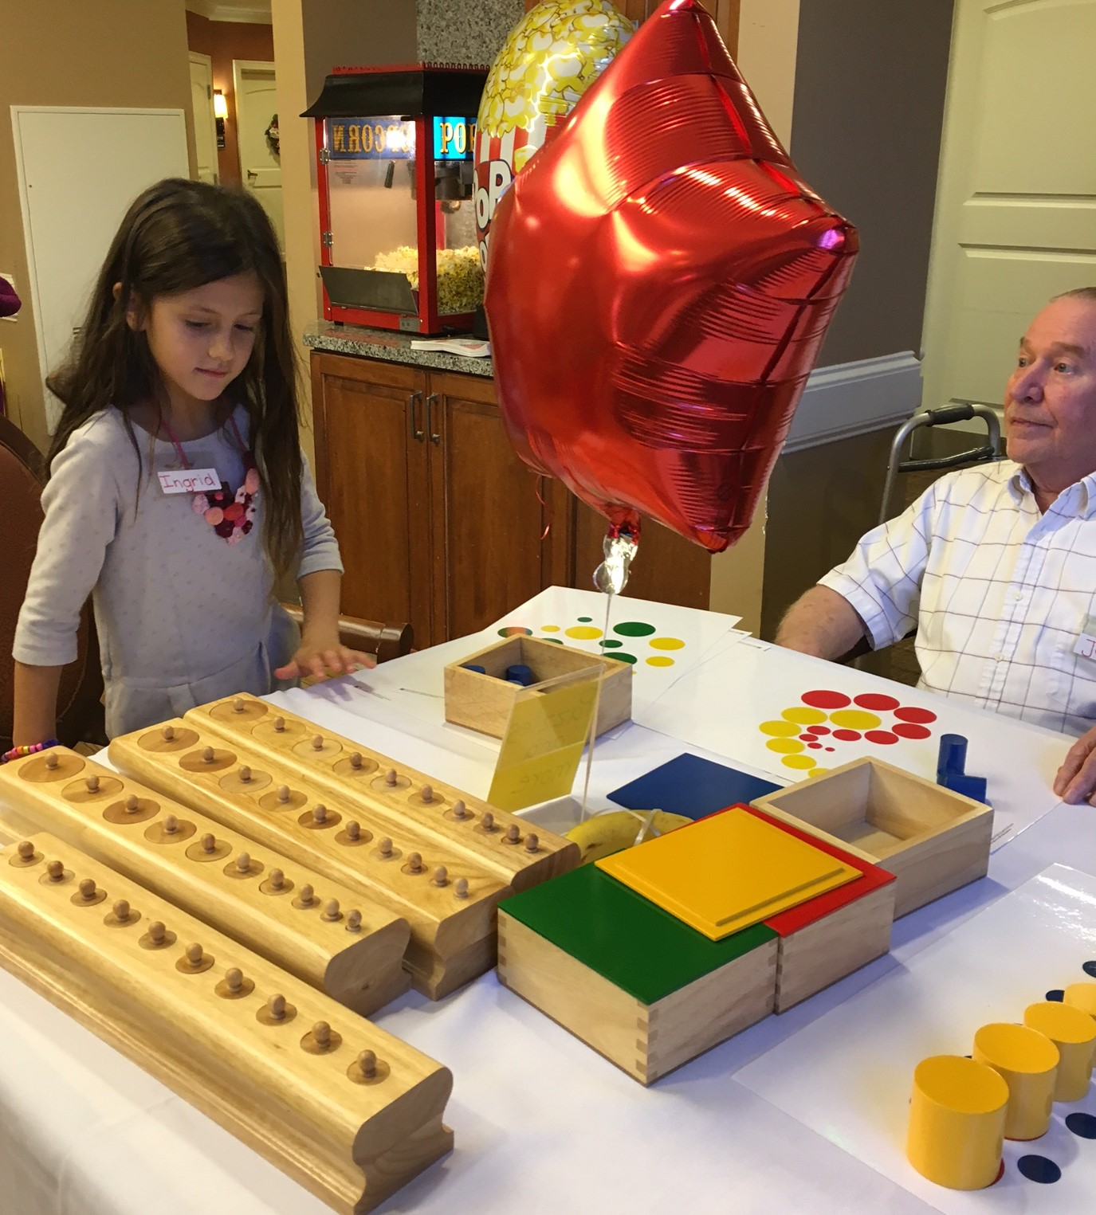
Forming & Educating Agents of Change
Teaching caregivers
Reflecting a deep respect for individuals
Honoring fundamental human needs
Responsible action to better the lives of our aging population

Slide 10
"You never change things by fighting the existing reality.
To change something,
build a new model that makes the old model obsolete."
Buckminster Fuller

