Slide 1
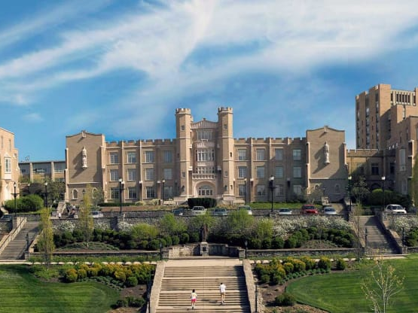
Promoting Culture and Cura Personalis
Hem Raj Joshi - AFMIX X

Slide 2
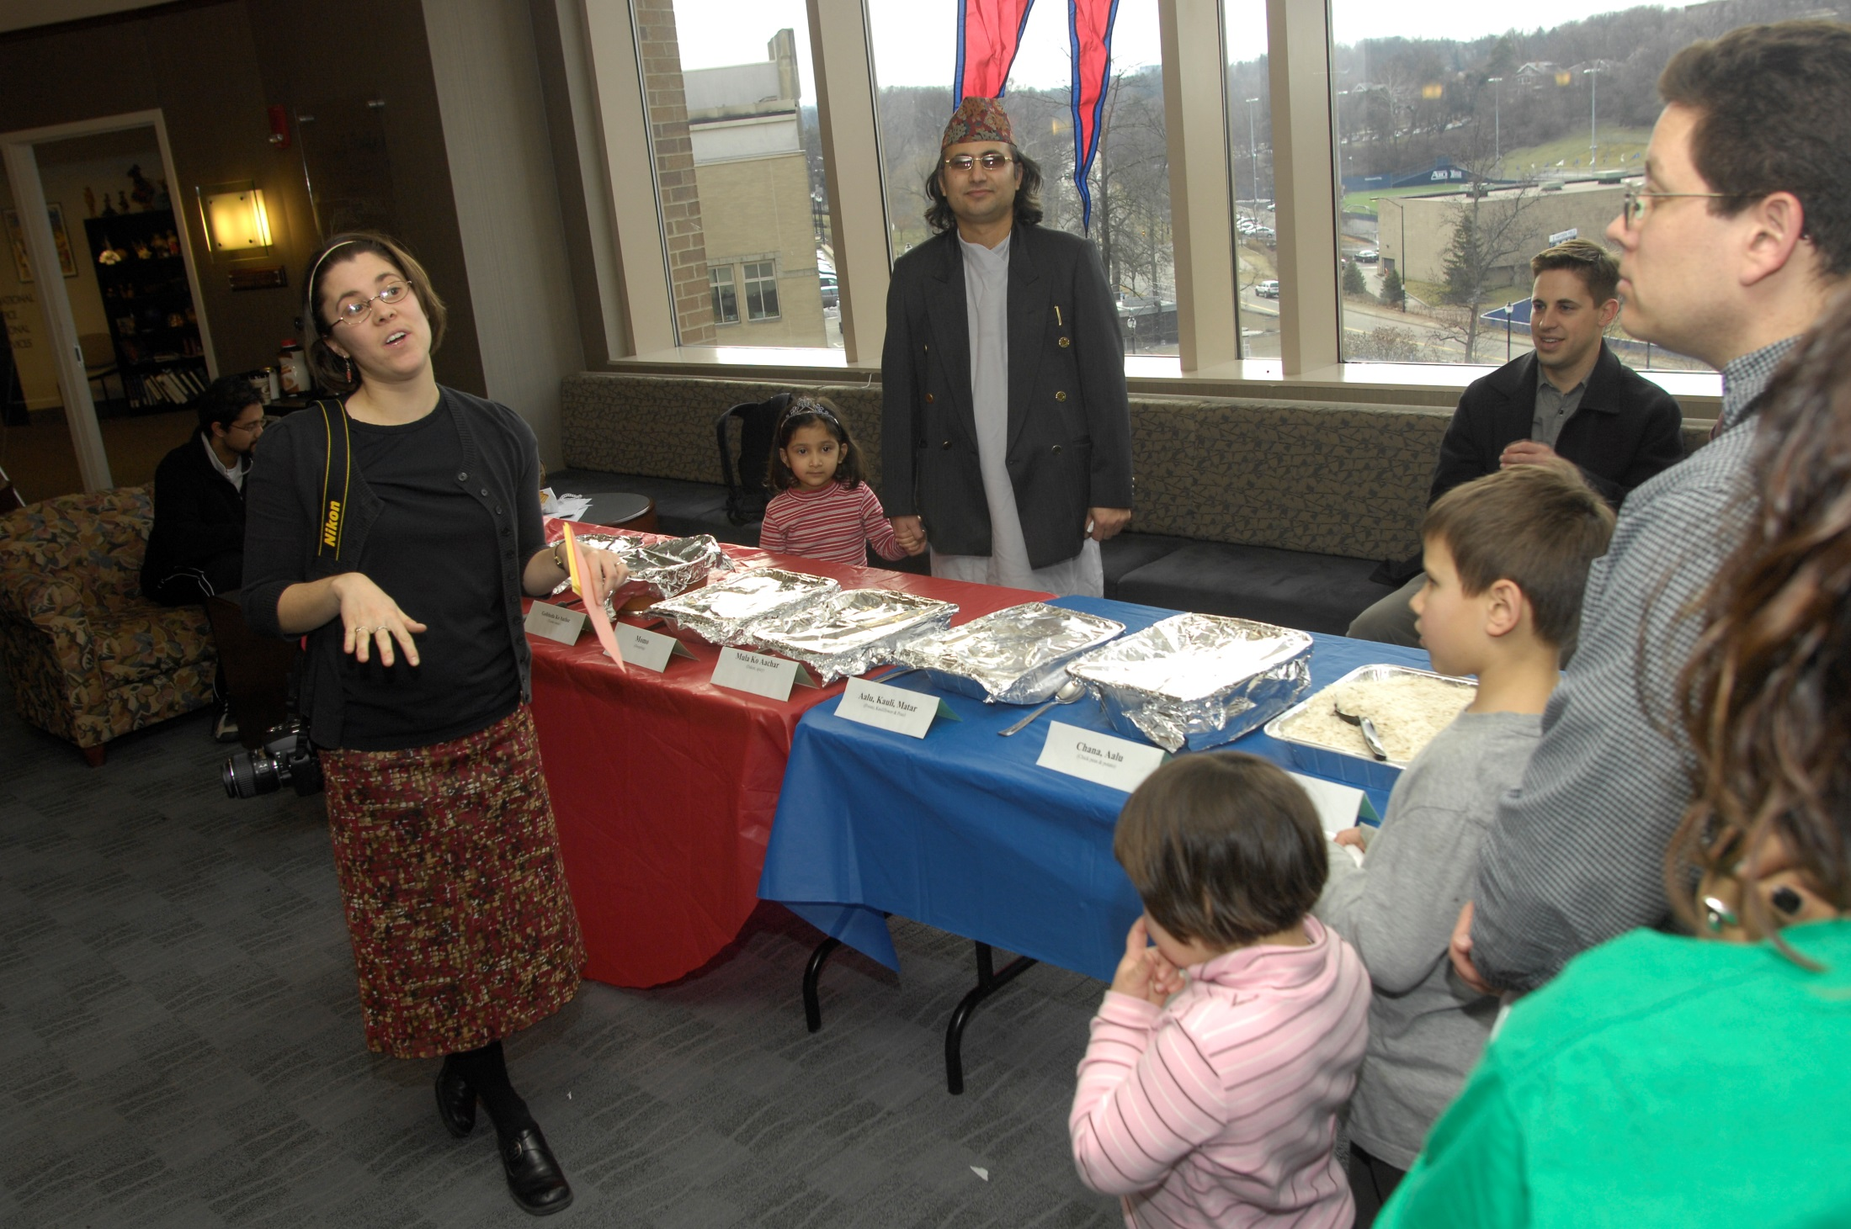
International Coffee Hour 2006

Slide 3
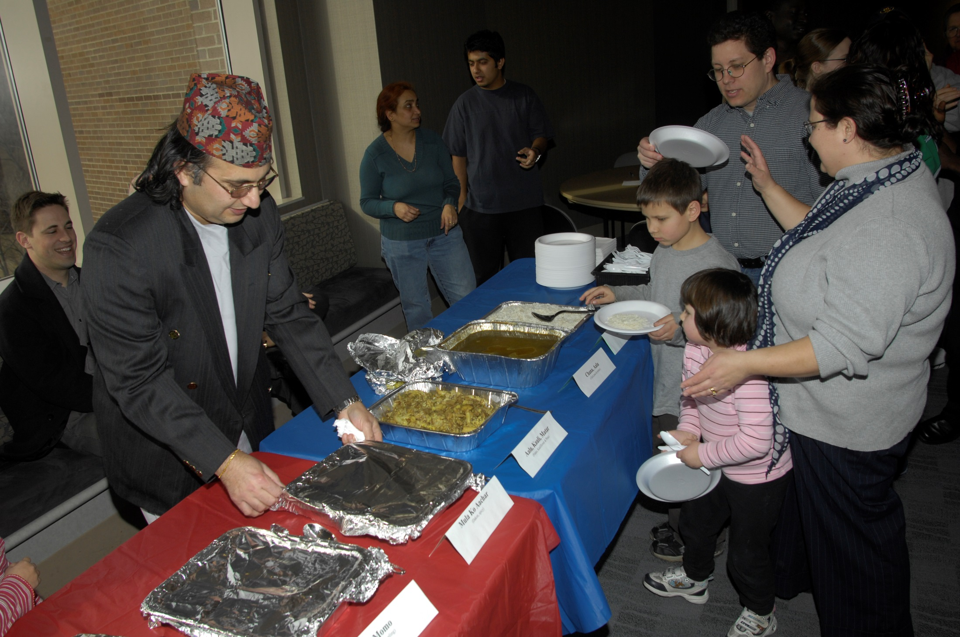
International Coffee Hour 2006

Slide 4
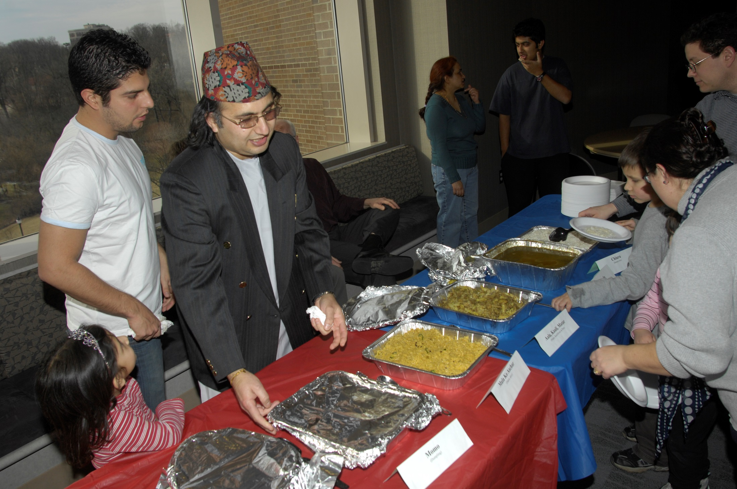
International Coffee Hour 2006

Slide 5
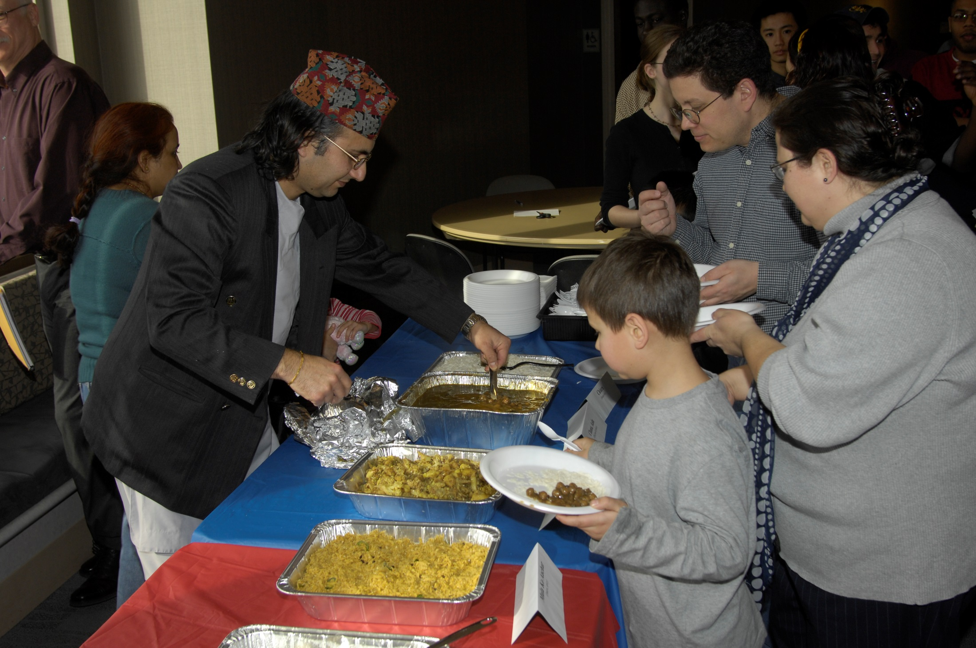
International Coffee Hour 2006

Slide 6
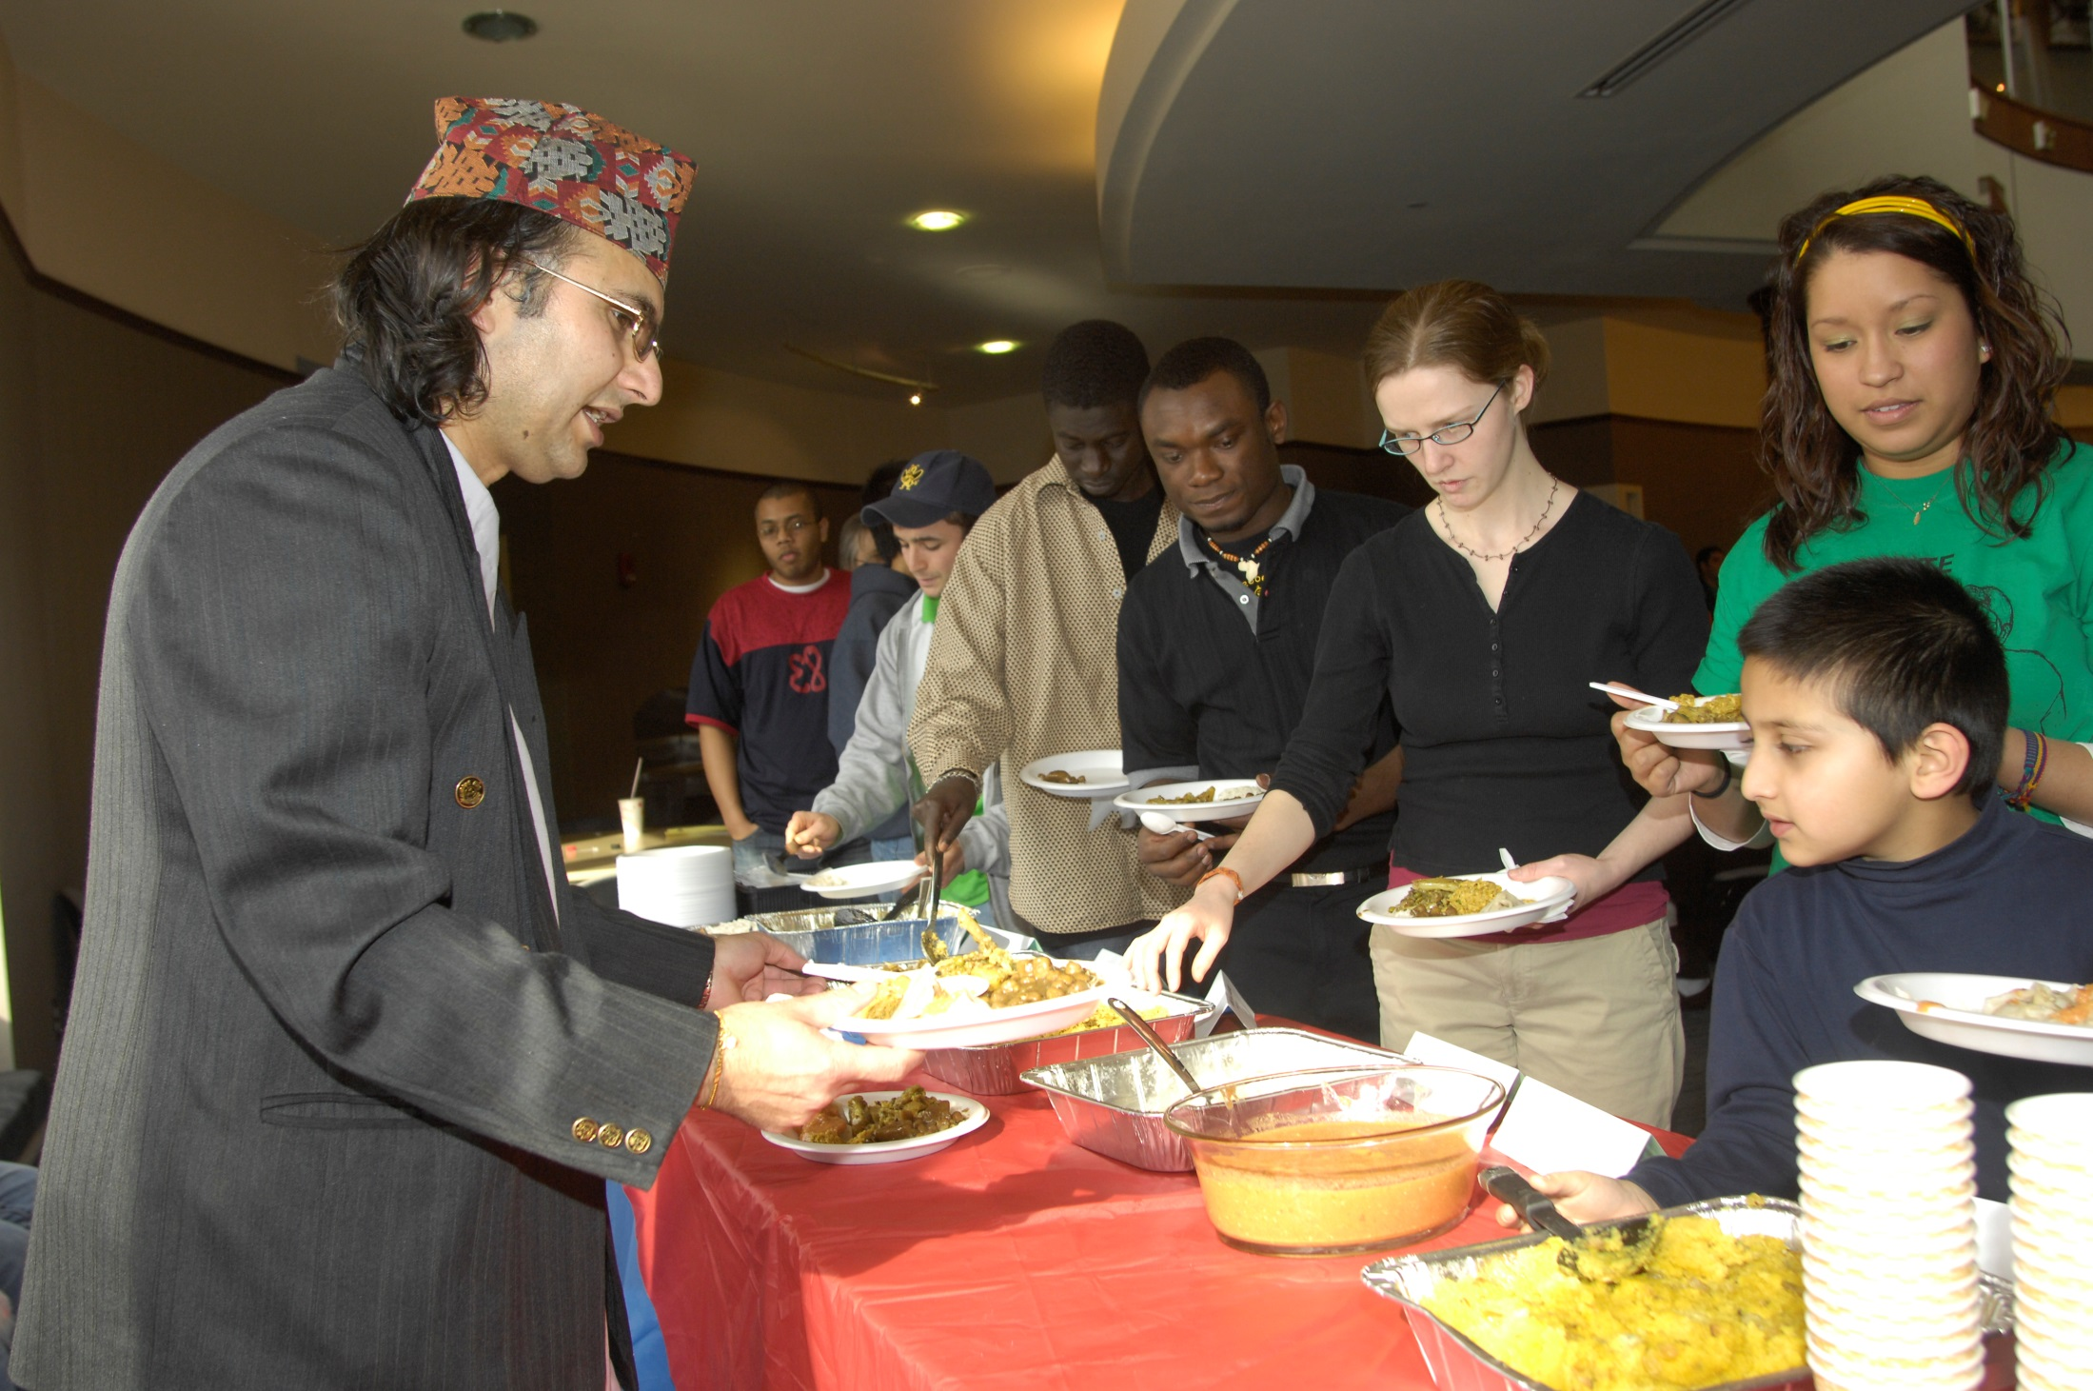
International Coffee Hour 2006

Slide 7
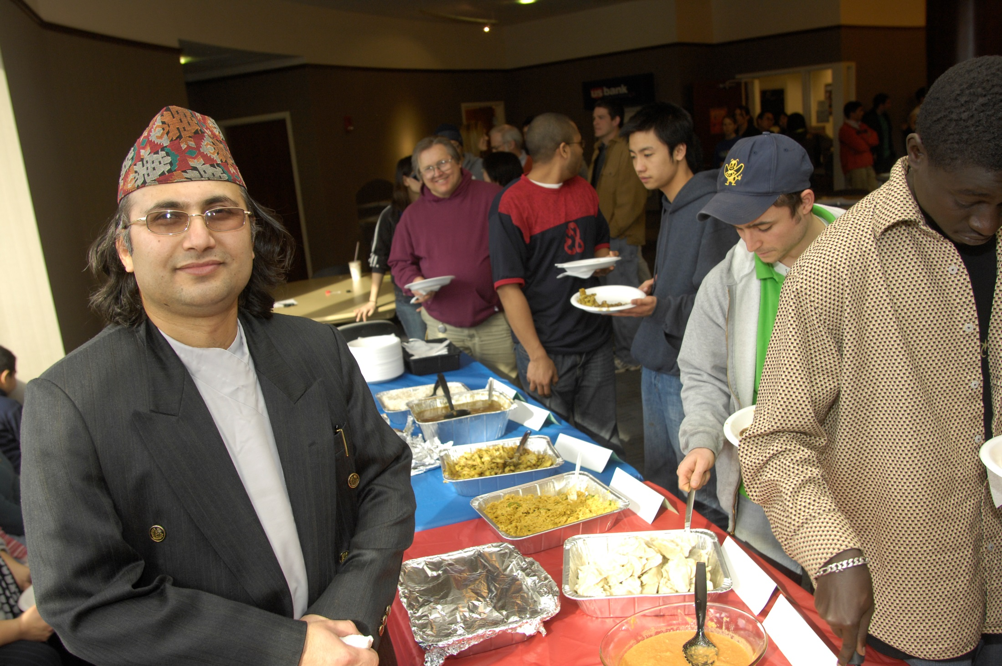
International Coffee Hour 2007

Slide 8
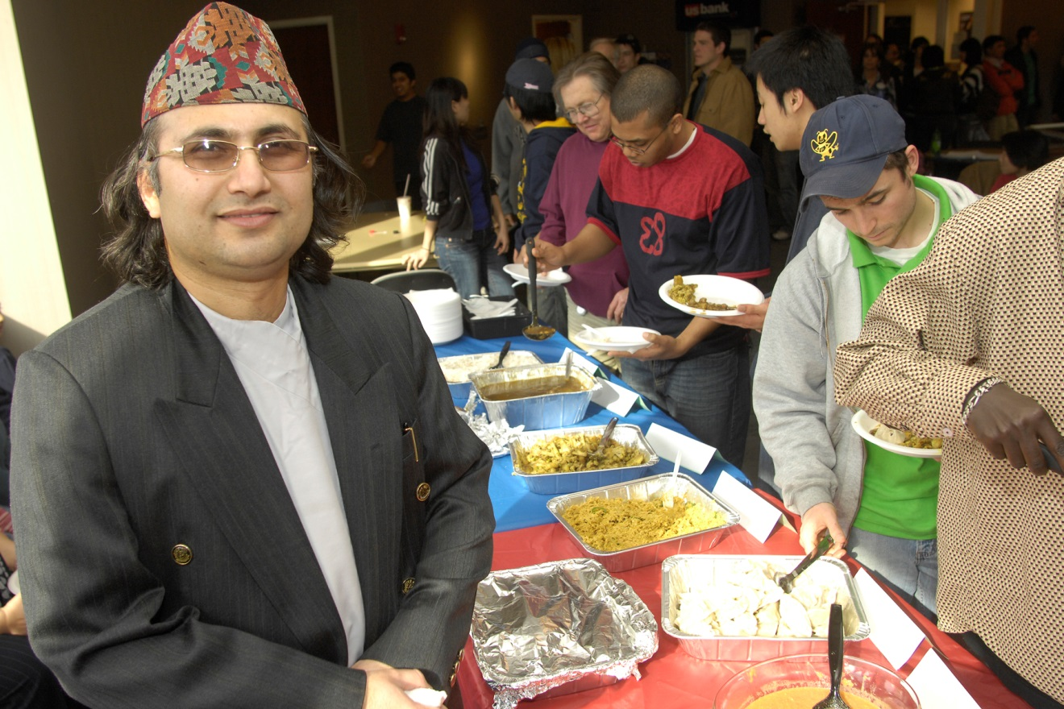
International Coffee Hour 2006

Slide 9
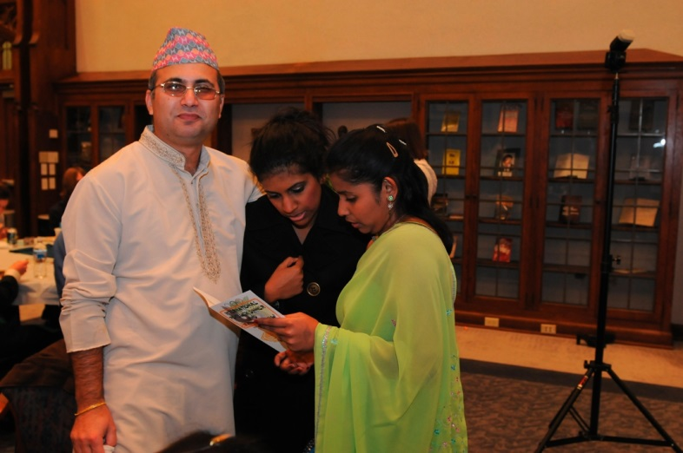
Xavier International Fashion Show 2008

Slide 10
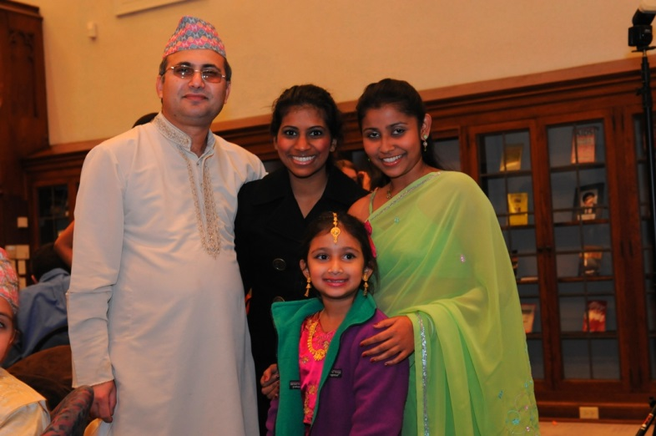
Xavier International Fashion Show 2008

Slide 11
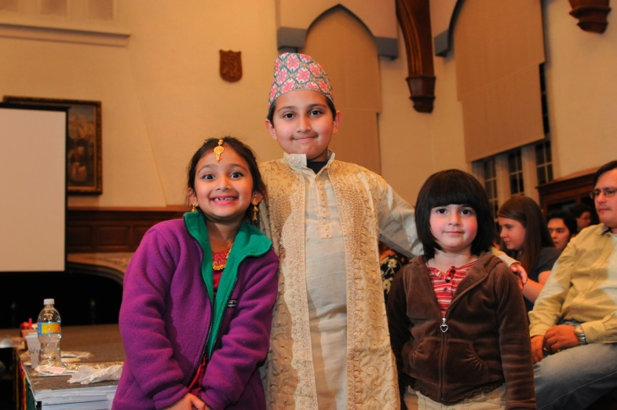
Xavier International Fashion Show 2008

Slide 12
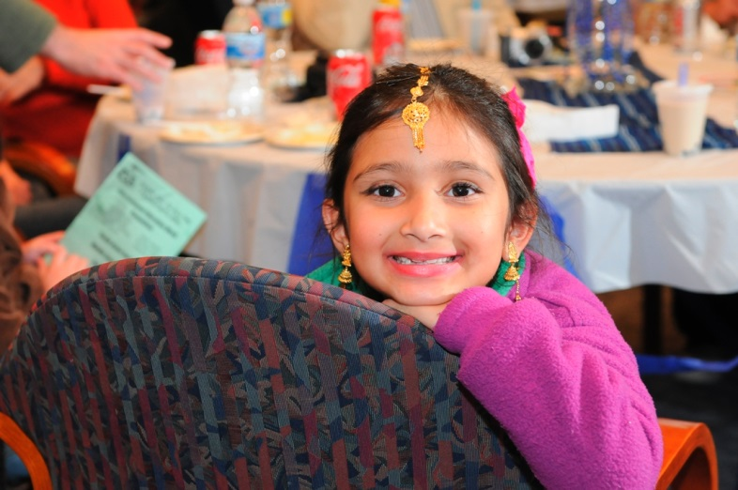
Xavier International Fashion Show 2008

Slide 13
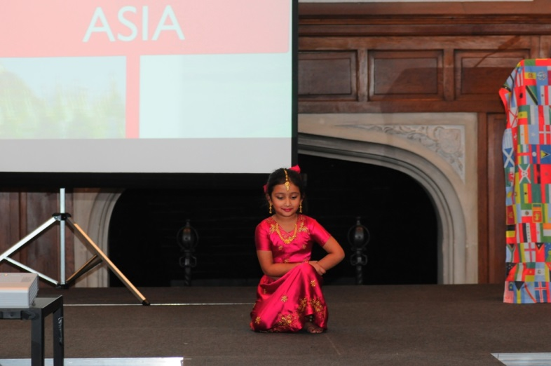
Xavier International Fashion Show 2008

Slide 14
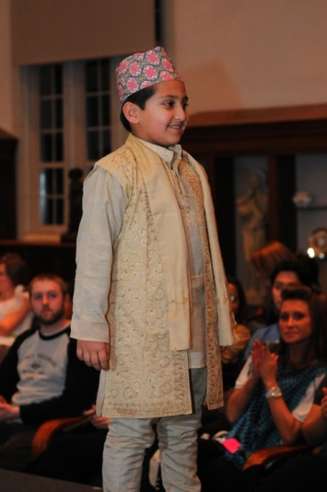
Xavier International Fashion Show 2008

Slide 15
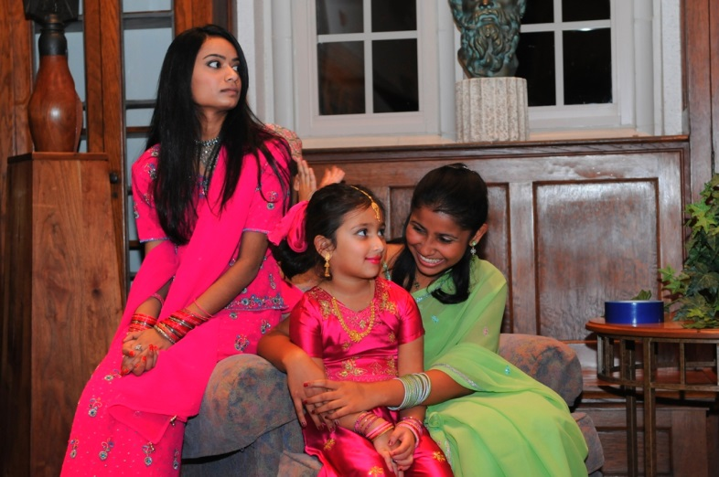
Xavier International Fashion Show 2008

Slide 16
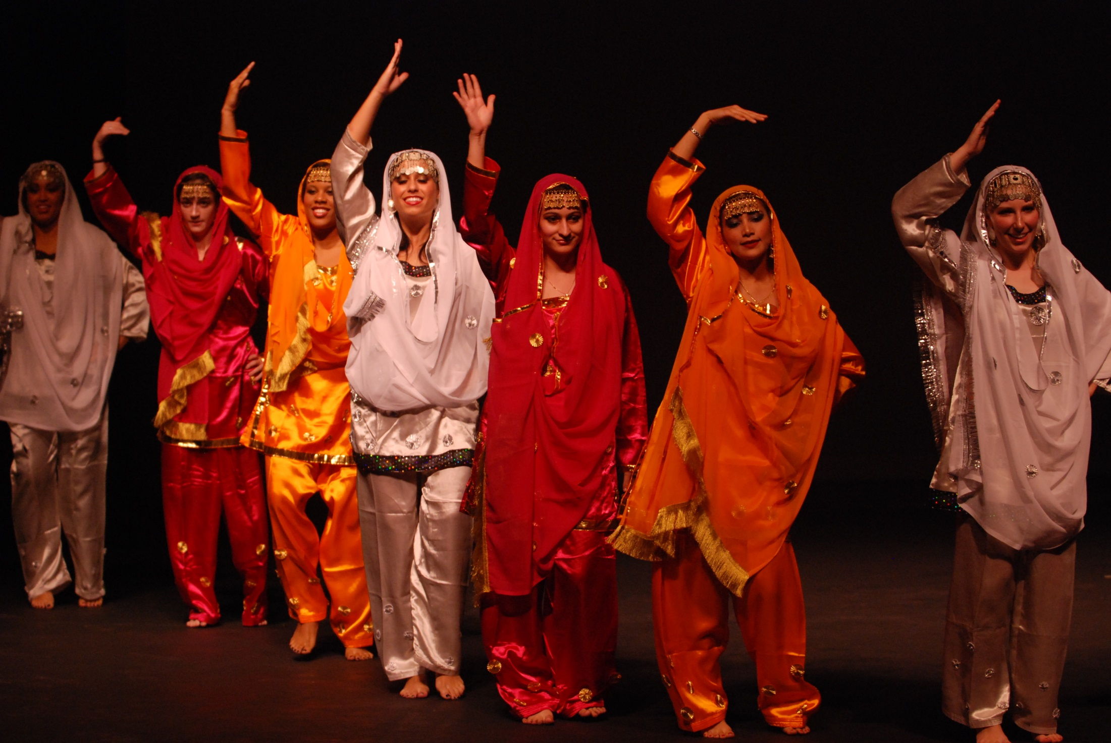
Xavier Midwest Masala 2009

Slide 17
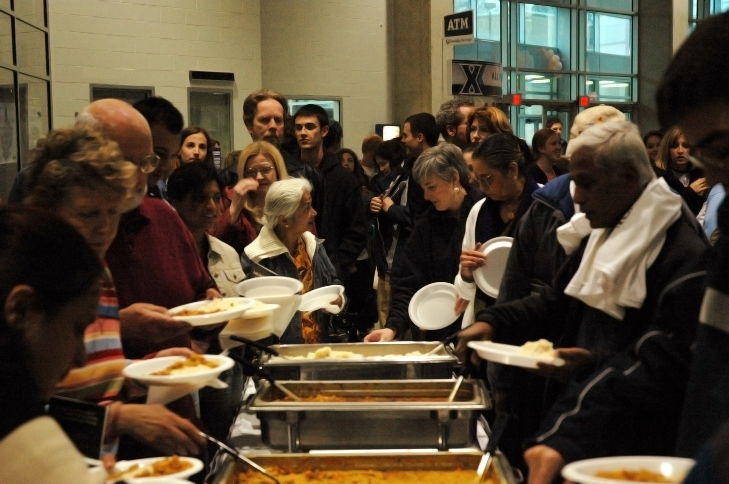
Xavier Midwest Masala 2009

Slide 18
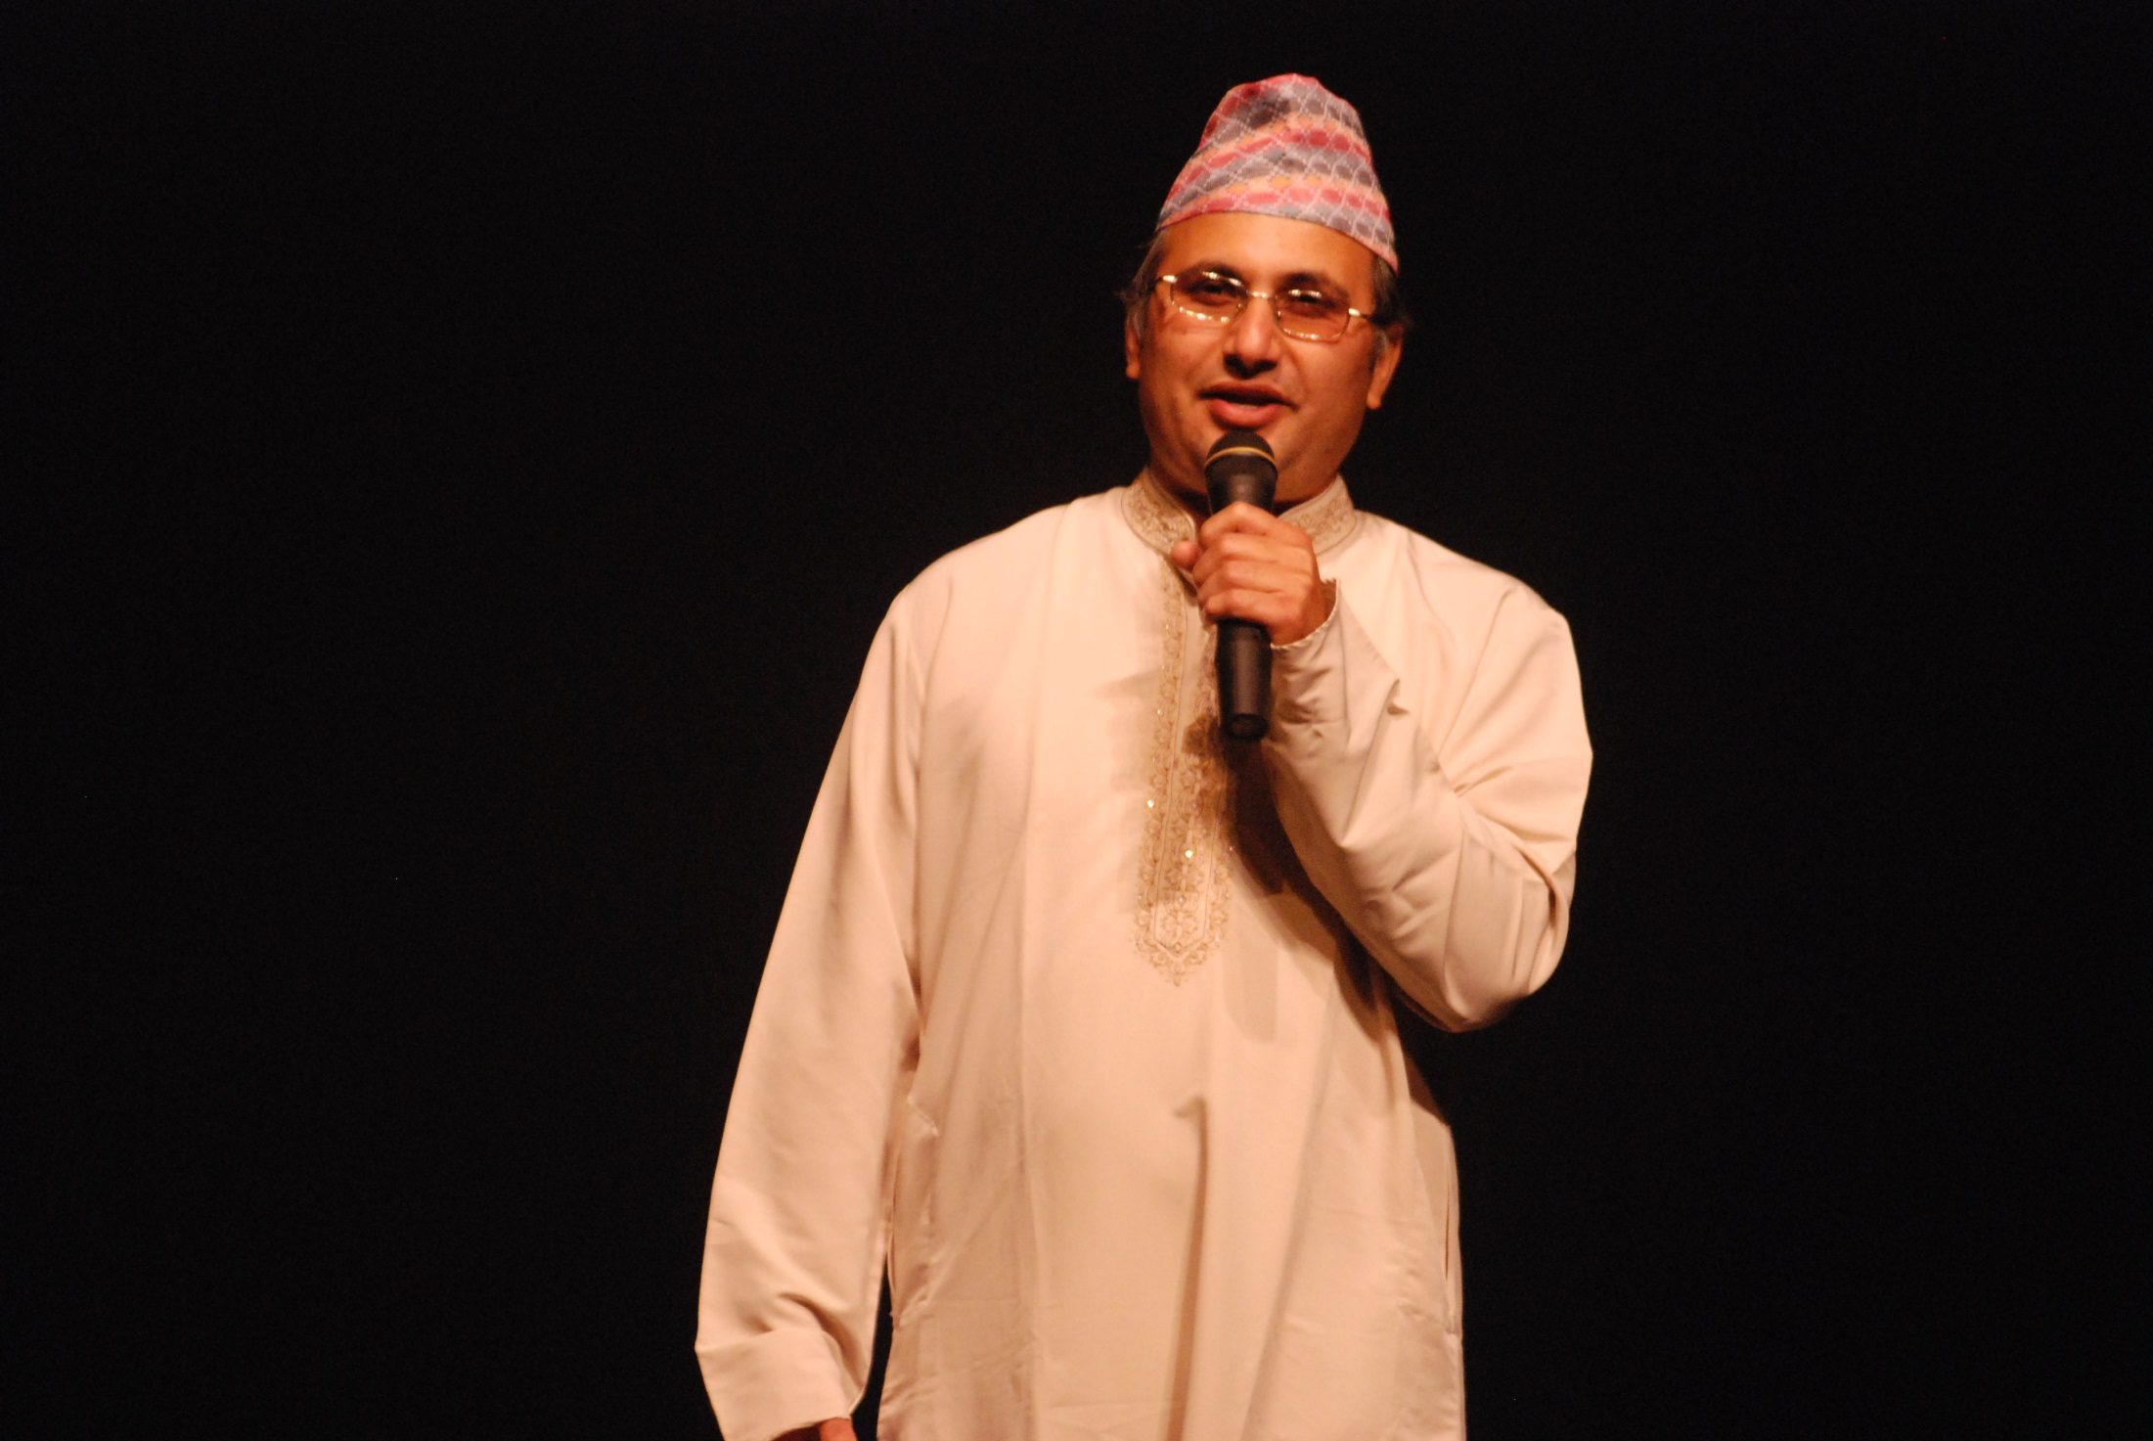
Xavier Midwest Masala 2009

Slide 19
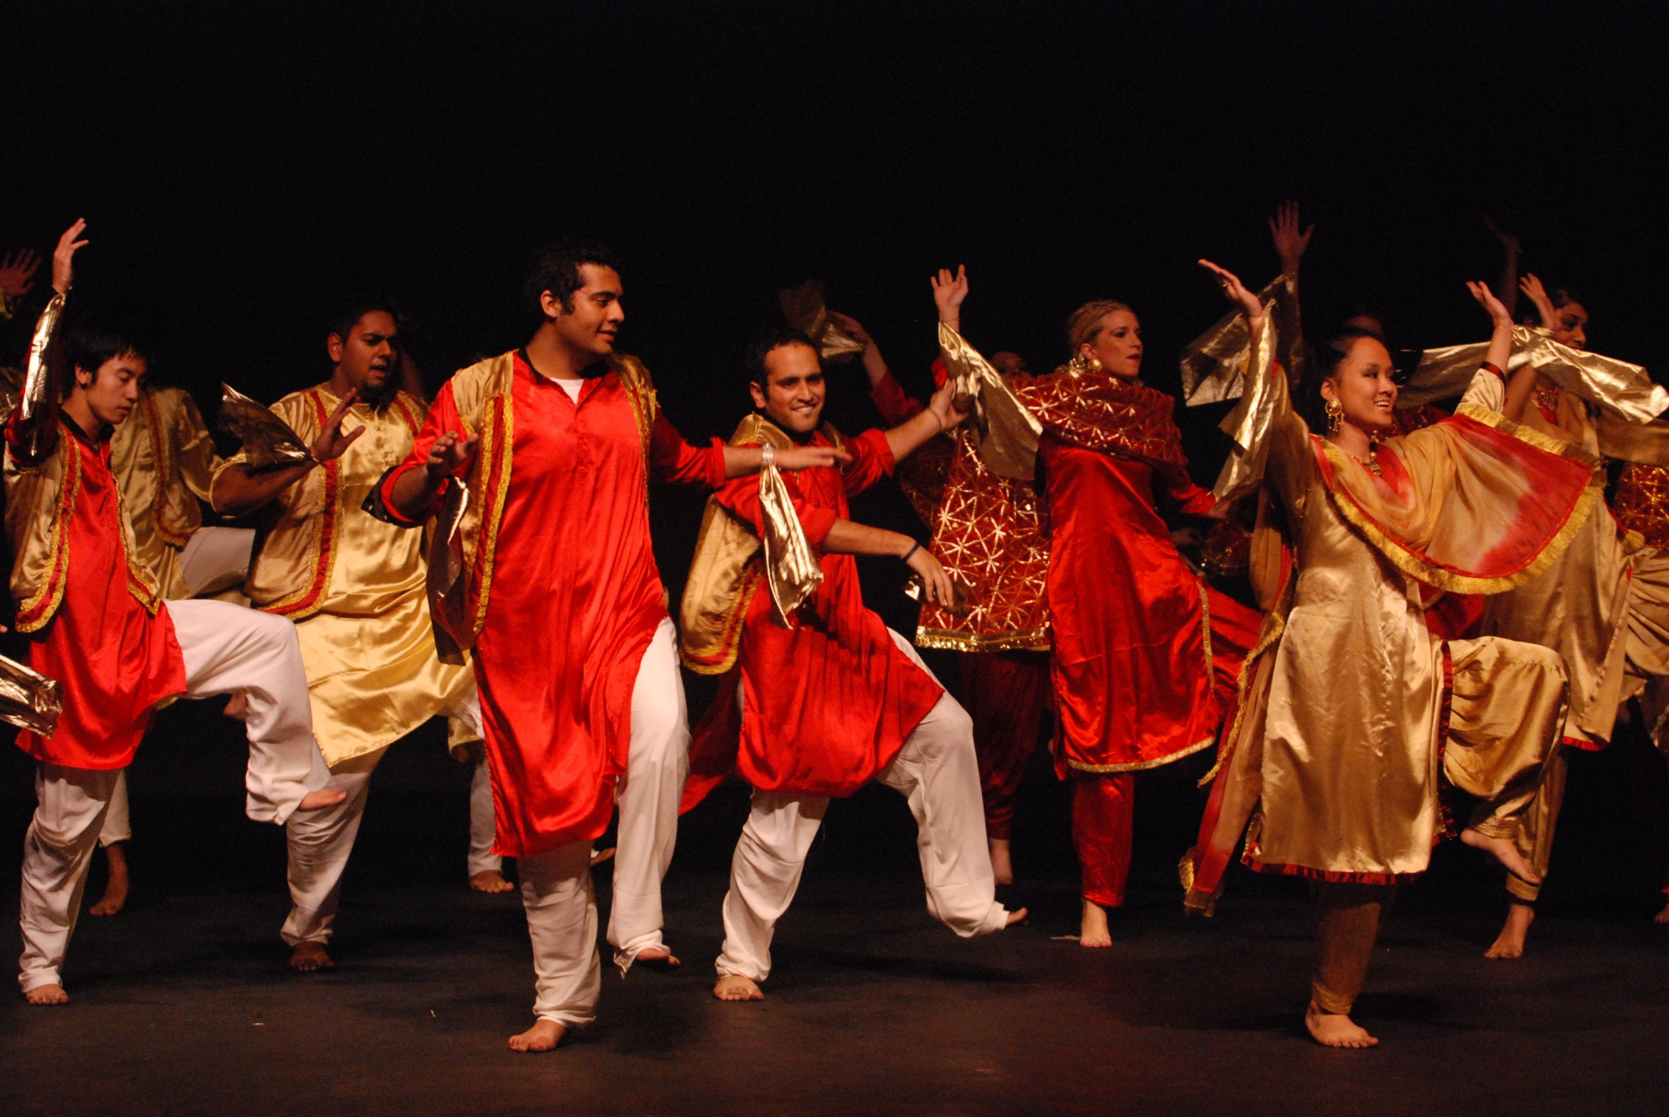
Xavier Midwest Masala 2009

Slide 20
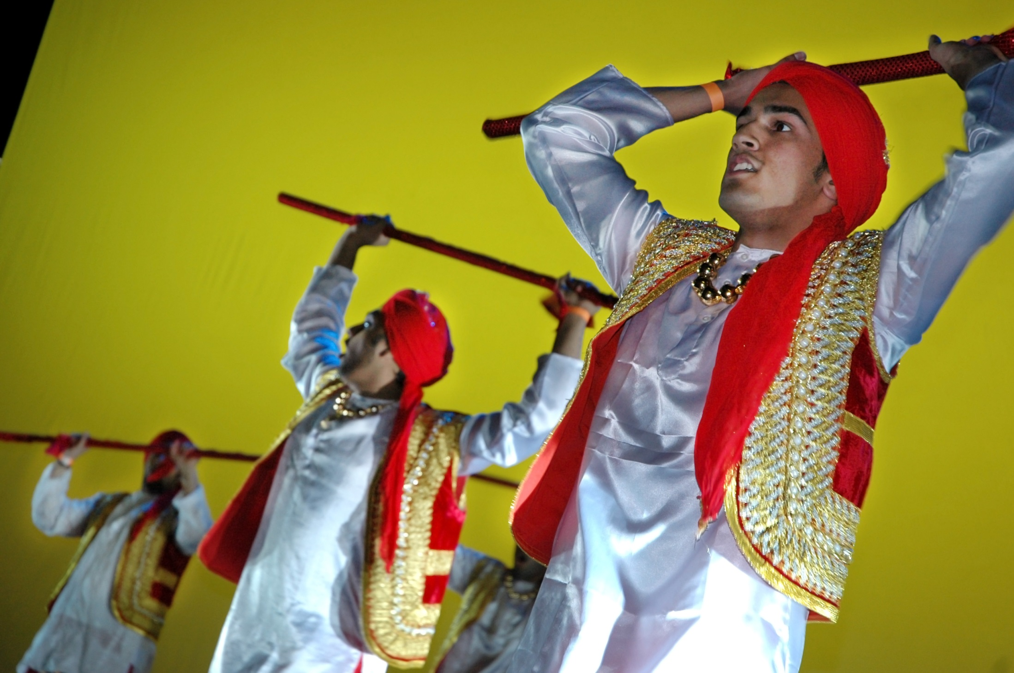
Xavier Midwest Masala 2009

Slide 21
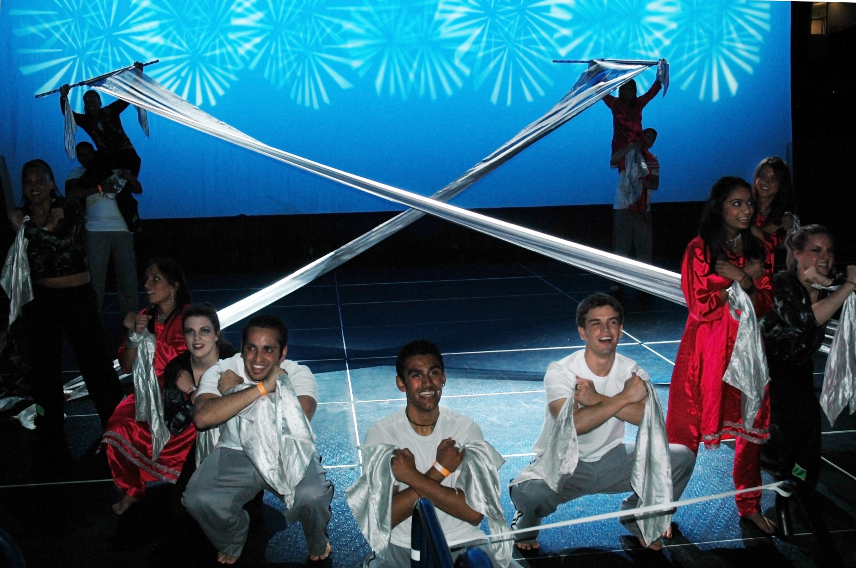
Xavier Midwest Masala 2009

Slide 22
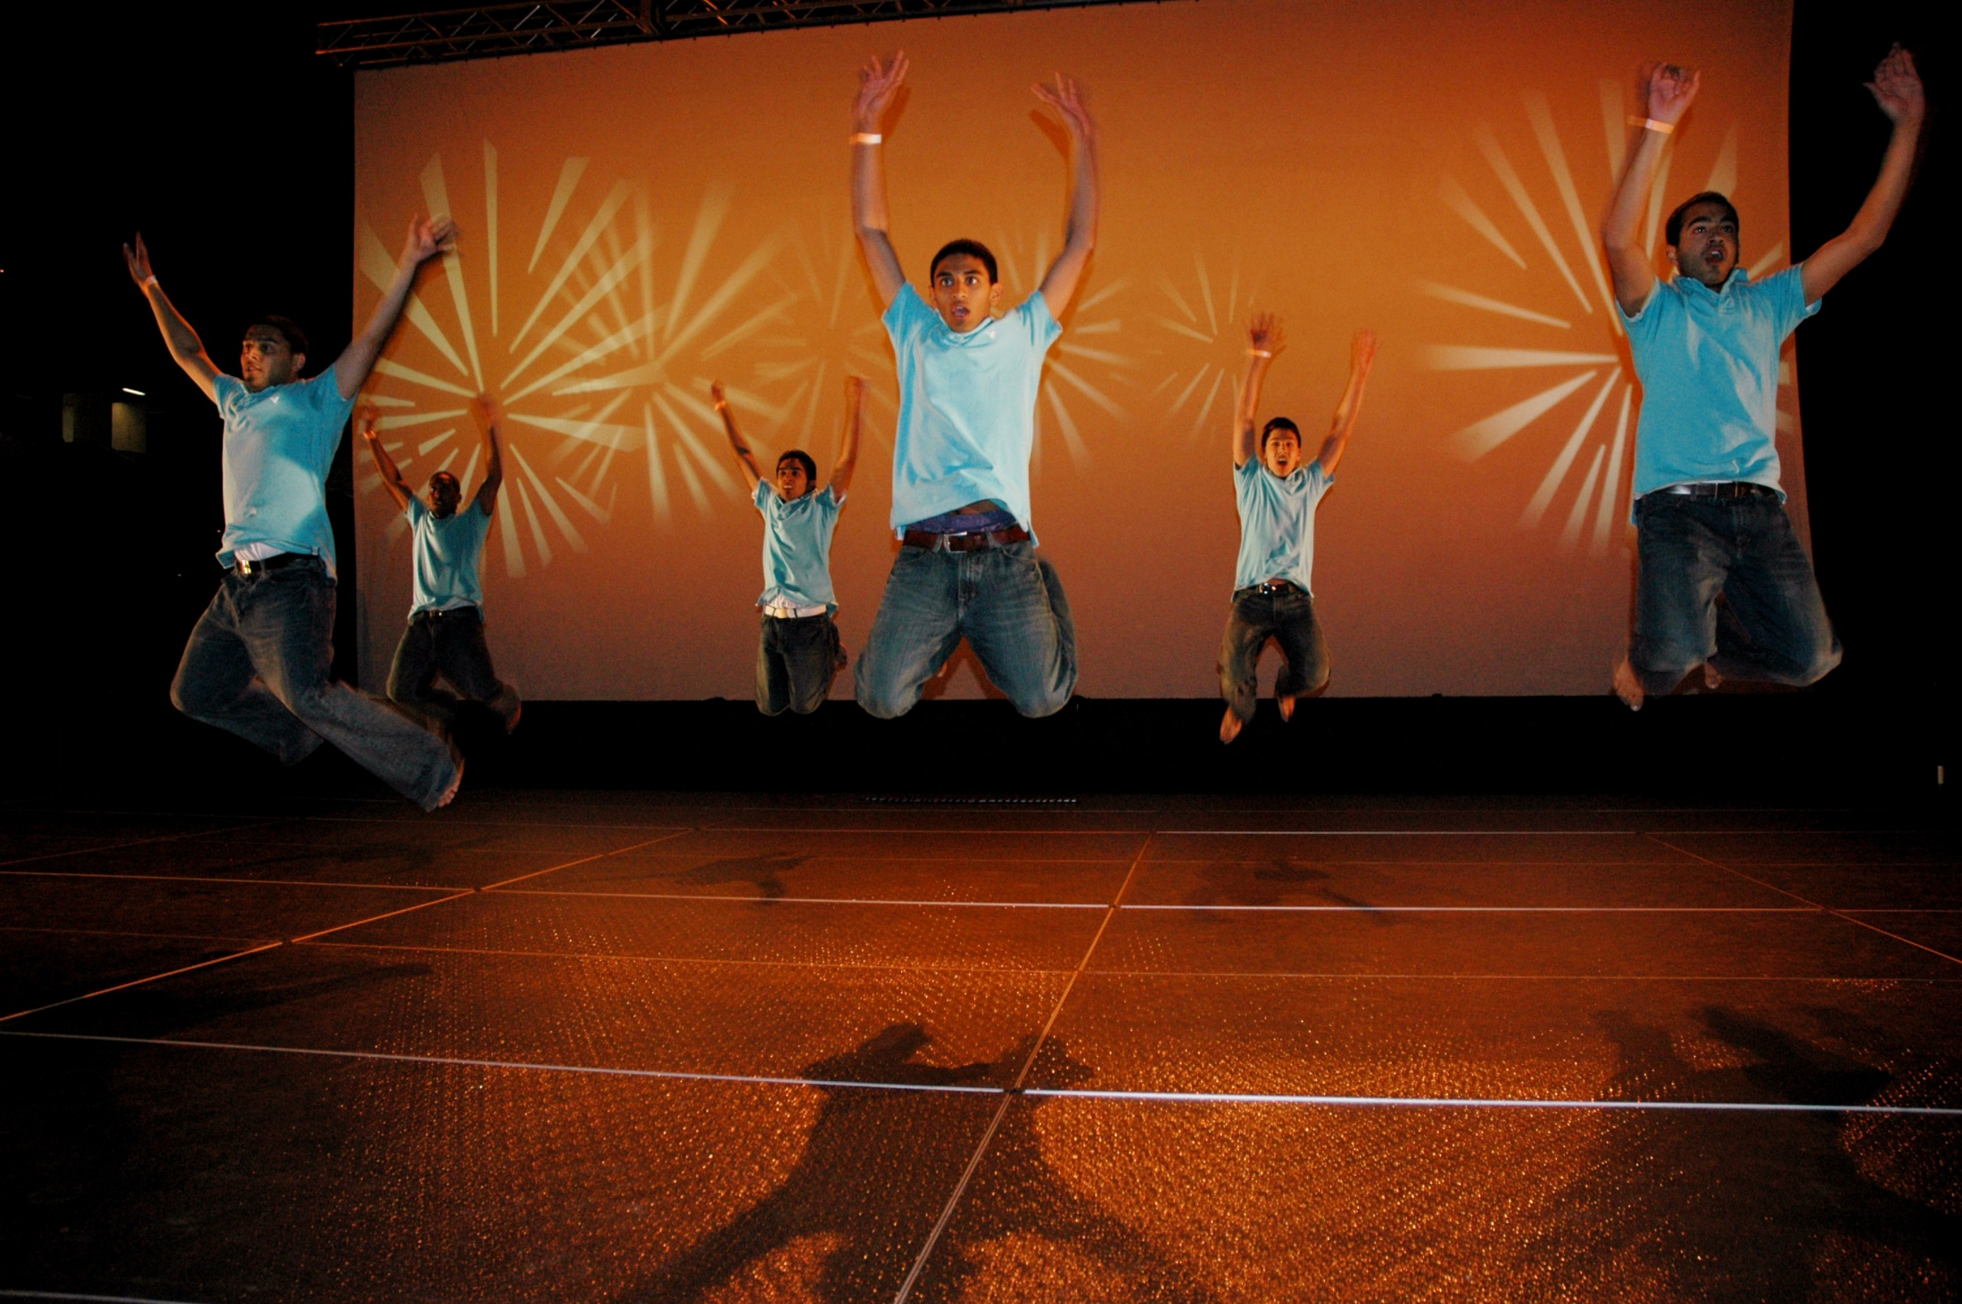
Xavier Midwest Masala 2009

Slide 23
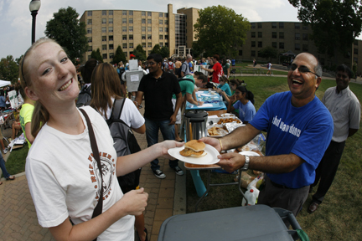
Xavier Club Day 2010

Slide 24
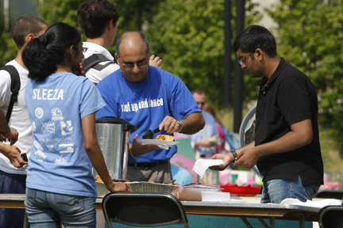
Xavier Club Day 2010

Slide 25
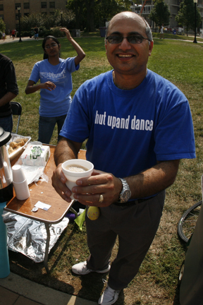
Xavier Club Day 2010

Slide 26
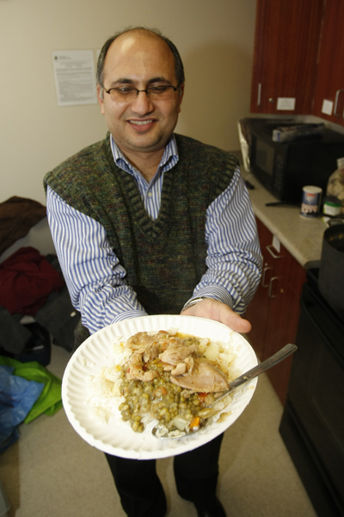
International Coffee Hour 2011

Slide 27
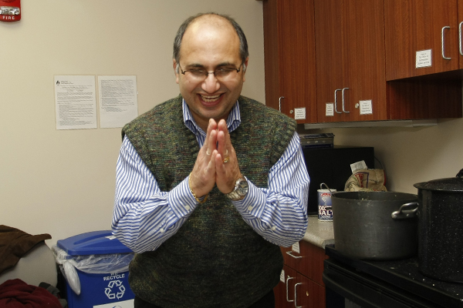
International Coffee Hour 2011

Slide 28
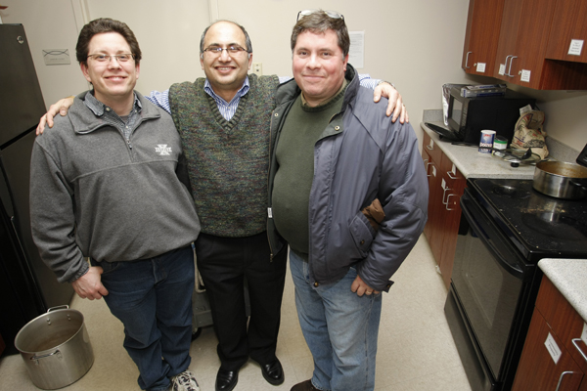
International Coffee Hour 2011

Slide 29
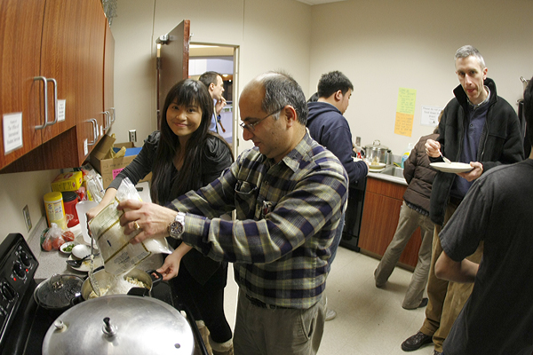
International Coffee Hour 2012

Slide 30
Holi at Xavier Greenspace 2012

Slide 31
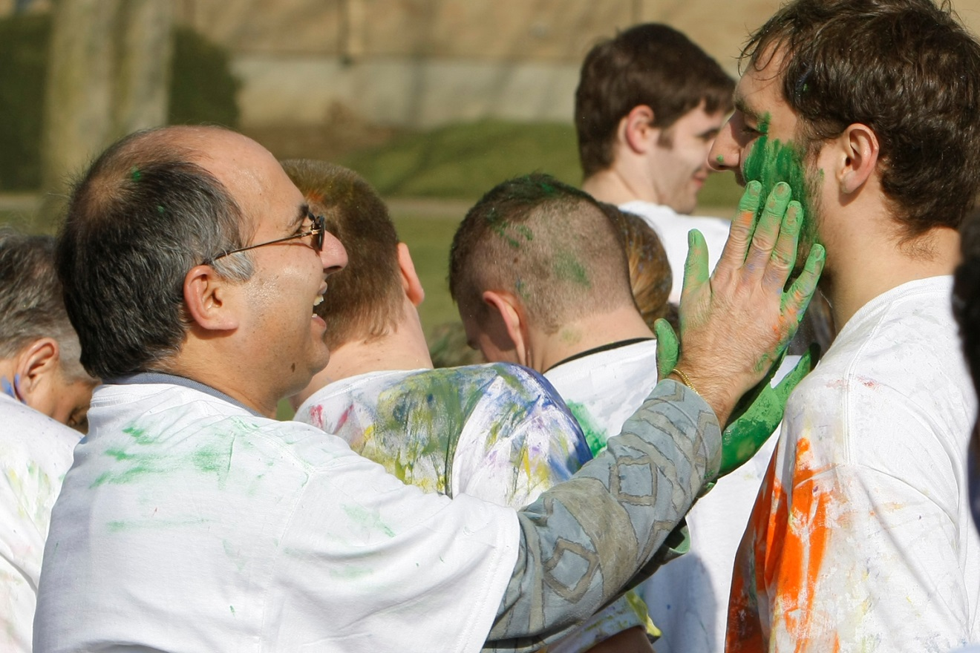
Holi at Xavier Greenspace 2012

Slide 32
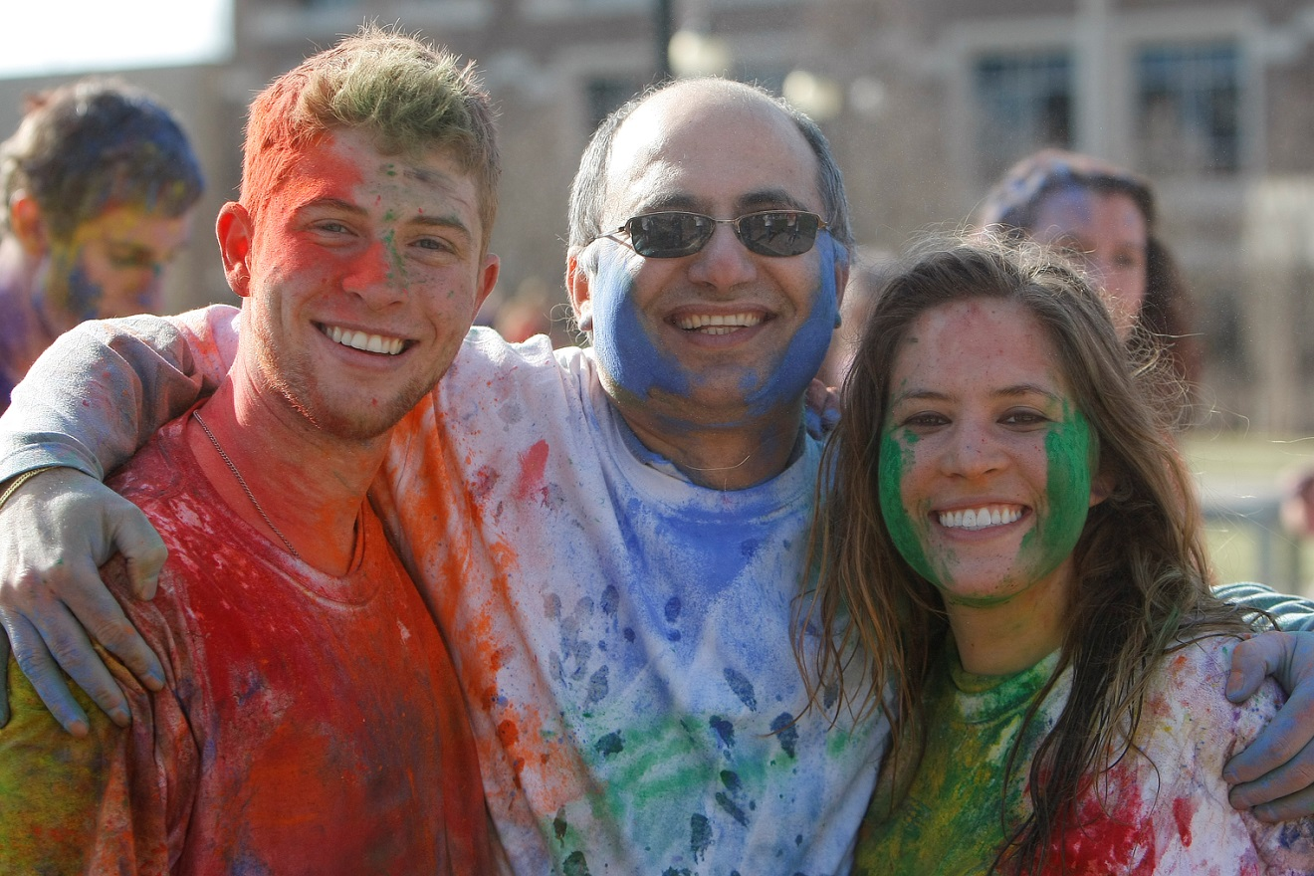
Holi at Xavier Greenspace 2012

Slide 33
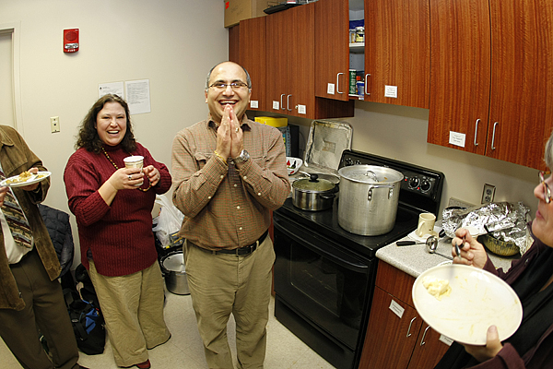
International Coffee Hour 2014

Slide 34
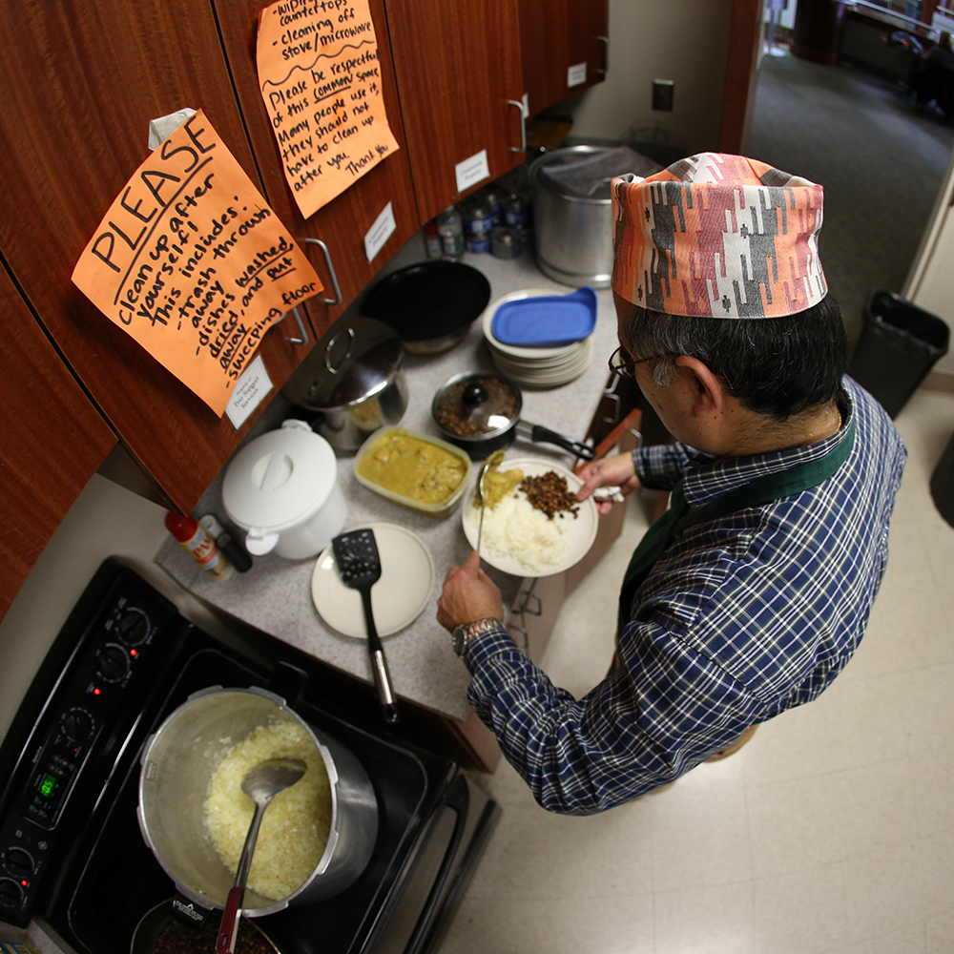
International Coffee Hour 2015

Slide 35
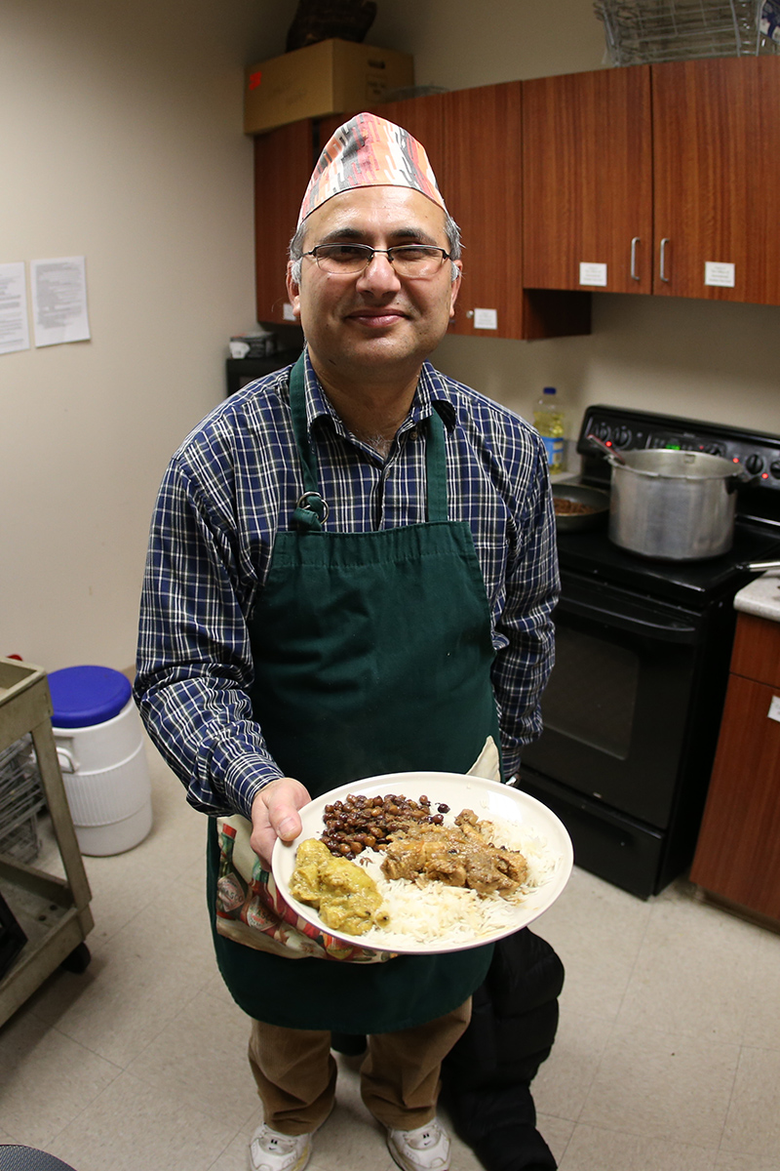
International Coffee Hour 2015

Slide 36
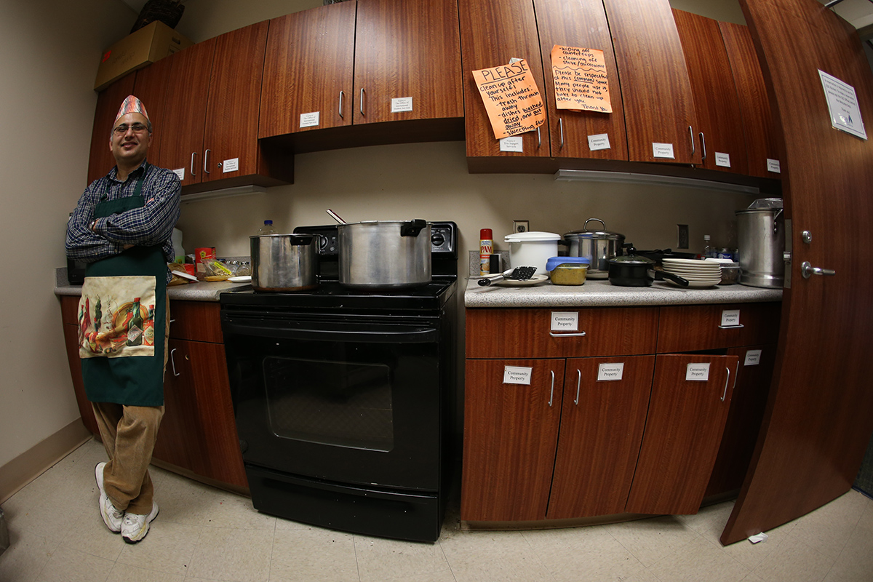
International Coffee Hour 2015

Slide 37
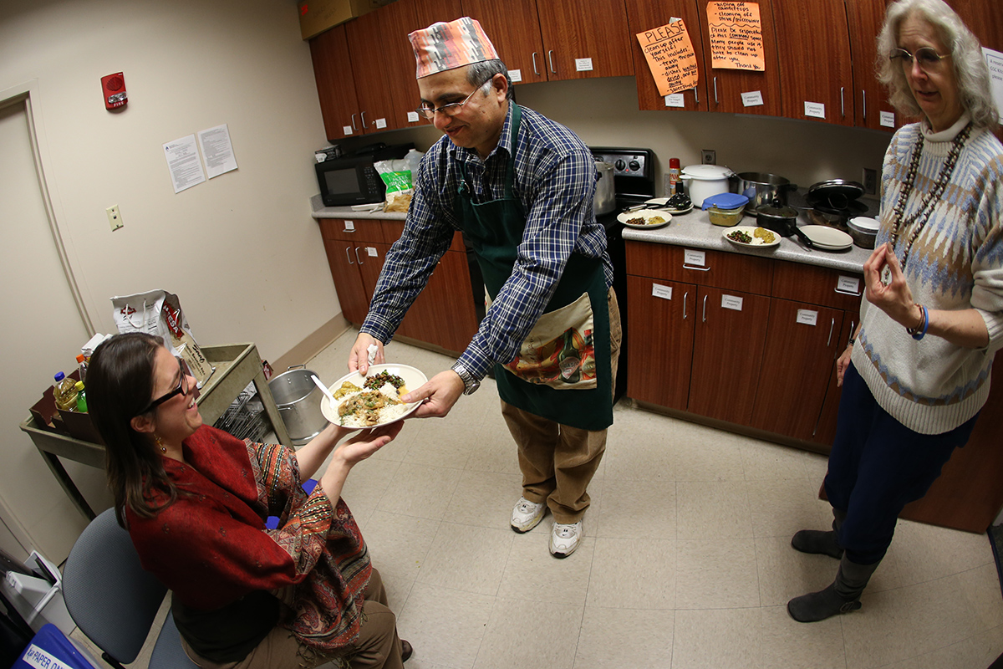
International Coffee Hour 2015

Slide 38
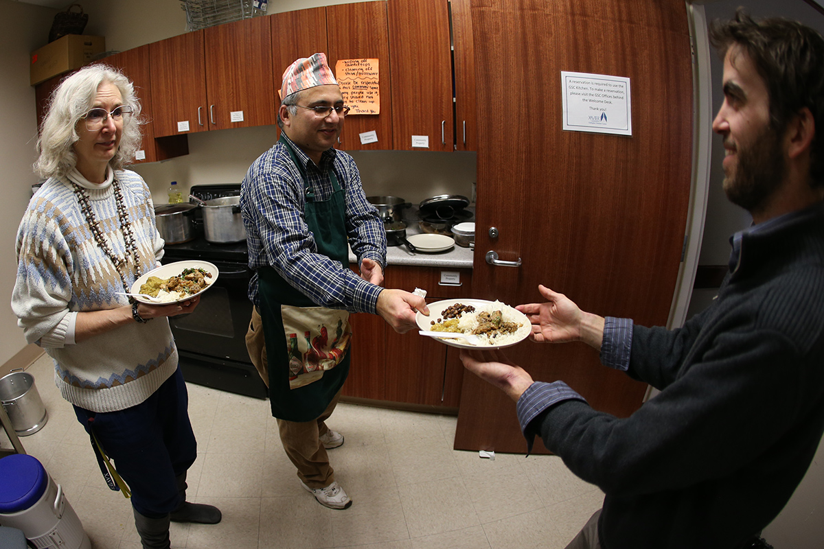
International Coffee Hour 2015

Slide 39
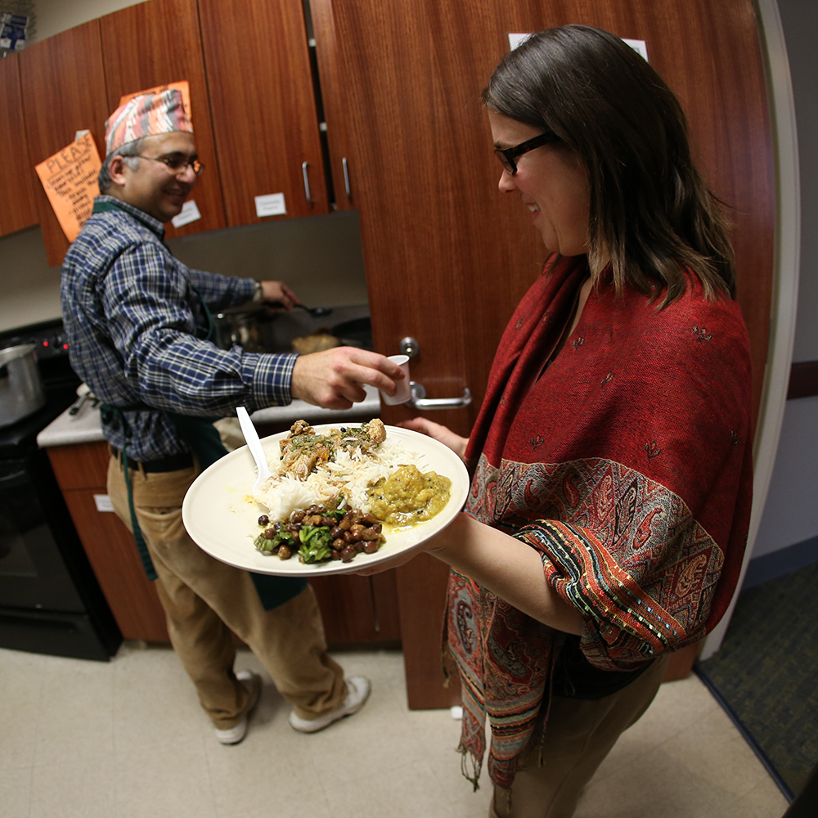
International Coffee Hour 2015

Slide 40
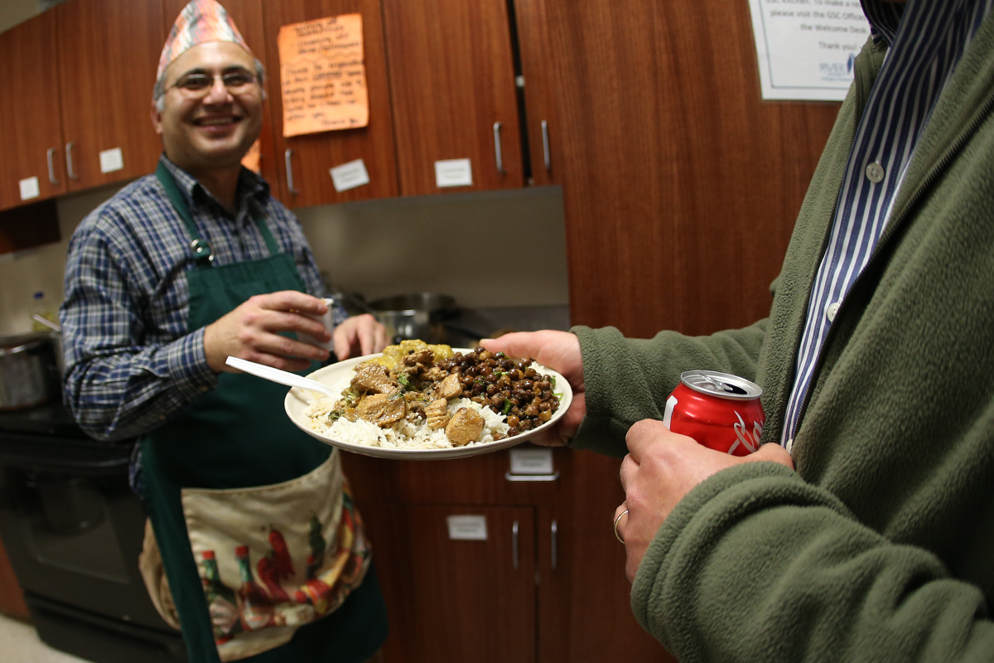
International Coffee Hour 2015

Slide 41
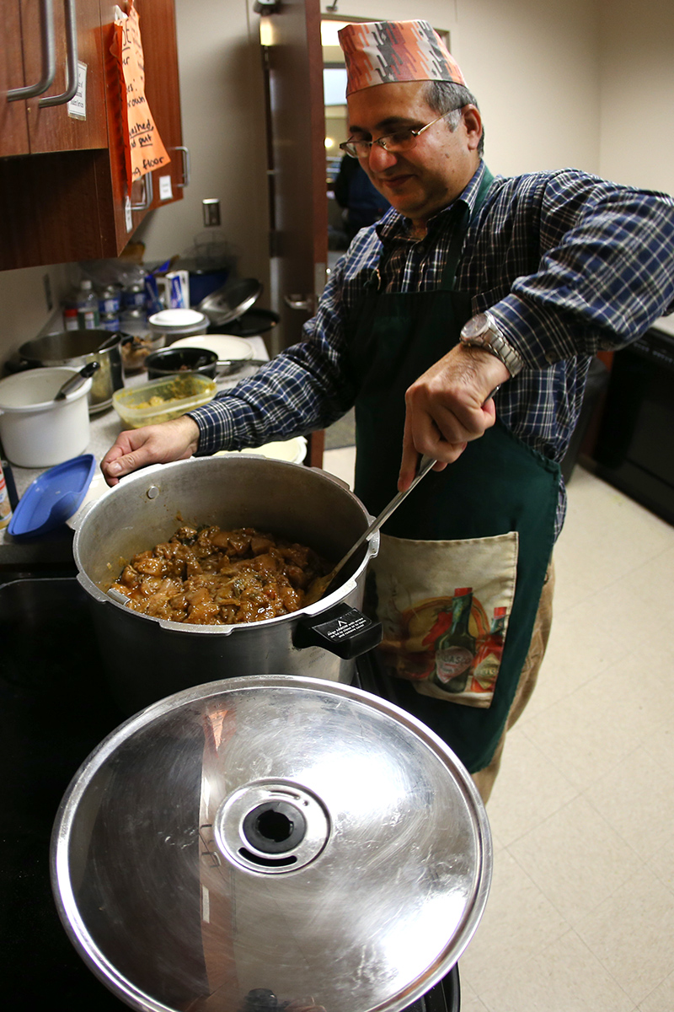
International Coffee Hour 2015

Slide 42
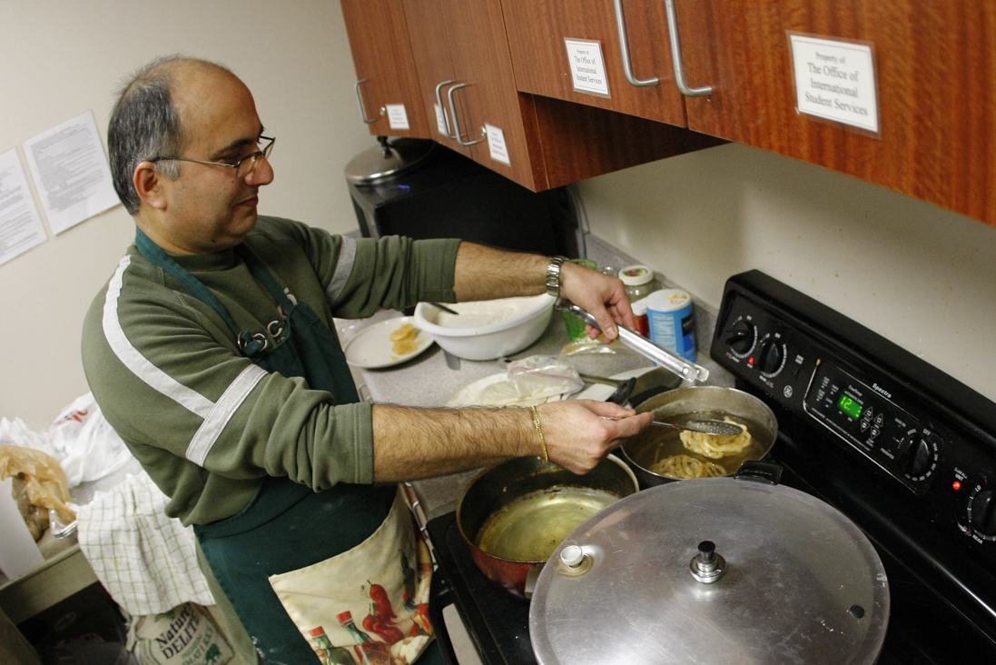
International Coffee Hour 2017

Slide 43
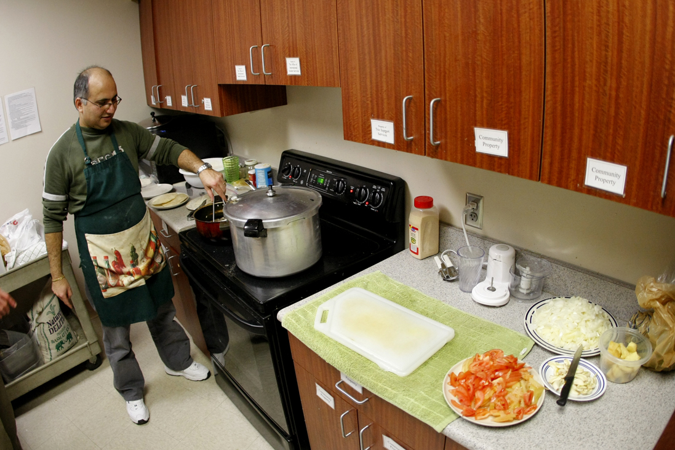
International Coffee Hour 2017

Slide 44
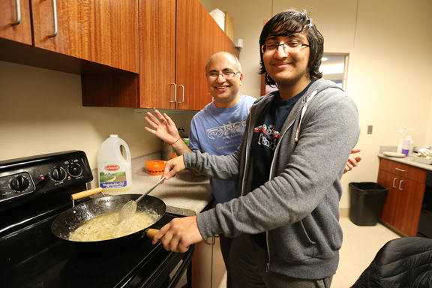
International Coffee Hour 2018

Slide 45
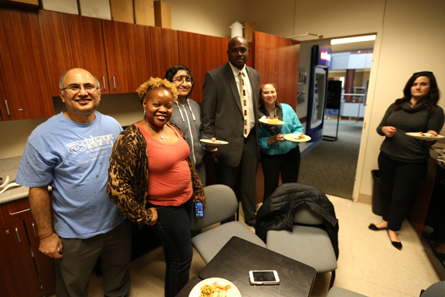
International Coffee Hour 2018

Slide 46
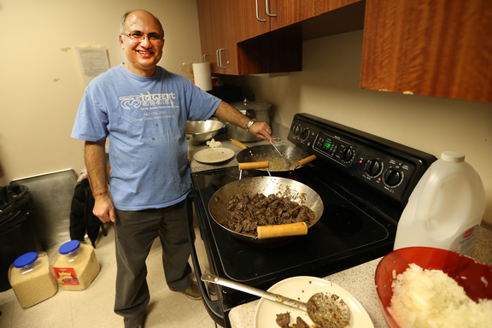
International Coffee Hour 2018

Slide 47
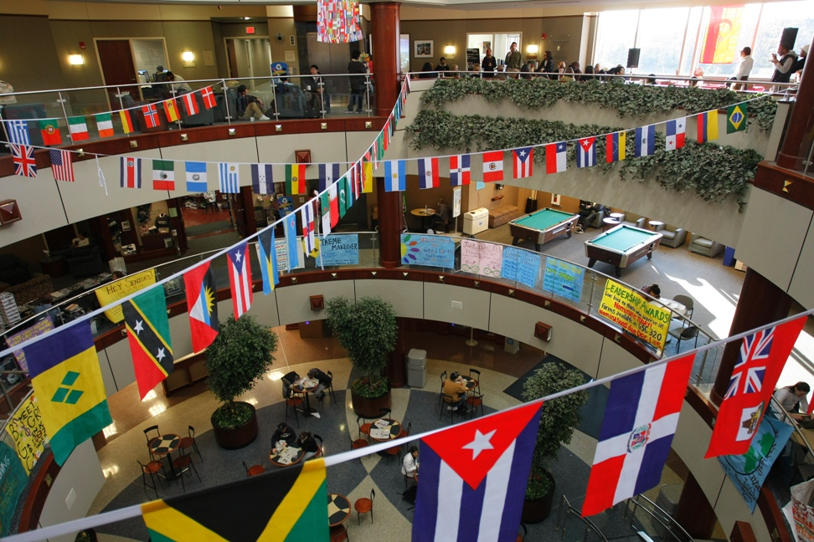
Gallagher Center

