Slide 1
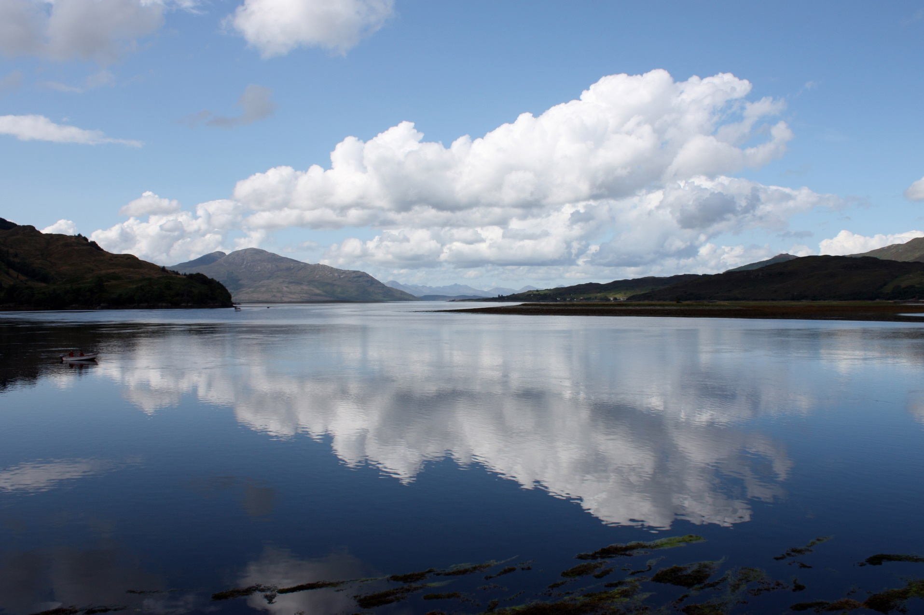
Reflection
Re-examining the Examen
For my Life and Work
Notes:
Now we’re going to take a deeper look at the examen. The hope is that you will see ways to integrate the examen more into your work here at Xavier.

Slide 2
What is the Examen?
Notes:
Reflective, prayful practice to detect God’s presence and discern God’s direction for us.

Slide 3
Form of the Examen
Pray for light to understand and appreciate the past day.
Review the day in thanksgiving.
Review the feelings in the replay of the day.
Choose one of those feelings (positive or negative) and pray from it.
Look toward tomorrow
Relish
Request
Reflect
Repent
Resolve
Thanksgiving
Petition
Review
Response
A Look Ahead
From
Jesuitresource.org
“Resources for The Daily Examen” page
From
“Re-imagining the Ignatian Examen” book
From
Jesuitresource.org
Daily Examen card
Notes:
The examen has a “standard” form. It serves as a useful but not mandatory structure for our reflection. That stand form has 5 steps, which can be described in different ways. Here how 3 resources describe those steps.

Slide 4
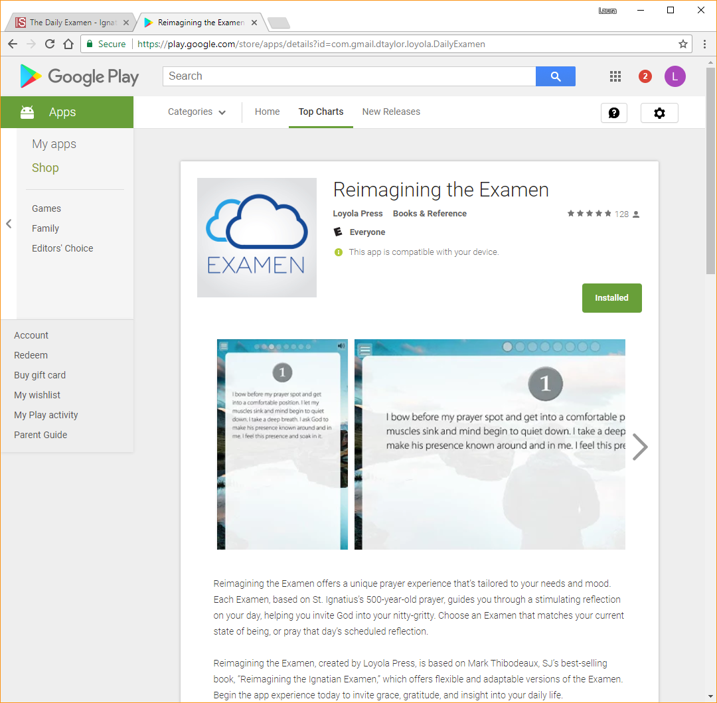
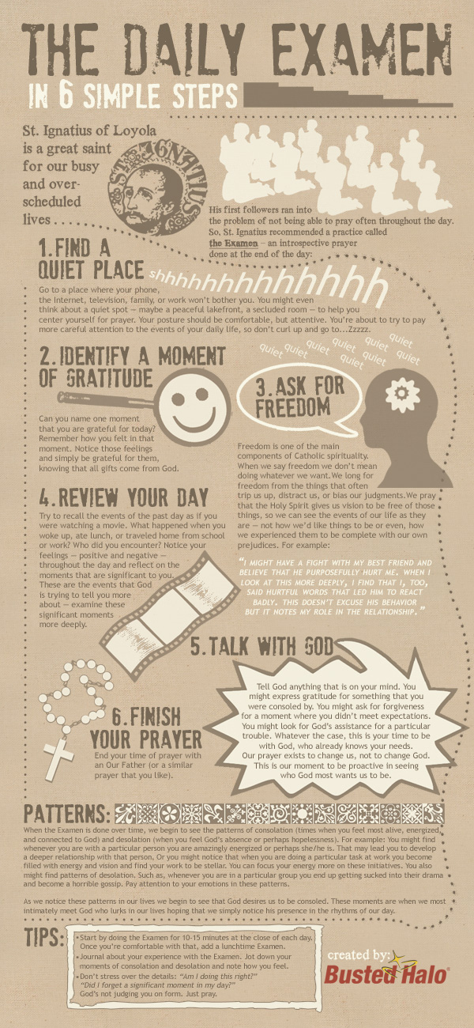
Versions of the Examen
THANKSGIVING How am I grateful for my kids today? How have they loved and supported me?
PETITION Before I review my day, I ask for clarity and honesty as I search for God and as I look at myself and my kids.
REVIEW From my interactions with my kids today.... What did my kids do or say that made me smile, laugh, or pause in joy? What did they do or say that challenged or frustrated me? How did I respond to my kids with love and patience? How did I respond to my kids out of frustration and impatience? When did I feel closer to them? More distant from them? Have I noticed God's presence in the midst of any of this? What might God be inviting me to consider when I reflect on these experiences in my family?
RESPONSE What is my response to God who is present in the life of my family?
A LOOK AHEAD As I consider my family's day tomorrow.... How can I be an instrument of God's love in my family tomorrow? How can I honor the gifts of my children more fully tomorrow?
Thanksgiving
What am I especially grateful for in the past day . . .
The gift of another day... The love and support I have received... The courage I have mustered... An event that took place today...
Petition
I am about to review my day; I ask for the light to know God and to know myself as God sees me.
Review
Where have I felt true joy today? What has troubled me today? What has challenged me today? Where and when did I pause today? Have I noticed God's presence in any of this?
Response
In light of my review, what is my response to the God of my life?
A Look Ahead
As I look ahead, what comes to mind? With what spirit do I want to enter tomorrow?
Hidden Inner Truths
(p14, Re-imagining the Ignation Examen)
I spend a few minutes in gratitude, thanking God for one or two blessings, big and small, that I have received today.
I ask God to reveal to me any hidden truths about any of the important relationships in my life.
If a striking revelation occurs to me, then I remain on that one hidden truth. Otherwise, I muse over the subconscious thoughts, feelings, attitudes.
When I settle on the one most important inner truth, I let go of all the others and have a conversation with God about this one reality in my life.
I note what emotion I am feeling with that one truth. What is the strongest emotion when I name this truth? I present to God that truth and that emotion.
I sit silently and I try to detect if God is trying to say or do something about this reality.
I make a commitment to God about this.
What was the high point of the day?
Can you discern a pattern in what constitutes high points? What can you do to increase the number and duration of these high points?
The low point of the day? look for reasons and patterns.
What would you do differently if you were given the chance for a “do over”?
When were you working at your best during the day?
What made it your best work? Were you working alone? With others? Who brings out the best (and worst) in you?
When did you struggle to stay focused and engaged?
What were you doing that challenged your focus? Was this an isolated incident, or is this something you deal with a lot of the time?
How hectic was the day?
Do you prefer to be busy and on-the-go all the time, or would you rather have more time to pause and reflect?
Look toward tomorrow.
Are you going to make any changes in your demeanor, communication styles, and attitudes?
Traditional
Video
App
Personal
Professional
Individual
Group
Departments
Committees
Friends
Family
Notes:
With-in the 5 steps, there is a lot of variation. Here are some examples of examens with different formats.

Slide 5
Examen Themes (examples)
Begin with a pause and a slow, deep breath or two; become aware that you are in the presence of the Holy. As I review the past 12 months, from a year ago through to the present moment - What am I especially grateful for this year?
An event that took place, Courage that I mustered, Love and support I received
I ask for the light to know God and to know myself as God sees me.
Where have I felt true joy this year? What troubled me this year? What has challenged me? Where and when did I find an opportunity for renewal and pause?
Have I noticed God's presence in any of this?
In light of my review, what is my response to the God of my life?
As I look ahead, to the coming months what comes to mind? With what spirit do I want to enter the next few months, the next year?
I ask for God's presence and grace, for this spirit, as I enter the next year
Ecological Examen by: Joseph Carver, SJ
All creation reflects the beauty and blessing of God’s image. Where was I most aware of this today?
Can I identify and pin-point how I made a conscious effort to care for God’s creation during this day?
What challenges or joys do I experience as I recall my care for creation?
How can I repair breaks in my relationship with creation, in my unspoken sense of superiority?
As I imagine tomorrow, I ask for the grace to see the Incarnate Christ in the dynamic interconnections of all Creation.
Conclude with the prayer of Jesus:
The glory that you have given me I have given them, so that they
may be one, as we are one, I in them and you in me, that they may
become completely one, so that the world may know that you have
sent me and have loved them even as you have loved me.
Ecology
Diversity
Lent
New Year
Begin with a pause and a slow, deep breath or two; become aware that you are in the presence of the Holy.
From my interactions with the people and world around me;
what experiences of my culture have I had today?
what experiences of other cultures did I have today?
How have I been enriched because of the experiences?
How have I been challenged?
Did these experiences cause me to feel closer to - or further from others?
Did these experiences cause me to feel closer to- or further from God?
What might God be saying to me through these experiences?
How can I honor the gifts of my cultural heritage tomorrow?
How can I honor the gifts of other cultures that God has bestowed upon me?
Notes:
Examens can also be written to focus on different themes, such as these example.

Slide 6
Reflection
Re-examining the Examen
For my Life and Work
Notes:
Now that we’ve looked at the form, formats, and some themes for the examen,
I’ll walk you through the process I took to write a personal exam.
I wanted an examen that would be broad enough to use every day, but have an element in it that was personal to me.
I have to say that writing my own examen was like an examen itself.

Slide 7
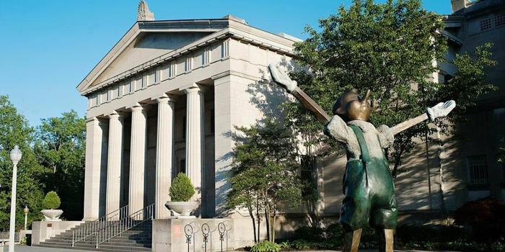
Cincinnati Art Museum
Docent
(volunteer educator)
Google Arts & Culture add-in:
every time you open
a new Chrome tab,
you see a work of art.
Notes:
Side Note (about me!)

Slide 8
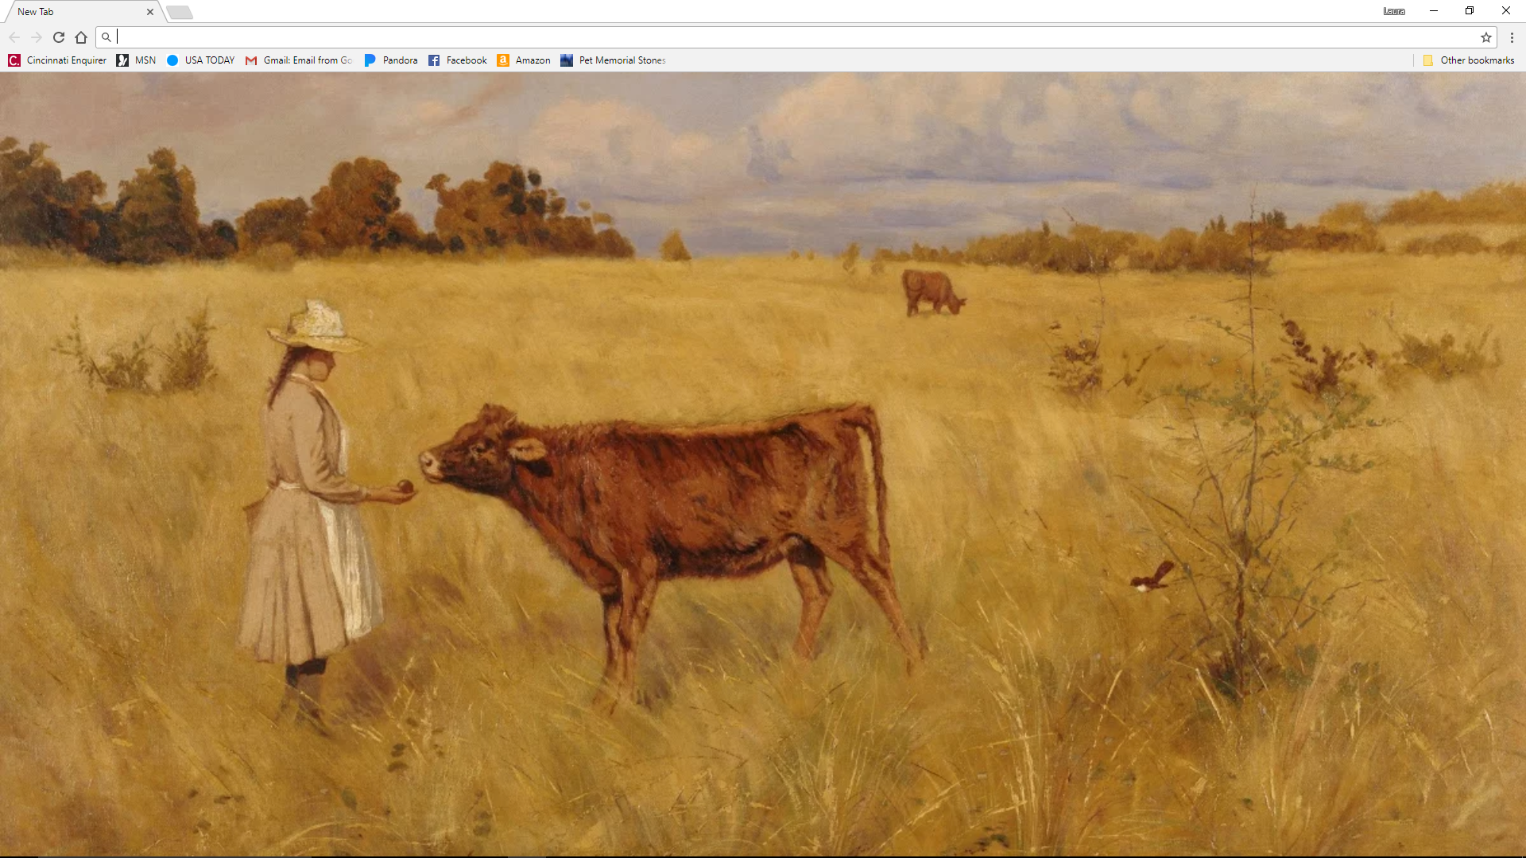
I take my time and LOOK at the art. I notice the style, the subject, the lines/shapes/colors/tones. I suss out the narrative, if there is one. I open my heart to see what this art has to tell me today.
What emotions are brought up as I notice?
I sit with those emotions, I pray about them. I pray for insight into their source and I pray for clarity as to their purpose.
I give thanks for the emotions, the insight, and any clarity I receive. I make a plan to integrate those emotions moving forward.
I notice what I notice. What is drawing my attention?
Notes:
The day I did this exercise with this painting was the day we learned that a co-worker had unexpectedly passed away.
It could have been the warmth of the colors, the interaction between the girl and the cow, or the bird perched on the branch. On that day, what I noticed was the sky.
Especially on the left, The sky is painted with much darker tones. And on the right, I imagined the clouds roiling across the landscape. I realized that I was feeling confused by my co-worker’s passing. My heart hurt, I couldn’t stop thinking, “I don’t understand.”
Opening my heart to the confusion and hurt, I tried to stay there, I tried to go outside myself to listen to the lesson waiting there.
I resolved how I was going to forward with my grief and confusion
An interesting note; Google Art add-in repeats. And when it has, I see different things. I find this is more of a reflection of what’s going on with me, than with the art itself.

Slide 9
Use this example, as well as the examples from Rosemary and Matt as Inspiration
To write your own examen

Slide 10
Write your own examen
Take about 5 minutes to find inspiration & form an idea.
Can be any style/theme
Can be done individually, or with others in the room such as departmental co-workers, committee colleagues, collaboration project co-workers, buddies.
For the subsequent 15 minutes, begin to write your examen.

Slide 11
Form of the Examen
Pray for light to understand and appreciate the past day.
Review the day in thanksgiving.
Review the feelings in the replay of the day.
Choose one of those feelings (positive or negative) and pray from it.
Look toward tomorrow
Relish
Request
Reflect
Repent
Resolve
Thanksgiving
Petition
Review
Response
A Look Ahead
From
Jesuitresource.org
“Resources for The Daily Examen” page
From
“Re-imagining the Ignatian Examen” book
From
Jesuitresource.org
Daily Examen card

Slide 12
Reflections
On the Examen?

