Slide 1
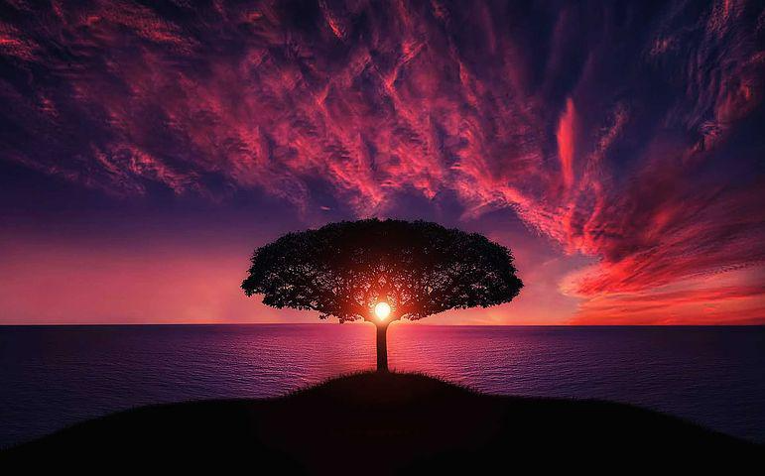
Opening:
Begin By taking Several Deep Breaths
Recall that you are in God’s Presence

Slide 2
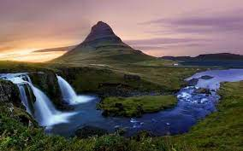
Reflection:
Spend Time Reviewing the Joys and Blessings of this day
Connection:
How did the interactions of the day make me feel?
What Feelings come up when Reviewing the Day?
What Memories of the day trigger the strongest emotions?

Slide 3
Intention:
What do I want to be Tomorrow?
How Can I become that person?

Slide 4
Direction:
As I look toward tomorrow, what invitations do I sense from God.

