Slide 1
AFMIX Assuring the Future Mission and Identity of Xavier
Review & Reflection

Slide 2
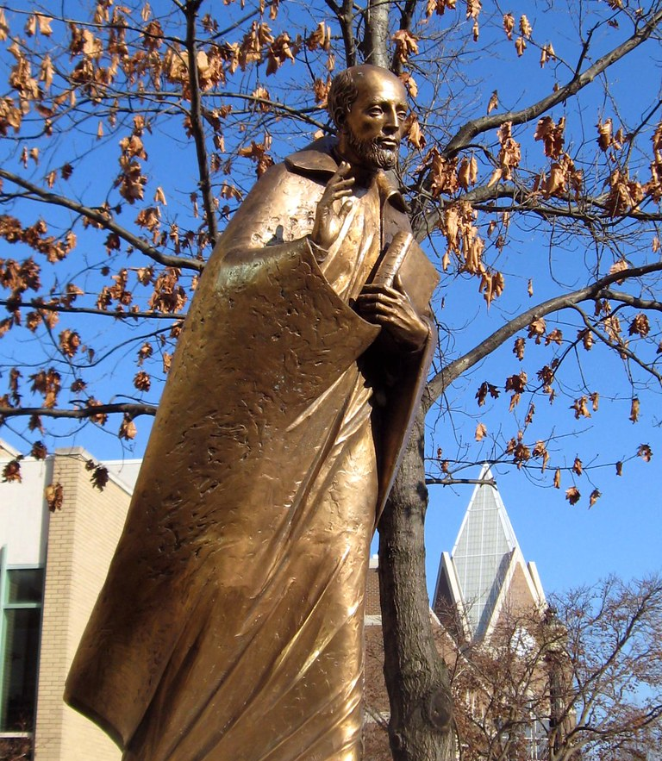
Xavier University Mission Statement
Mission Statement
Xavier is a Jesuit Catholic university rooted in the liberal arts tradition. Our mission is to educate each student intellectually, morally, and spiritually. We create learning opportunities through rigorous academic and professional programs integrated with co-curricular engagement. In an inclusive environment of open and free inquiry, we prepare students for a world that is increasingly diverse, complex and interdependent. Driven by our commitment to educating the whole person, promoting the common good, and serving others, the Xavier community challenges and supports all our members as we cultivate lives of reflection, compassion and informed action.
Accepted by the Xavier Board of Trustees on
December 1, 2017.
Xavier is a Jesuit Catholic university rooted in the liberal arts tradition. Our mission is to educate each student intellectually, morally, and spiritually. We create learning opportunities through rigorous academic and professional programs integrated with co-curricular engagement. In an inclusive environment of open and free inquiry, we prepare students for a world that is increasingly diverse, complex and interdependent. Driven by our commitment to educating the whole person, promoting the common good, and serving others, the Xavier community challenges and supports all our members as we cultivate lives of reflection, compassion and informed action.
Accepted by the Xavier Board of Trustees on
December 1, 2017.

Slide 3
An Opportunity… -to take a closer look at the essential values of the University, its purpose and direction.

Slide 4
An Exploration…
Discovery the history of Ignatius of Loyola and the Society of Jesus
An introduction to Ignatian Spirituality and Jesuit Education.
Jesuit Resources
Characteristics of a Jesuit Higher Education
Reflection
Prayer & Meditation
This Photo by Unknown Author is licensed under CC BY

Slide 5
An Examination…
Theology of God
Discernment
Sacred Writing
The Daily Examen
Ways to Pray

Slide 6
A Pause…

Slide 7
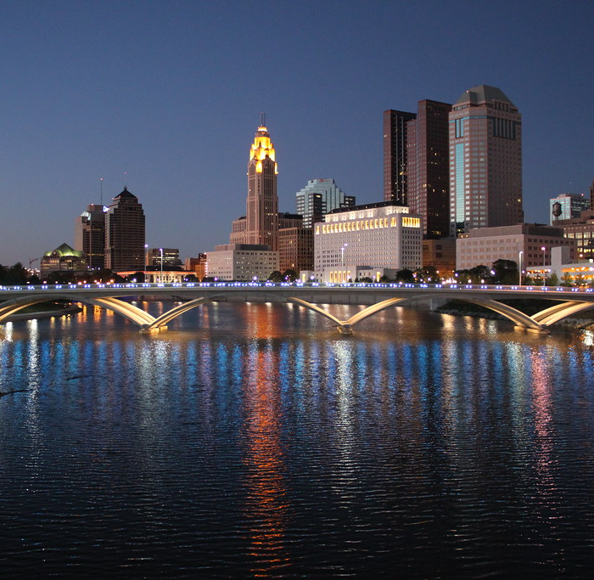
A Connection… Bringing satellite campus employees and remote employees together with main campus employees to meet and explore.

Slide 8
A time to Communicate…
Conversations
Collaboration
Community
Notes:
The hyperlink takes you to the orientation course for clinical faculty on Canvas. This is a form for keeping track of students’ key information for the contact.

Slide 9
An Exercise…
Spiritual Exercises
Reflection and Responses
Refresh and Renew
We Intentionally Live the Ignatian Spirit Through Our Work
Service Rooted in Justice and Love
Living the Magis

Slide 10
A blessing…
*Enriched
*Grateful
*Blessed
“How wonderful it is that nobody need wait a single moment before starting to improve the world.”
-Anne Frank

