Slide 1

Universal Web Design:
Easy Steps to Website Accessibility
Elaine Crable
Xavier University
Cincinnati, Ohio

Slide 2
Accessibility Agenda
The barriers and frustrations people with disabilities face with inaccessible websites.
Five Steps: How to make our academic website content more accessible to people with disabilities, and all users in general.

Slide 3
Accessibility
The internet is a place of equality. It can give us power and choice at the same level if accessible.
Tim Berners-Lee (founder of WWW) says the power of the web is in its universality ….access by everyone regardless of disability is its essential aspect.
Focus on the concept of Inclusion and supporting the underserved populations.
Law….

Slide 4
Law
Federal Rehabilitation Act of 1973
  Section 504
    Anti-discrimination law
  Section 508
    Applies to federal agencies and organizations with federal subsidies
Americans with Disability Act (ADA) of 1990
  For schools –same requirements for Section 504

Slide 5
Technology, Equality, and Accessibility in College and Higher Education (Teach) Act
11/15 – Legislation introduced in U.S. House requiring colleges to make instructional technology accessible to disable students.
Necessary to provide equivalent resources.
Notes:
Legislation introduced on Friday in the U.S. House of Representatives would require colleges either to make instructional technology accessible to disabled students or to provide them with equivalent, alternative resources.
Rep. Tom Petri, a Wisconsin Republican and senior member of the House education committee, said his bill would ensure that disabled students were given equal treatment as technology plays a larger and larger role in instruction. The bill is called the Technology, Equality, and Accessibility in College and Higher Education (Teach) Act.
The legislation also calls on the government to develop guidelines for electronic instructional materials used in higher education.
The National Federation of the Blind and the Association of American Publishers released a joint statement calling the legislation long overdue.
“Every day, blind college students face devastating setbacks to their education because of inaccessible technology,” Marc Maurer, president of the federation, said in the statement. “The use of e-readers, web content, mobile applications, and learning-management systems by educators is more prevalent than ever, and disabled students are being needlessly left behind.”

Slide 6
Growing Concern
56.7 million report a disability in U.S.
1 in 5 in U.S. have hearing loss
11% post secondary report disability
45% of1.6 million veterans seek disability
177,000+ veterans claimed hearing loss

Slide 7
Accessibility Advocates
Disability Rights Commission
  Percent of people who deal with a disability increases with age
  Increasingly more older Americans are using the Web
Administration on Aging
  20% of US population will consist of older adults by 2030
Web Accessibility Initiative (WAI) – W3C Guidelines http://www.w3.org/WAI/

Slide 8
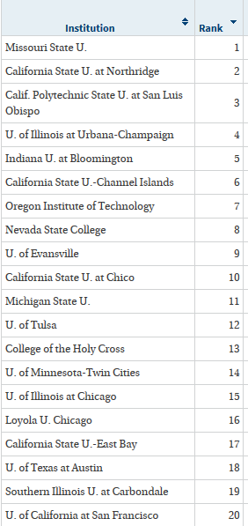
Best College
Web Sites

Slide 9
Accessibility ….
Accessibility is not…
  Text-only pages
  Separate accessible versions (except in multimedia)
  Boring
  Difficult
Accessibility is…
  Accessibility is about building web pages that can be navigated and read by everyone, regardless of disability, location, experience or technology.

Slide 10
What is web accessibility?
https://www.youtube.com/watch?v=cUhZf99qXjk

Slide 11


Web Accessibility
Nearly 1 in 5 Americans have some kind of disability.
The major kinds that affect web use include:
Visual – blind, low vision, color-blind
Hearing – deafness level
Motor – inability to use a mouse, slow response time, limited motor Cognitive – includes learning disabilities, unable to focus, PTSD

Slide 12
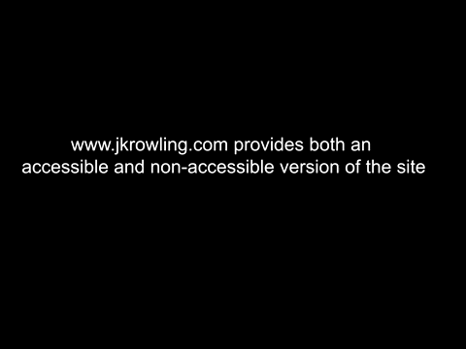
JAWS Demo Comparison

Slide 13
Accessibility Challenges
Deaf: Need captioning and/or transcript of audio for sound
Motor: People who don’t have use of their arms or hands sometimes navigate the web via the keyboard, hitting keys with a stick in their mouths.

Slide 14
Basic Accessible Design Principles
Provide appropriate alternative text
Caption video, provide transcripts for audio
Make file downloads (e.g., PDFs) accessible
Do not rely on color alone for meaning
Make sure content is structured, clearly written and easy to read

Slide 15
Some Beginning Steps to Accessibility
Create or update the following kinds of files to make them accessible:
  Microsoft Word
  Microsoft PowerPoint
  Adobe PDF

Slide 16
How To with Office……

Slide 17
MS Word – Accessibility Steps
Create Structured Documents
Use Style Attributes
Make Images Accessible
Make tables Accessible

Slide 18
1. Structured Documents
Create Main Headings and Sub Headings
(These provide summaries/sign posts)
New York | New York
Albany | Albany
Buffalo | Buffalo
Washington | Washington
Spokane | Spokane
Seattle | Seattle

Slide 19
2. MS Word and Styles
Chose a STYLE – certain attributes
  Set of commands controlling appearance of text
Benefits –
  Consistent/Professional docs
  Less Effort needed when creating docs
  Consistent appearance
  Clear navigation for reader
  Easily change appearance
  Automatically create Table of Contents

Slide 20
MS Word Style Exercise
Headings
  Type the Text of your heading
  HOME tab/ STYLES group - click heading want (or Customize one)
  Use STYLES rather than Bold/Font changes, etc.

Slide 21
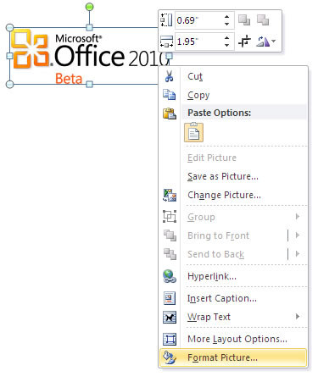
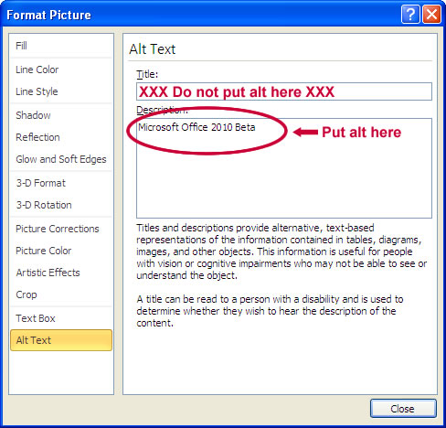
3. Word – Making Images Accessible
Provide text descriptions of any image
    Steps: 1. Highlight the image.
    2. Right click and select “Format Picture.”
    3. Select the “Alt Text” and enter your descriptive text

Slide 22
MS Word Styles/Headings/Alt Text
Demo

Slide 23
4. Word Table Accessibility
Insert Table Command
  (Provides info on relationship between Column headings and Row Values)
Salesperson | Salary | Expenses
Joe | $55,000 | $345
Mary | $61,000 | $234
Tom | $31,000 | $145

Slide 24
MS PowerPoint

Slide 25
PowerPoint Accessibility Steps
Provide the Presentation File to Students early
Don’t Overload Slides
Don’t Use Color to Convey Meaning
Alt Text for any graphics
Avoid over use of Animation
Use template when embedding information

Slide 26
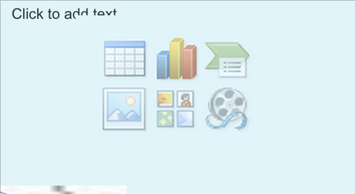
Use PowerPoint Templates

Slide 27
Checking Accessibility

Slide 28
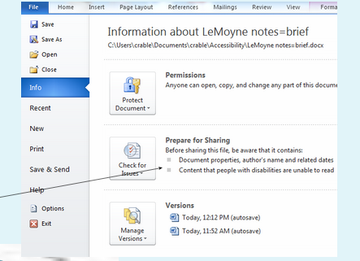
Checking MS files for Accessibility
File>Info>Check for Issues>Check Accessibility

Slide 29
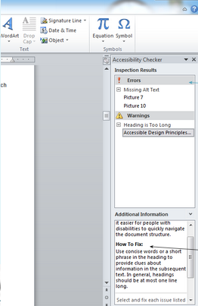

Slide 30
Demo Accessibility Checking in MS docs

Slide 31
PDF Accessibility

Slide 32
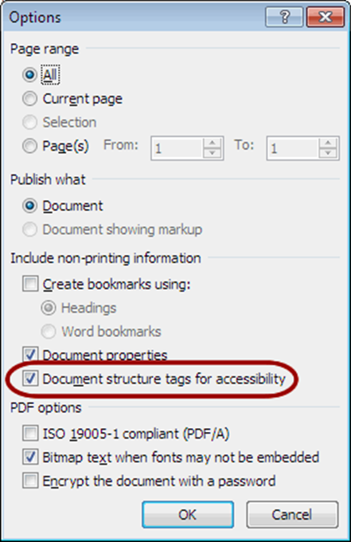
PDF Accessibility
To create truly accessible PDF files, you will need Adobe Acrobat Professional.
Substitute for Acrobat:
  MS Word and PowerPoint : File>Save As, PDF

Slide 33
Multimedia and Accessibility

Slide 34
Multimedia Accessibility
Transcripts of Audio
  Helpful for everyone
  No need to synchronize the text with the audio
Video Captions
  MAGpie Captioning
    Free software download from NCAM http://ncam.wgbh.org
  Camtasia by Tech Smith
  Youtube and add captioning (will need some editing)

Slide 35
Captioning YouTube Videos
Create your own narrated PowerPoint or mini lecture and post as a YouTube
Caption:
  Video Manager and click the drop-down menu next to the “Edit” button for your video
  Select Captions
  Click the Add captions button.
  Edit the captions
  How to Caption YouTube:
  http://www.youtube.com/watch?v=qYcj85tBje4
  http://www.youtube.com/watch?v=qbUcv3Bc61g

Slide 36
Learning Management Systems
Blackboard is constantly improving its Accessibility and has an Accessibility Team regularly improving Bb.
Canvas is considered “Gold” in Accessibility
Faculty responsible for the content regardless of LMS accessibility level. Docs and videos must be created to be accessible

Slide 37
References and Related Information on Accessibility
Accessibility Standards Summary: https://docs.google.com/document/d/1Kwq1EKQqhuLpXqedE6FwlgF6DpTolHVGKQW3YH1iA3w/edit
Coombs, Norman (2010) Making Online Teaching Accessible. John Wiley. San Francisco, Ca.
NC State Web Site Accessibility Scanning Service Tutorial http://www.youtube.com/watch?v=29kwPw0EO5I
WAVE Web Accessibility Tool http://wave.webaim.org/
Web Page Color Contrast: Web Accessibility Manual Checks http://www.youtube.com/watch?v=9rS6KIJ3bi4
Word Accessiblity Exercise https://drive.google.com/?pli=1&authuser=0#folders/0BxDsuAOzsD7sYjZmMmMxYzYtZjZlYy00OWYwLTgzNGQtZDUxY2Q4OTMxZTYy
Youtube captions: https://support.google.com/youtube/answer/2734796?hl=en

