Slide 1
Accessibility Agenda
What is web accessibility?
  http://www.youtube.com/watch?v=kziXJX6a7E4
  http://www.youtube.com/watch?v=2j2x2miPPDQ&feature=related (demo of JAWS )
Barriers and frustrations people with disabilities face with inaccessible websites.
Quick look at how to make website content more accessible to both people with disabilities, and users in general.

Slide 2
Accessibility
The internet is a place of equality. It can give us power and choice at the same level if accessible.
Tim Berners-Lee (founder of WWW) says the power of the web is in its universality ….access by everyone regardless of disability is its essential aspect.
Ignatian concept of Inclusion and supporting the underserved populations.
Federal Section 508 standards – ADA law

Slide 3
Accessibility is ….
Accessibility is not…
  Text-only pages
  Separate accessible versions (except in multimedia)
  Boring
  Difficult
Accessibility is…
  Accessibility is about building web pages that can be navigated and read by everyone, regardless of disability, location, experience or technology.

Slide 4


Web Accessibility
Up to 20% of Americans have some kind of disability.
The major kinds that affect web use include:
Visual – blind, low vision, color-blind
Hearing – deafness
Motor – inability to use a mouse, slow response time, limited fine motor Cognitive – includes learning disabilities, unable to focus

Slide 5
Barriers to Accessibility
Visual: Screen readers, read web page content aloud for people who have low or no vision.
  Simulation: www.webaim.org/simulations/screenreader-sim.htm
Deaf: Need captioning for sound.
Motor: People who don’t have use of their arms or hands sometimes navigate the web via the keyboard, hitting keys with a stick in their mouths.
Requires site design that allows for exclusive keyboard navigation…(try getting around a web page using just the keyboard, without using a mouse.)

Slide 6
Basic Accessible Design Principles
Provide appropriate alternative text
Caption video, provide transcripts for audio
Make file downloads (e.g., PDFs) accessible
Do not rely on color alone to convey meaning
Make sure content is structured, clearly written and easy to read

Slide 7
Some Beginning Steps to Accessibility
Create or update the following kinds of files to make them accessible:
  Microsoft Word
  Microsoft PowerPoint
  Adobe PDF

Slide 8
Word Accessibility
Word Style Headings
  Type the Text of your heading
  HOME tab/ STYLES group - click heading want (or Customize one)
  Use this rather than Bold/Font changes, etc.

Slide 9
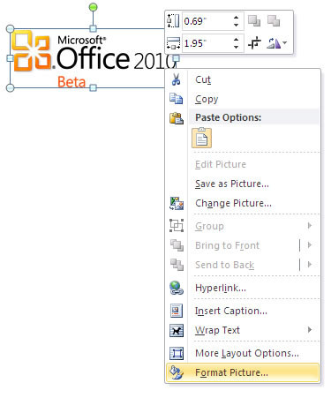
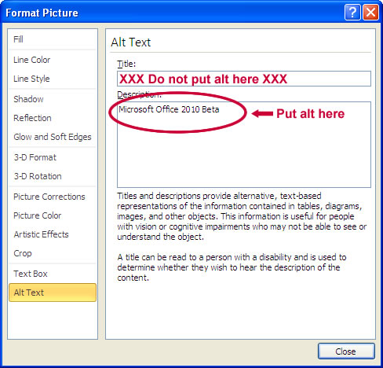
Word Accessibility
Provide text descriptions of any image
    Steps: 1. Highlight the image.
    2. Right click and select “Format Picture.”
    3. Select the “Alt Text” and enter your descriptive text

Slide 10
Word Accessibility
Use Word’s built-in style features for bullet and number lists provided in
HOME/PARAGRAPH
or
INSERT/ ILLUSTRATIONS/SMARTART

Slide 11
Word Accessibility
Links – After adding link, right click and “Edit Hyperlink” with descriptive text
Checking for Accessibility within Word
  File > Info>Check for Issues> Check Accessibility

Slide 12
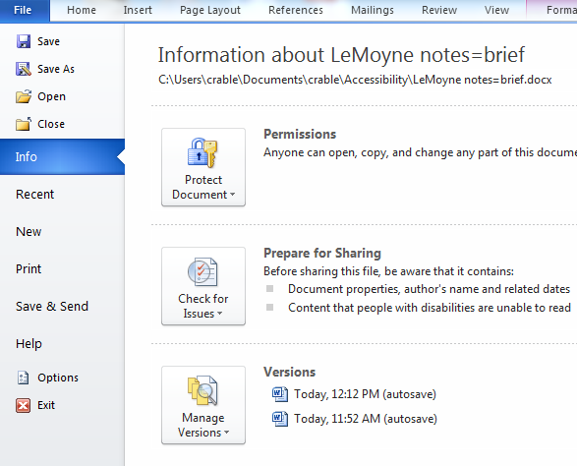

Slide 13
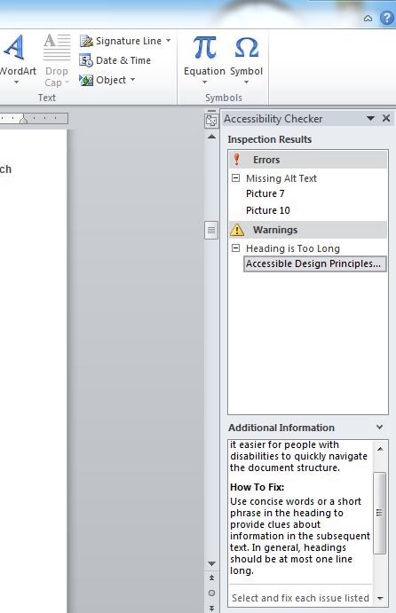

Slide 14
PowerPoint Accessibility
Provide the Presentation File to Students early
Don’t Overload Slides
Don’t Use Color to Convey Meaning
Carefully Select Colors and Fonts
Avoid Animation and Transitions
Embedded Content may not be Accessible-use template

Slide 15

Power Point Templates
Using the standard templates listed below increases accessibility use in the presentation


Slide 16
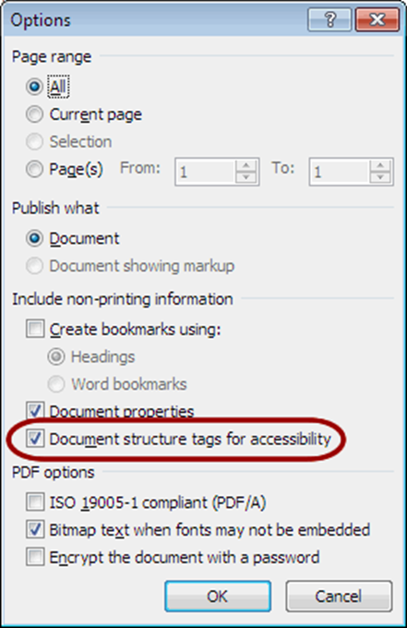
PDF Accessibility
To create truly accessible PDF files, you will need Adobe Acrobat Professional.
Substitute for Acrobat:
  MS Word and PowerPoint : File>Save As, PDF
    Before saving, select Options, Document structure tags for accessibility

Slide 17
Blackboard
BlackBoard is not as accessible as it could be…but getting better
Until then…
  …make sure any files (e.g., PDFs, Word, PowerPoint) you upload are accessible
  … do not use unnecessary graphics
  … keep number of ‘clicks’ to minimum
Just be AWARE…. And we will have universal accessibility

