Slide 1
Universal Apostolic Preferences
“The universal apostolic preferences seek to deepen these processes of personal, communal, and institutional conversion.”
Letter from Fr. General,
19 February 2019
Some Resources

Slide 2
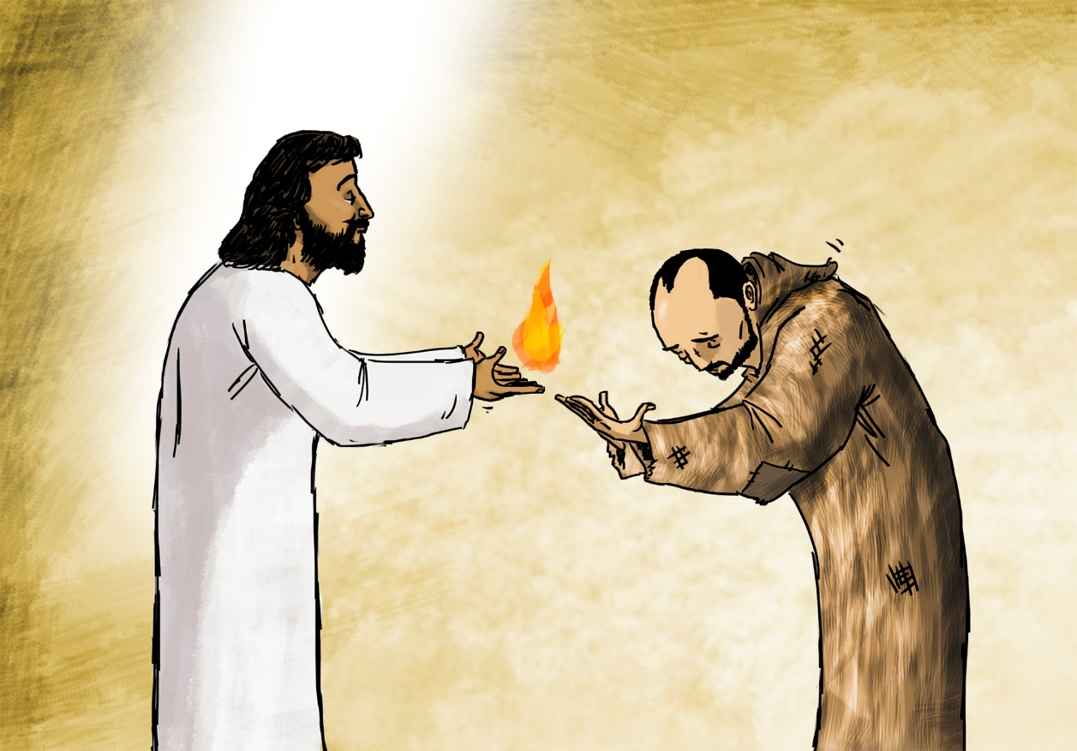
"Do not put new wine into old wineskins. Otherwise the skins burst, the wine spills out, and the skins are ruined. Rather, pour new wine into fresh wineskins, that both may be preserved.”
Matthew 9:17

Slide 3
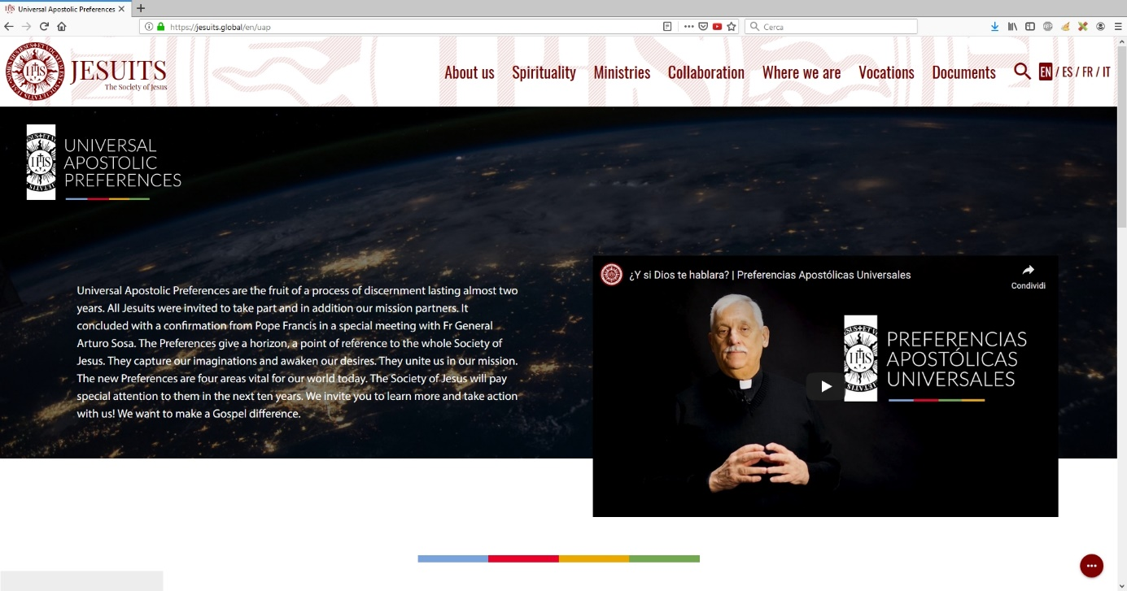
SJ Global Website
- UAPs section
Visit the SJ Global website

Slide 4
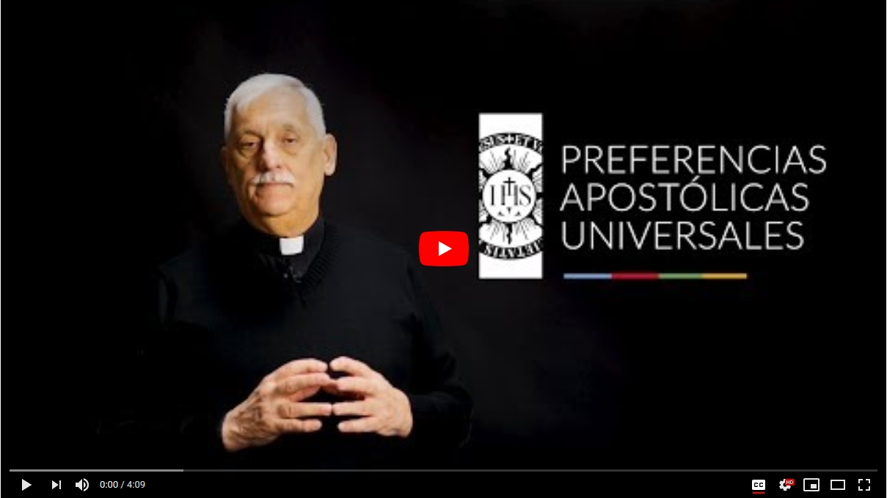
Video - Launch of the UAPs (4 min)
Fr. General talking passionately about the UAPs
Visit the YouTube SJ channel
Subtitles in Spanish, English, French, Italian, Polish, Japanese, Chinese

Slide 5
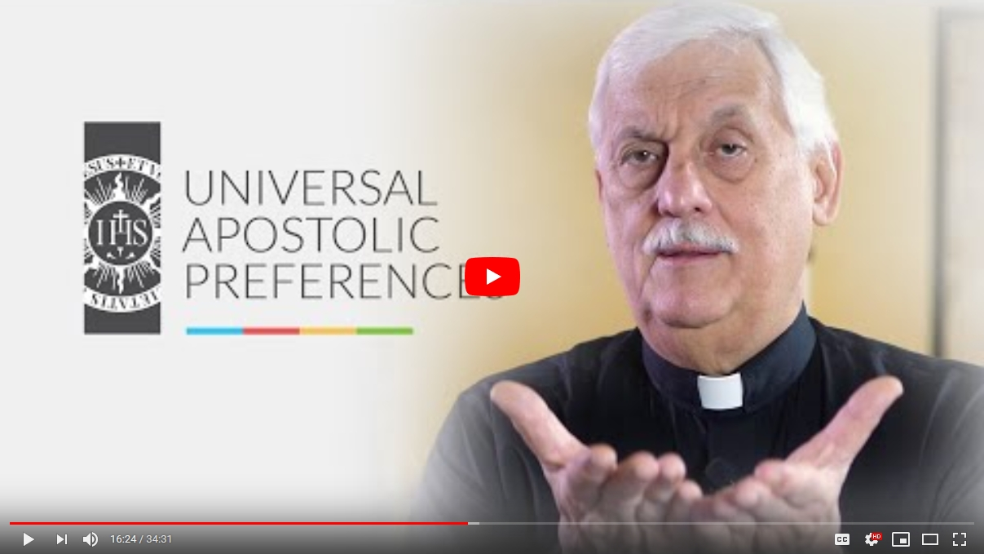
Video - Fr. General explaining the UAPs (30 min)
YouTube SJ channel, English version
YouTube SJ channel, Spanish version

Slide 6
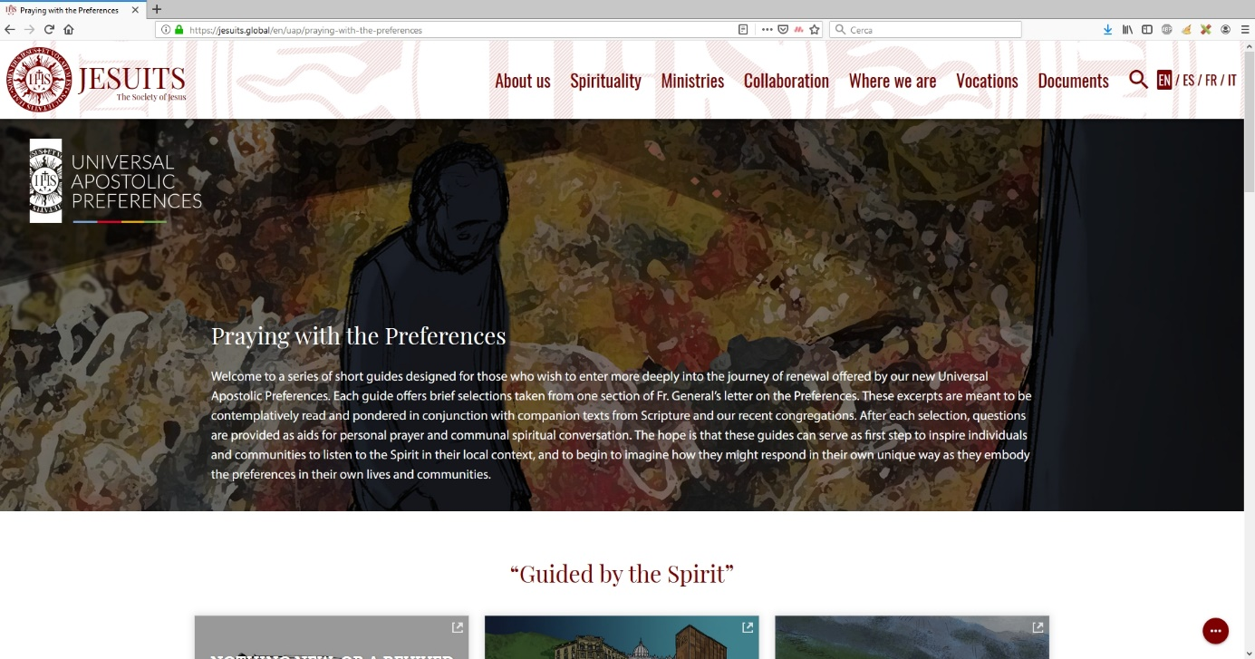
SJ Global Website
- Praying with the UAPs
A series of 7 short prayers on the UAPs, in 4 languages
More to come for
Advent 2019!
SJ Global website

Slide 7
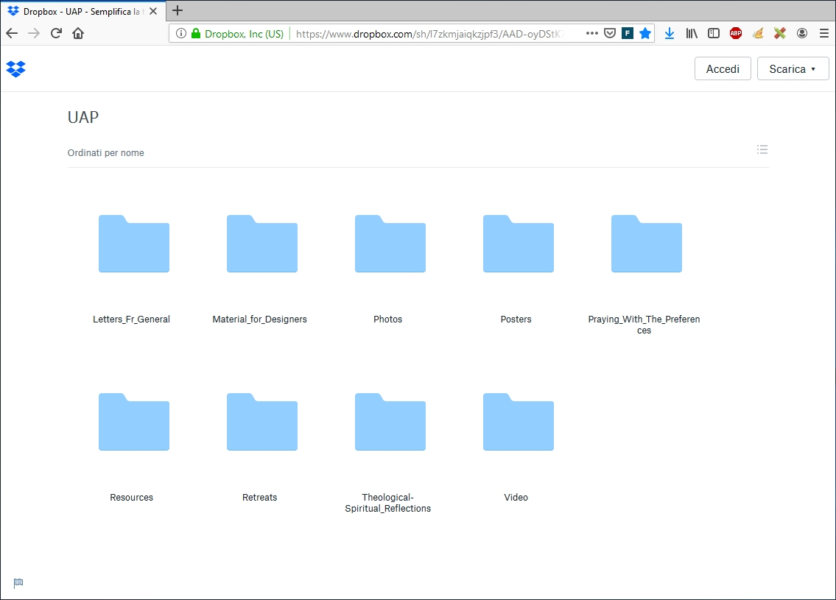
Dropbox repository
Repository with a range of UAP material from around the world
Dropbox

Slide 8
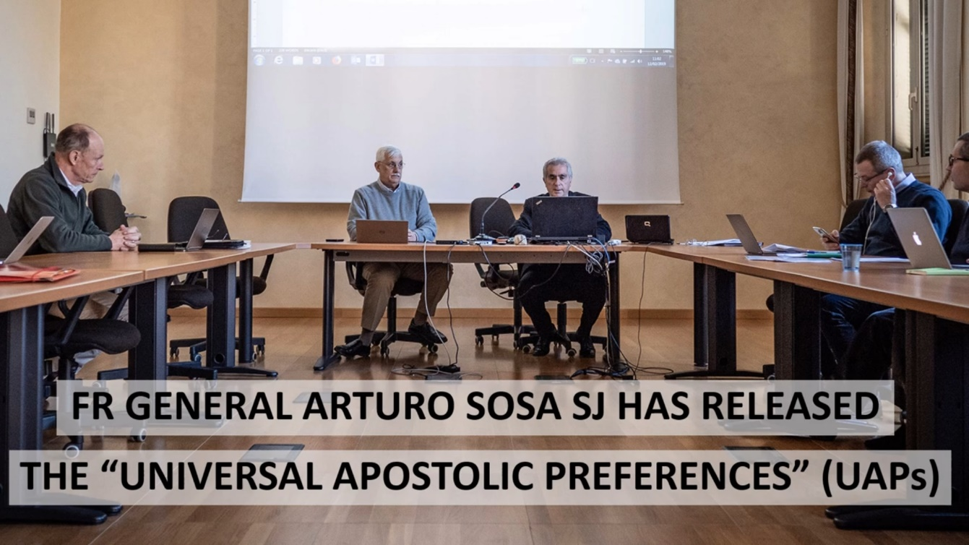
Video presentation for meetings
A video presentation about the UAPs
An invaluable tool for any meeting

Slide 9

Posters
Posters about the UAPs
Produced in English, Spanish, French and Italian
Customizable in any language
Available here

Slide 10
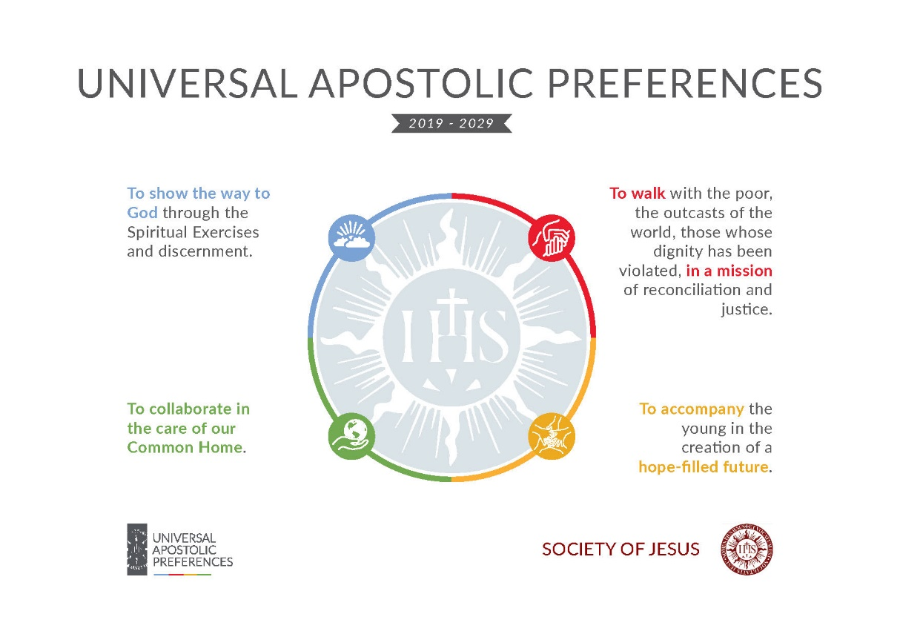
A4 posters/flyers
A4 posters resuming in
one page the UAPs,
for meetings
Produced in English, Spanish, French and Italian
Available here

Slide 11


UAP Logos
Feel free to download for your own use
Professionally designed
Available here

Slide 12

Special videos
Launch - November 2019
Contact Stefano (webmaster@sjcuria.org) and hear about the winning video formula we designed
Check regularly on our site for videos communicating the passion and the power of the UAPs

Slide 13

Social Media
Check our Facebook, Twitter, YouTube, Flickr
Updated regularly

Slide 14

Annuario
Special 2020 edition, with many fabulous articles on the UAPs

Slide 15
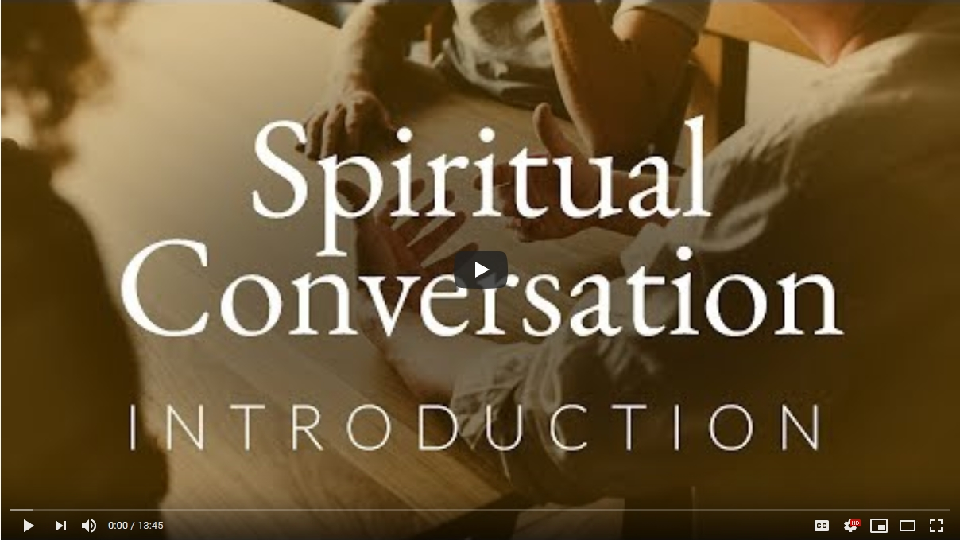
Upgrade your skills!
See a short video on
Spiritual Conversation, giving you the why, what and how
Click here

Slide 16
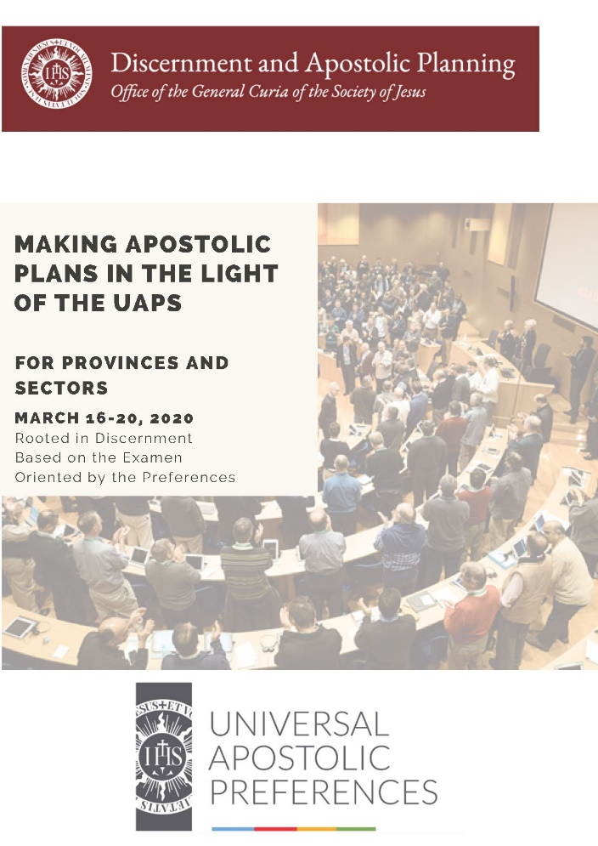
Move the UAPs forward
“Making Apostolic Plans in the light of the UAPs; a step by step guide”
For Major Superiors, Sector heads or their delegates
March 16 – 20, 2020 Rome
Learn from the experts, contribute your know how!
Contact Daniel Kenny
(dpa-apm@sjcuria.org)

Slide 17

Masterclass
“Apostolic Planning and the UAPs – A Road to Conversion”
A Masterclass style video course
Videos from selected experts
Coming Easter 2020 on the
DPA website

Slide 18

Have you more resources?
If you have developed any more resources for the UAPs
Please send them to Stefano
We need your help!

Slide 19


Slide 20

Communications Office
Curia Generalizia della Compagnia di Gesù

