Slide 1
Recruiting at Xavier University
Xavier University Career Development Office
Notes:
MS – Welcome and housekeeping items (remain on mute, put questions in the chat)

Slide 2
Discussion Points
Meet the team
XU Points of Pride
Handshake Overview
Employer Engagement Opportunities
Career Fairs
Mentor Programs
Employer Campus Presence
Next Steps

Slide 3
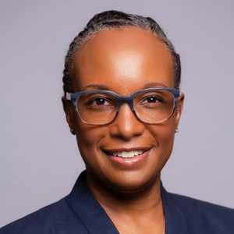
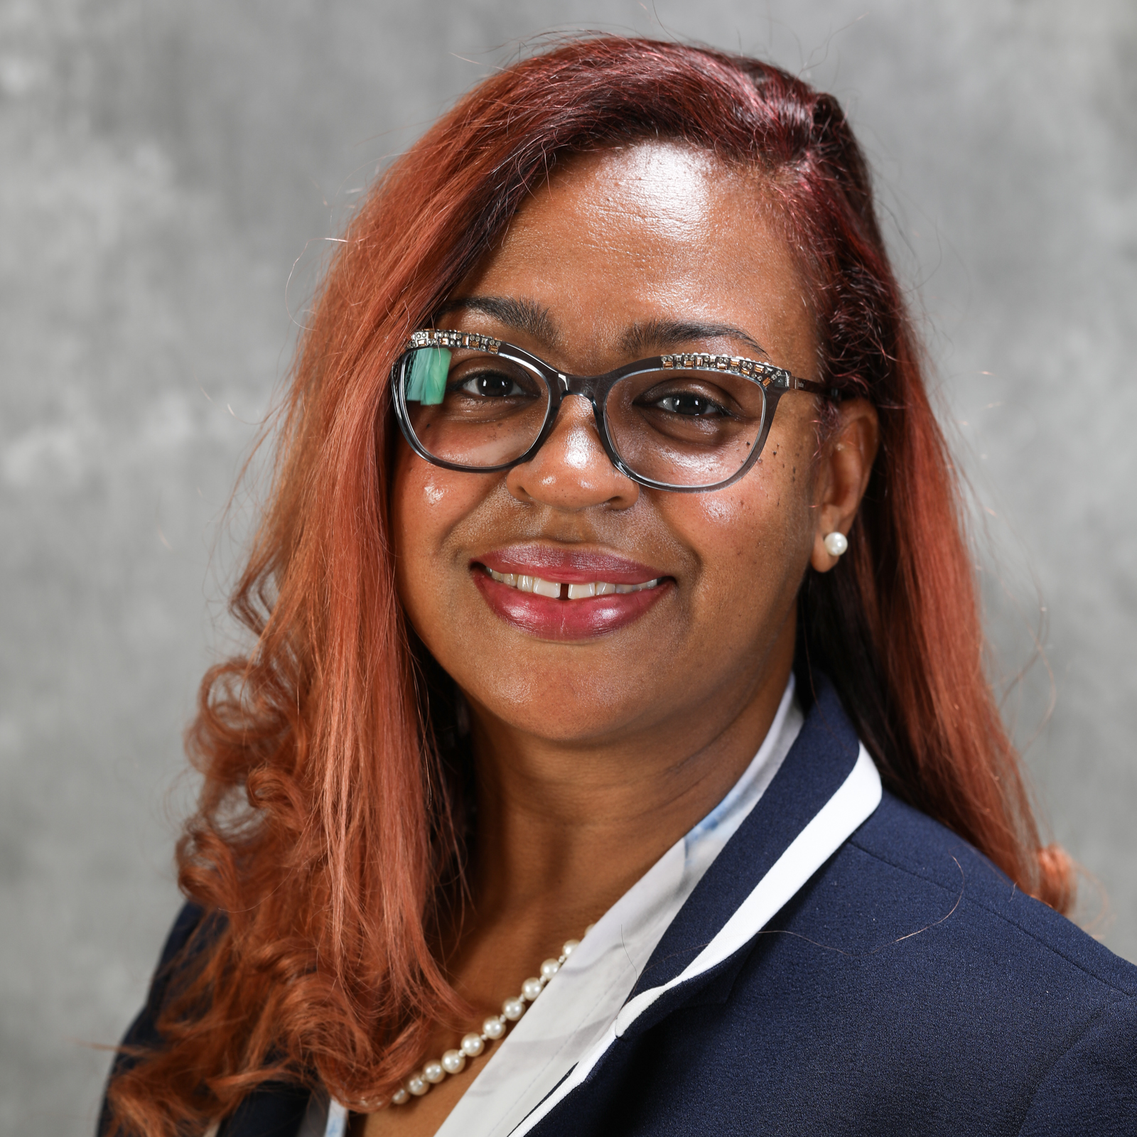
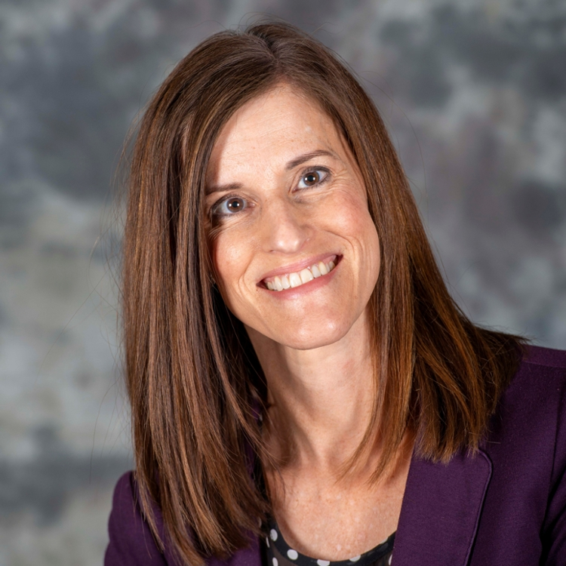

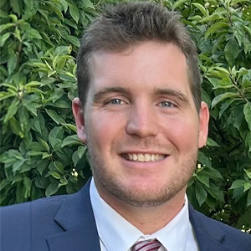


MEET THE CAREER DEVELOPMENT TEAM
Terri Carr, Ed.D
Director of Career Development
Matescia Stroud
Associate Director
Employer Relations
Heather Deters
Sr. Assistant Career Development
Alson McyAdams
Assistant Director
Nick Andriole
Assistant Director
Kurt Hollender
Assistant Director
Cheyenne Edo-Osagie
Assistant Director
Notes:
MS – kick off introductions, invite each team member to introduce themselves

Slide 4
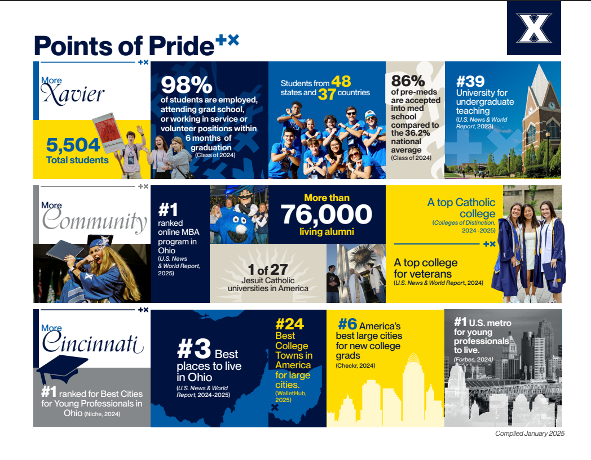
PHOTOS
CHOOSE A OR B
Notes:
MS

Slide 5
HANDSHAKE
Post internships and full/part-time jobs in a centralized platform.
Manage candidate applications; receive email notifications when applicants apply for your positions.
Submit campus recruiting requests; host virtual events
  Information sessions
  Pre-Interview nights
  Information tables
  Career Connections
Coordinate interview schedules and request on-campus interview space.
Register for career fairs and networking events
Connect with Xavier University on Handshake: xavier.joinhandshake.com
Notes:
MS (normally ER Grad Intern)

Slide 6
EMPLOYER ENGAGEMENT OPPORTUNITIES
Information Sessions, Pre-Interview Nights
On-Campus Interviews
Career Fairs
Networking Events
Resume Reviews
Mock Interviews
Workshops and panels
Notes:
MS

Slide 7

CAREER FAIRS
Inclusive Networking Event
Thurs, September 11, 2025 4:00 - 6:00 PM (ET)
Fall Career Fair
Wed, September 17, 2025 1:30-4:30 PM (ET)
All majors, all class levels, including alumni.
Internships and Part-Time Jobs Fairs
Oct 9, 2025/ Spring 2026 TBD 1:30 AM-4:30 PM (ET)
Spring Career Fair
TBD March 2026, 1:30-4:30 PM (ET)
All majors, all class levels, including alumni.
Southwest Ohio/Northern Kentucky Education Career Fair
TBD March/April 2026
Collaborative event among 6 area campuses.
Notes:
Cheyenne

Slide 8
MENTORING AT XAVIER
Professional Mentor Program
  Pairs students with an industry professional with 3+ years of experience
  Serves as a long-term mentor, guiding students in their career journey
  Open to sophomores and first semester juniors
Flash Mentoring
  Open to students of all class years
  Connect with industry professionals for one time conversations about careers, industries, needed skill sets, and more
Sign up to be a mentor at: xavier.edu/mentor
Notes:
Cheyenne

Slide 9
BUILDING YOUR ORGANIZATION’S PRESENCE AT XAVIER
Layered engagement
Planning ahead allows Career Development to help promote to campus community
Approachability, incentives, and personalized student outreach
Engage with Career Development social media accounts
  Recruiting videos, Instagram takeovers
Let us know when you hire Xavier students and alumni!
Notes:
Cheyenne

Slide 10
NEXT STEPS
Connect with Xavier University on Handshake: xavier.joinhandshake.com
Post your internships and jobs on Handshake
Register for this semester’s recruiting events
Request your information table/pre-interview night on Handshake
Request your interview schedule and host your interviews on campus
Sign up to be a mentor: xavier.edu/mentor
Notes:
Cheyenne

Slide 11
QUESTIONS
Please add your questions to the chat, or unmute yourself to ask.
Notes:
Cheyenne & Matescia monitor chat and pose questions

Slide 18
Replace with your image on the Master or delete this box to use this image.

