Slide 1

Demystifying Recruiting and Hiring International Students:
F1 Work Authorization Overview
Megan Lindle
Xavier University
Director, International Student and Scholar Services

Slide 2

Agenda
Myths vs. Truths
Benefits of Hiring
F1 work authorization
CPT, OPT, STEM OPT
Important Reminders
Resources
Xavier ISSS contacts

Slide 3
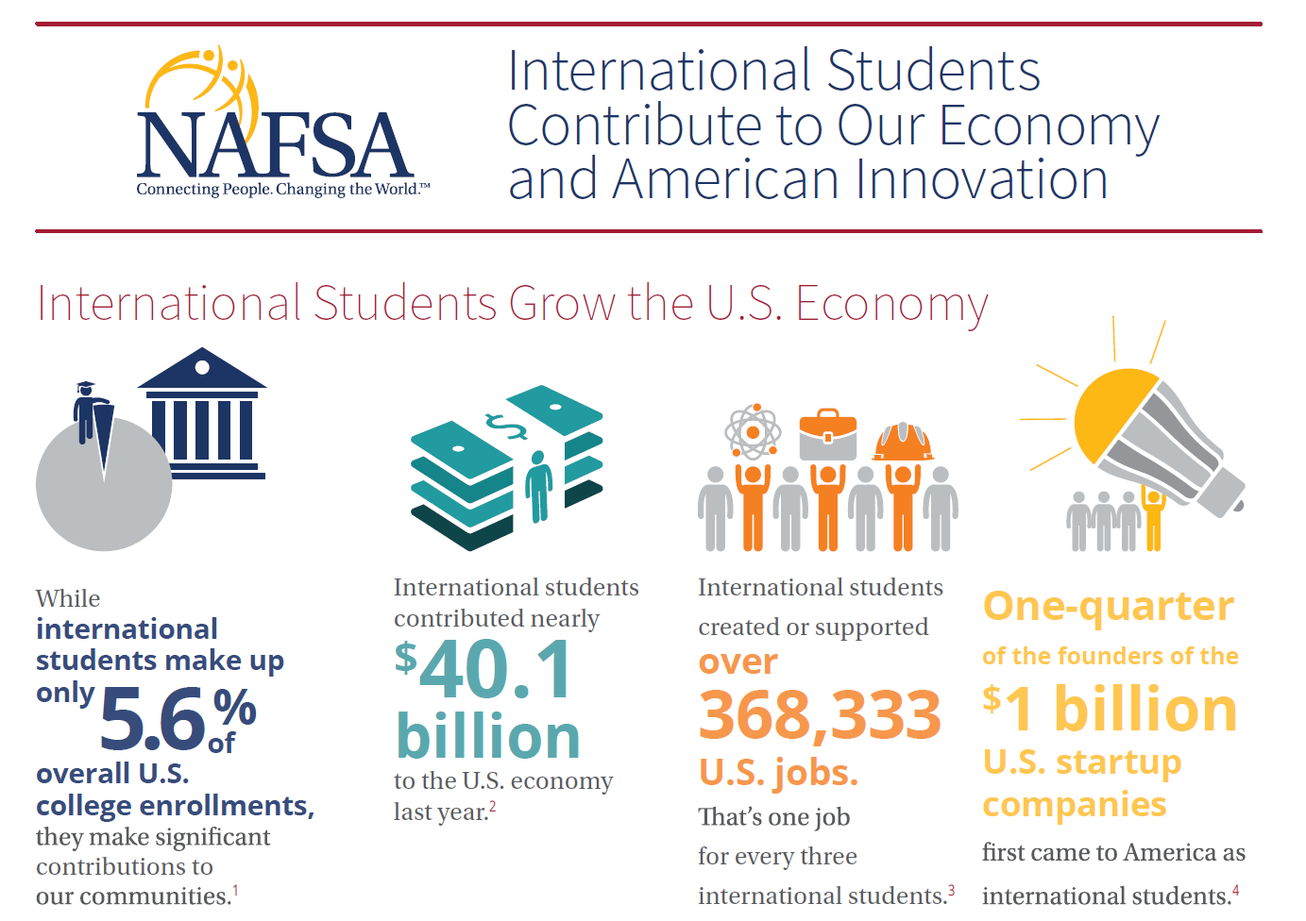
Ohio Statistics 2023-2024:
1.3 billion to economy
10,937 jobs supported
~36K international students enrolled

Slide 4
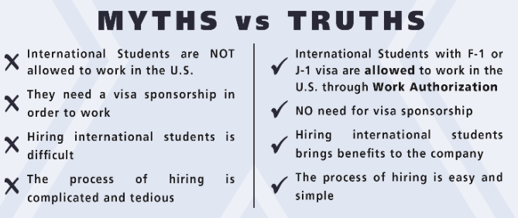
Myths vs. Truths

Slide 5

Benefits of Hiring International Student Interns
Access to diverse talent pool
Specialized skills and current knowledge
Cost-effective talent solution
Building pipeline for future talent
Simplified hiring process
Notes:
Here are the key selling points for employers considering students on CPT or OPT:
1. Access to a diverse talent pool
Global perspective and intercultural fluency: International students bring diverse cultural backgrounds and perspectives, enriching the workplace environment and fostering innovation.
Multilingual skills: Many international students are proficient in multiple languages, which can be invaluable for companies operating in a globalized market or serving diverse clientele.
2. Specialized skills and current knowledge
Up-to-date expertise: Students, particularly in STEM fields, often possess specialized skills and knowledge in the latest technologies and research, making them valuable assets to fill talent gaps.
Strong work ethic and adaptability: International students demonstrate strong motivation and adaptability, having successfully navigated a new educational system and cultural environment.
3. Cost-effective talent solution
No visa sponsorship required during CPT/OPT: Employers do not need to sponsor a visa or incur the associated costs during the CPT or OPT periods, notes the University Career Center.
Potential tax savings: Employers may be exempt from FICA taxes (Social Security and Medicare) for F-1 students classified as non-resident aliens for tax purposes.
Entry-level wages: Students are often willing to accept competitive, entry-level wages, providing a cost-effective staffing solution.
4. Building a pipeline for future talent
Evaluating potential hires: CPT and OPT offer a "trial period" for both students and employers to assess compatibility and performance before considering longer-term employment and potential visa sponsorship.
Long-term talent acquisition: Hiring students on CPT or OPT allows employers to identify and groom potential candidates for future H-1B visa sponsorship or other employment-based immigration options, according to Boundless Immigration.
5. Simplified hiring process
Reduced burden for employers: The responsibility for applying for CPT and OPT authorization primarily lies with the student, simplifying the hiring process for employers, states the University Career Center.
Support from universities: Universities' international student offices provide guidance and support to both students and employers, ensuring compliance with regulations.

Slide 6

F1 Student Work Authorization
F1 students are allowed to work legally, without sponsorship, through CPT and OPT work authorization.
CPT = Curricular Practical Training
  Approved by the student’s program and international office and takes place while they are still enrolled in school
OPT= Optional Practical Training
  Student’s international office helps them to apply and reviewed for approval by the U.S. government (USCIS) and typically takes place after graduation
J1 students are also allowed to work without sponsorship through academic training work authorization
  Student should school their international office for more information

Slide 7
CPT, OPT, STEM-OPT
Curricular Practical Training (CPT)
  Applying for CPT is the responsibility of the student (their program of study and international office will help)
  Student registers for course requirement
  Employer issues offer letter and/or completes the CPT Authorization form provided by the school
  Student can work part-time (20 or less hours/week) or full-time (more than 20 hours/week) in their field of study
    Full-time is more common during co-op semesters or summer breaks
  Student’s school updates I-20 immigration document with your company information and dates authorized prior to employment start date
  No limit to part-time CPT and is approved by semester(364 day limit for full-time)

Slide 8
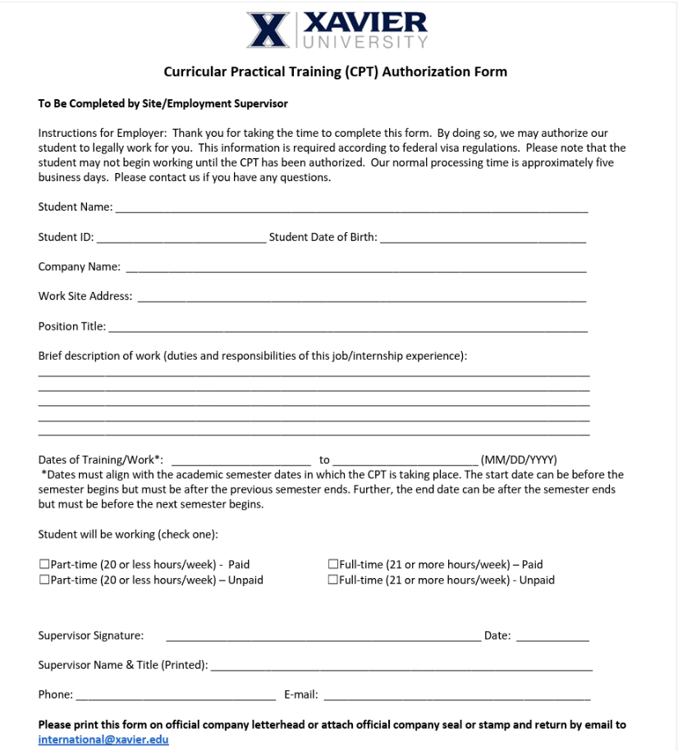
Xavier University CPT Authorization Form compliments initial offer letter and makes it easy on the employer while allowing student to meet immigration requirements.

Slide 9

CPT, OPT, STEM-OPT
Optional Practical Training (OPT)
  Part-time (20 or less hours/week) or full-time (more than 20 hours/week) in student’s field of study
  Student can apply up to 90 days before graduation or up to 60 days after graduation
  Work authorization for up to 12 months (may have 24 more months for STEM extension, if applicable)
  Student does not need a job offer in order to apply but will need to report a position within 90 days of start date

Slide 10
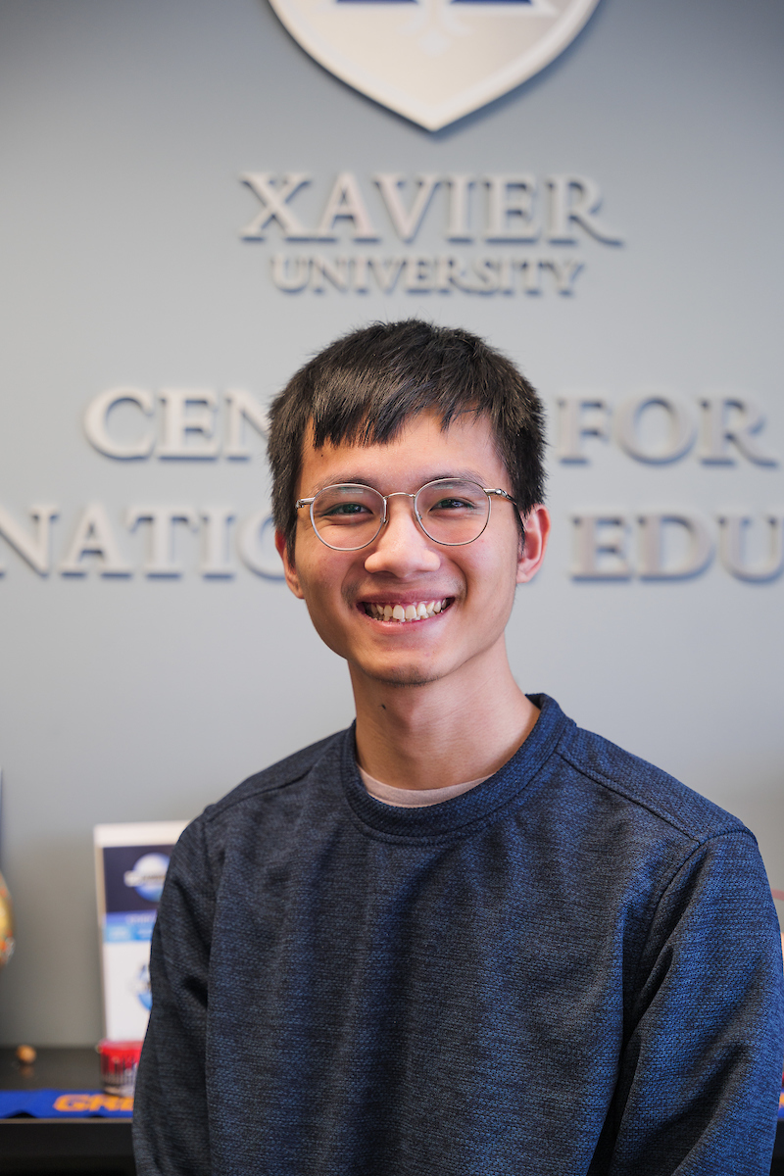
CPT, OPT, STEM-OPT
OPT- STEM Extension
  Graduated student may apply for 24-month extension of post-completion OPT if they received a qualifying degree in Science, Technology, Engineering and Mathematics (STEM) fields
  Must be employed by an employer who is enrolled in and is using E-Verify; and
  Received an initial grant of post-completion OPT employment authorization based on their STEM degree.
  Follow work plan developed by employer
  May be eligible to use previous STEM degree (must have received degree from currently accredited and SEVP-certified institution, have not already utilized STEM extension previously, and position directly related to previously obtained STEM degree)

Slide 11
Important Reminders
Comply with immigration regulations
  Adhere to rules governing CPT and OPT and contact ISSS office with any questions
Collect and review I-9 and supporting documents, prior to start date, including (but not limited to):
  Social security number
  I-20 document that shows work authorization approval on 2nd page
  EAD card (shows work authorization period for OPT)
  Passport copy
  I-94 copy
If hiring for STEM OPT, employer must participate in E-Verify
Notes:
Important considerations for employers:
Compliance with immigration regulations: Employers must adhere to the specific rules governing CPT and OPT, including ensuring the employment is directly related to the student's major and maintaining proper documentation, says GreenCardMaker.com.
E-Verify enrollment for STEM OPT: Employers hiring STEM OPT students must be enrolled in the E-Verify program, notes USCIS.
Potential for future sponsorship: While not immediately required, employers should be prepared to consider sponsoring highly-performing employees on CPT or OPT for longer-term work visas after the CPT or OPT period expires, notes Boundless Immigration.
By understanding these advantages and responsibilities, employers can effectively leverage the talent and potential of international students on CPT and OPT, contributing to their company's growth and success while fostering a more diverse and globally-minded workforce.

Slide 12
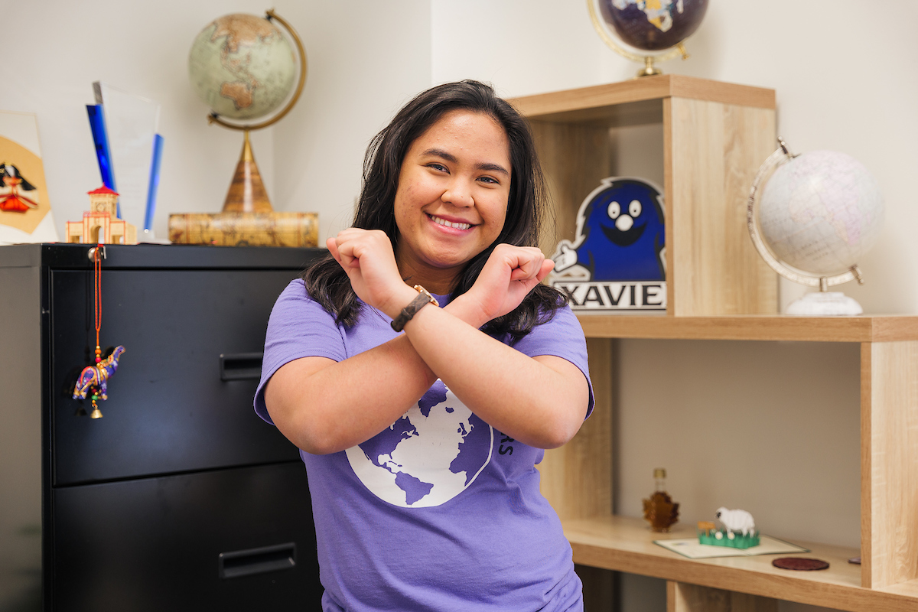
Resources
Study in the States (SEVP resource)
  https://studyinthestates.dhs.gov/sevis-help-hub/student-records/fm-student-employment
Handshake and XU Career Development Office (CDO)
  https://www.xavier.edu/career/handshake
  https://www.xavier.edu/career/employers/index
Xavier International Student and Scholar Services
  https://www.xavier.edu/international-students/current-students/employment-information
Interstride
  https://interstride.com/employers/

Slide 13
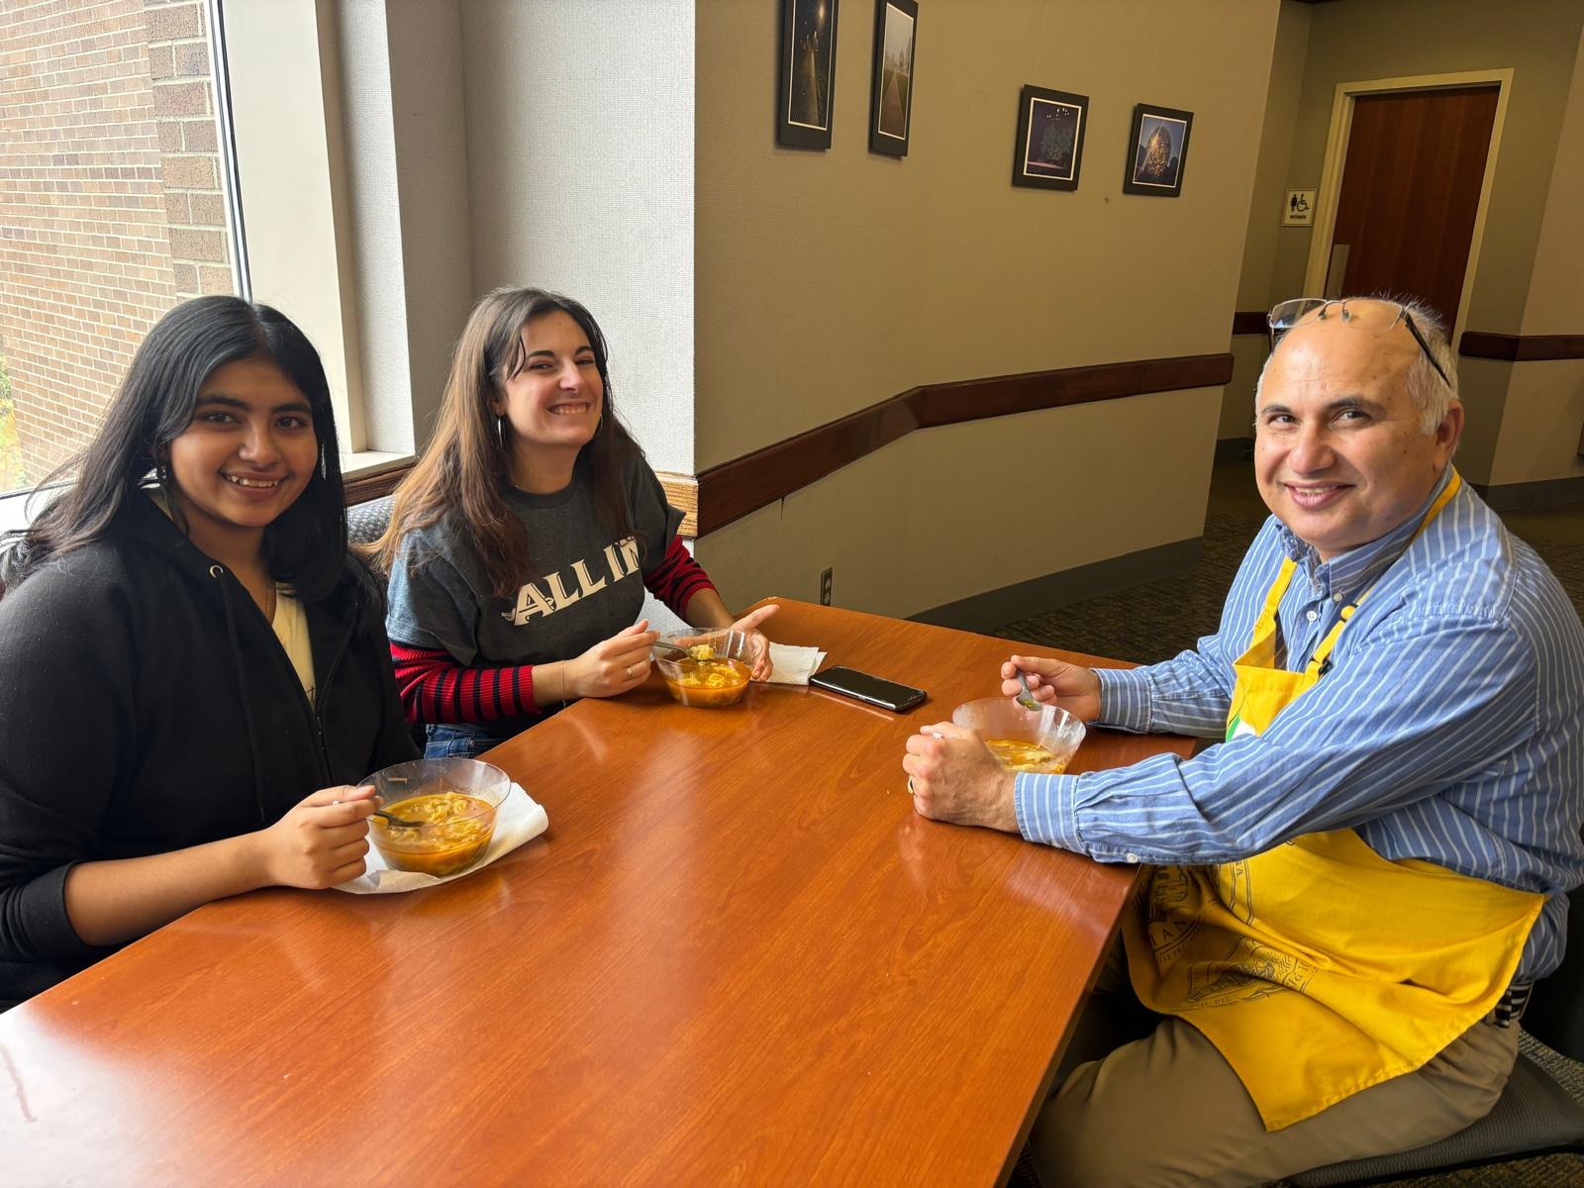
Resources
Partnership Opportunities:
Cincinnati USA Regional Chamber of Commerce
  Networking events
    CINC – Cincinnati Intern Network Connection
  International Chambers
Cincinnati COMPASS
  Networking events
Greater Cincinnati World Affairs Council
African Professional Network (APNET)

Slide 14
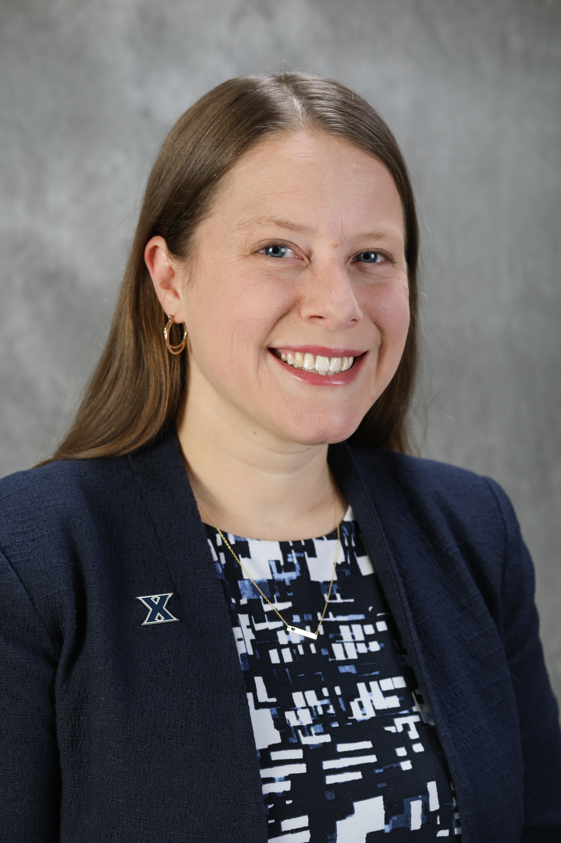
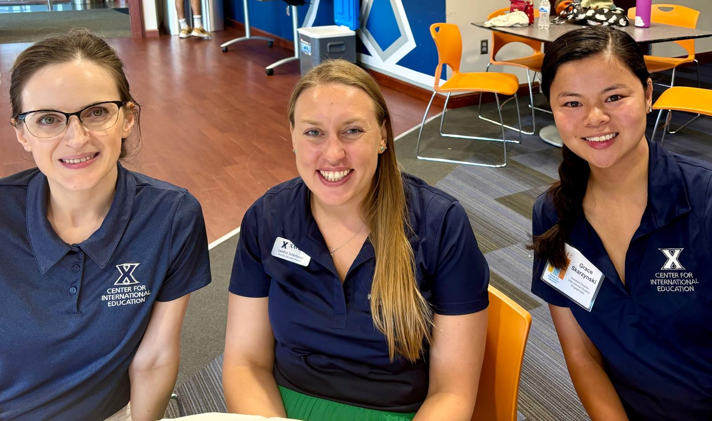
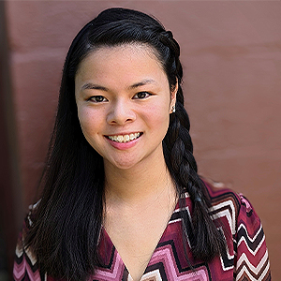
XU International Student and Scholar Services Contacts
Megan Lindle
Director, International Student and Scholar Services
lindlem@xavier.edu
Grace Skarzynski
Assistant Director, International Student Engagement
skarzynskig@xavier.edu
Socials:
@xuinternational
QUESTIONS?

