Slide 1
XAVIER UNIVERSITY CENTER FOR
INTERNATIONAL EDUCATION
INTERNATIONAL STUDENT AND SCHOLAR SERVICES
TAX WORKSHOP

Slide 2
AGENDA ITEMS!
Paying for Tax Code
Disclaimer
Introductory Concepts
Federal Tax Return Basics
State Tax Return Basics
Deadlines
Sprintax
Q&A
Disclaimer
Introductory concepts
Federal tax return basics
State tax return basics

Slide 3
Payment for Tax Code (Sprintax)
Credit Card payment: $5
https://commerce.cashnet.com/CIE
Send email with payment receipt, to international@xavier.edu
Cash payment: $5
Drop off cash payment to CIE front desk, in envelope that lists your full name on the front
After making payment for the code, you will receive an email from ISSS with your Sprintax code and instructions along with a copy of our slides from the Tax Workshop presentation.
Please note: Those who already paid today will receive their code and email today.

Slide 4
DISCLAIMER
Xavier University and CIE staff cannot complete or review your tax filings.
You, as a student, is solely responsible for the proper completion of your tax filings.
As part of this responsibility, it is highly recommended that you refer to official IRS and state filing instructions.
The aim of this presentation is to provide you with a general understanding of tax principles as they apply to international students and as such, is for information purposes only. Each one of you have a unique tax position and so you are responsible for your own tax determination and compliance. Xavier does not offer legal, accounting, or tax advice and services, and recommends students consult a tax advisor for individual tax advice.

Slide 5
INTRODUCTORY CONCEPTS
Nonresident vs resident alien
F and J students are nonresident aliens for the first 5 years in the US
J non-students (Scholars) are nonresidents for the first 2 years in the US
  This counts prior history (if you entered the country prior to being a student
  The A and G visas are always nonresident (ambassadors and other diplomats)
  If you don’t fall under any of these categories, you don’t have to be here ☺

Slide 6
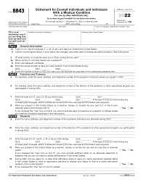
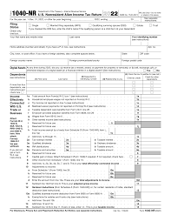
FEDERAL TAX BASICS
Federal Forms for nonresidents
Form 8843
Form 1040NR or Form 10NR-EZ

Slide 7




WHO MUST FILE
Received taxable earnings or income over $0 in previous tax year (received a W2 or 1099 form)
Received a taxable stipend, grant or allowance in previous tax year (received a 1042S form)
Everyone must complete Form 8843 – irrespective of income or days of presence.

Slide 8


TYPES OF INCOME
Other Income?
Employment
Scholarship covering costs other than tuition and tuition related
Expenses (merit-based or athletic scholarships that cover):
  Room and board
  Stipend
Investment income/Crypto
Other Income?
Gambling winnings
Focus group – gift card
Rental income (over 14 nights)
Selling art/design works
All reportable

Slide 9

NON TAXABLE
INCOME
Scholarship for ONLY tuition and related expenses (merit-based/Athletics)
Scholarship received from outside the US
Money transferred from parents/relatives overseas
Income ‘earned’ in their home country (investment income, rent, job before moving to US, etc.)
Interest on regular savings account

Slide 10
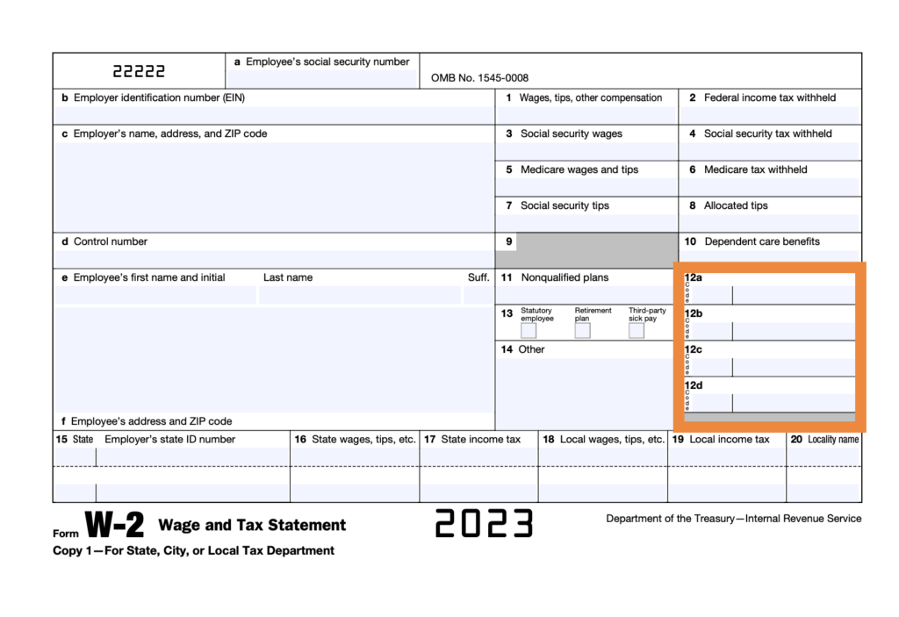

INCOME
Income documents nonresidents may receive at the end of the tax year
W2
DOCUMENTS
Outlines Wages, Salary, Compensation from the entire year (Employment Earnings)
1042-S
Fellowship / Taxable Scholarships / Non-Degree Aid
Income exempt by a tax treaty
Royalty Payments
Prize/Award/Miscellaneous foreign payments
1099 Series
Xavier Prizes and Awards
Rental income
Investment Income
Independent Contractor Services and Commissions

Slide 11
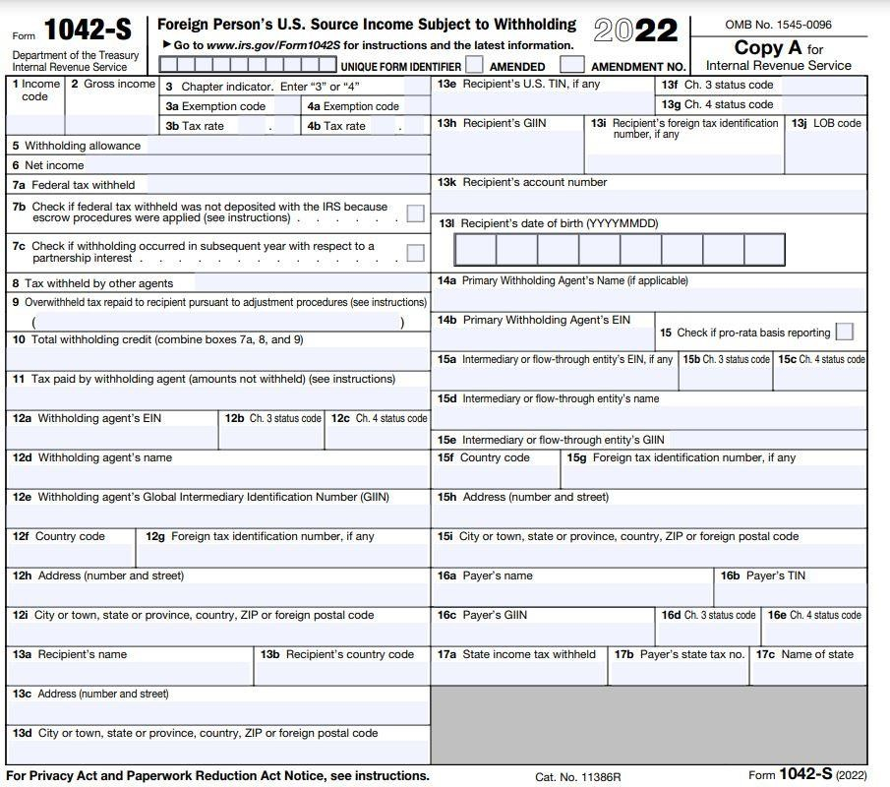
INCOME
Income documents nonresidents may receive at the end of the tax year
W2
DOCUMENTS
Outlines Wages, Salary, Compensation from the entire year (Employment Earnings)
1042-S
Fellowship / Taxable Scholarships / Non-Degree Aid
Income exempt by a tax treaty
Royalty Payments
Prize/Award/Miscellaneous foreign payments
1099 Series
Xavier Prizes and Awards
Rental income
Investment Income
Independent Contractor Services and Commissions

Slide 12
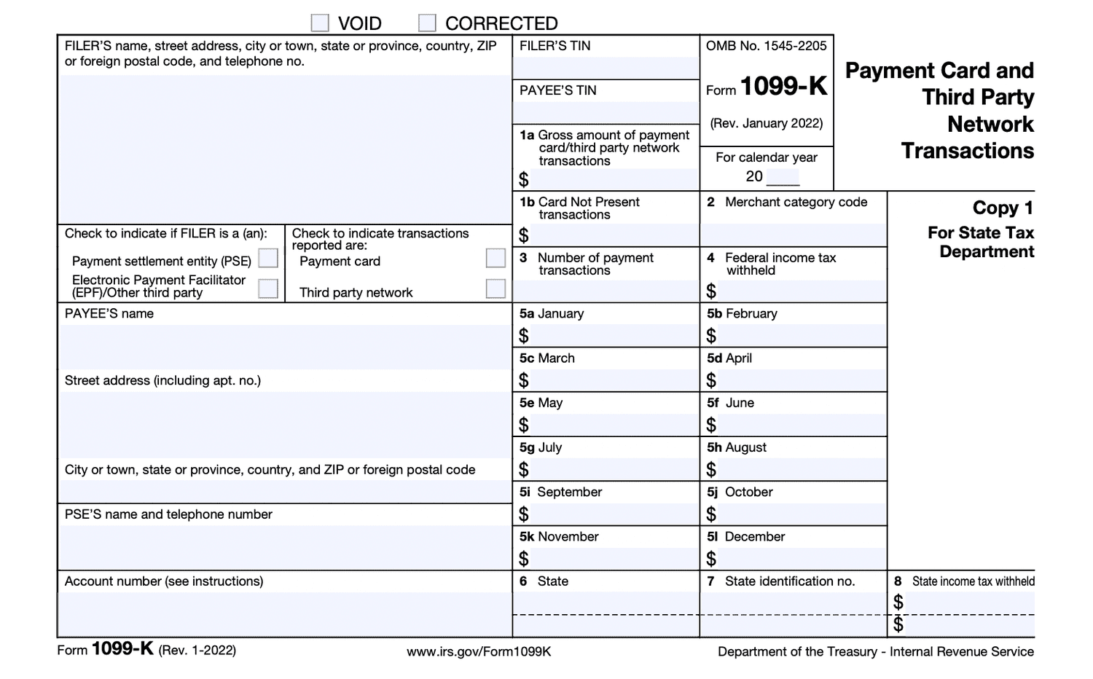
INCOME
Income documents nonresidents may receive at the end of the tax year
W2
DOCUMENTS
Outlines Wages, Salary, Compensation from the entire year (Employment Earnings)
1042-S
Fellowship / Taxable Scholarships / Non-Degree Aid
Income exempt by a tax treaty
Royalty Payments
Prize/Award/Miscellaneous foreign payments
1099 Series
Xavier Prizes and Awards
Rental income
Investment Income
Independent Contractor Services and Commissions

Slide 13
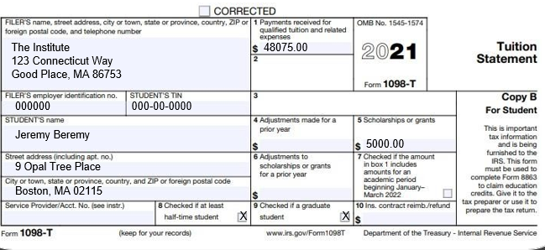
1098-T
Mostly used to claim education tax credit
Significant cause of misfiling for nonresidents
Not relevant for tax nonresidents
Sometimes - all students with an SSN on file with their school will get one, even nonresidents, so it can cause a lot of confusion!
www.sprintax.com

Slide 14
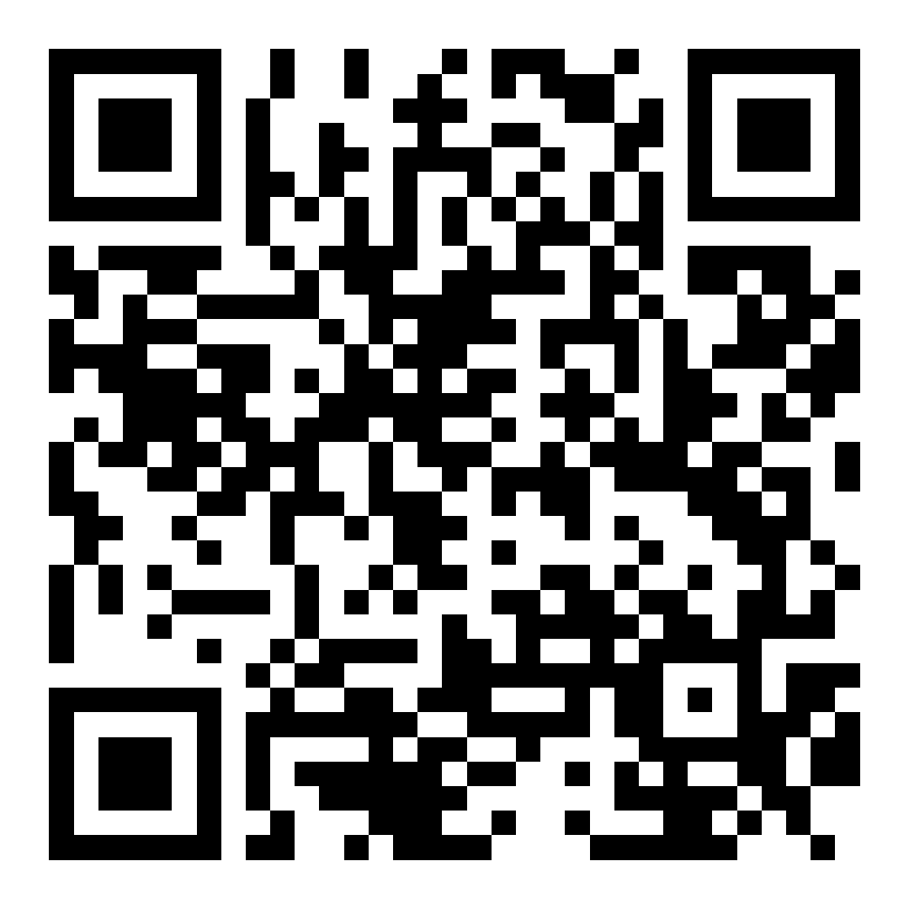
FEDERAL
REQUIREMENTS
FORM 8843
https://www.irs.gov/pub/irs-pdf/f8843.pdf

Slide 15
STEP BY
STEP GUIDE

Slide 16
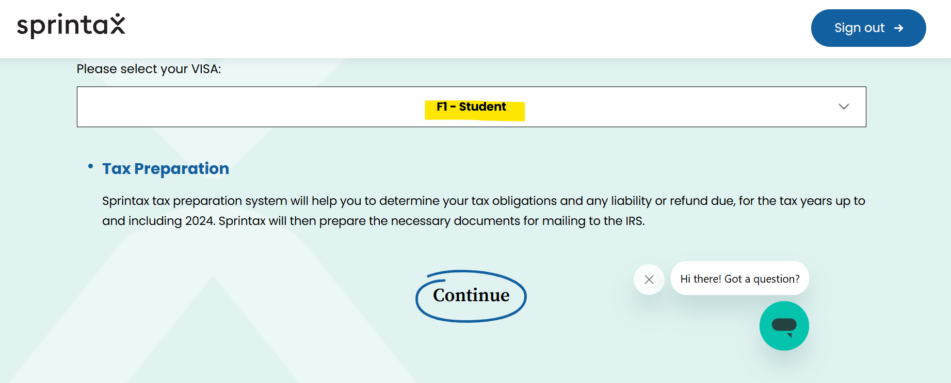
LOGGING IN
WELCOME
Create log in (if first time user) and choose your visa type.

Slide 17
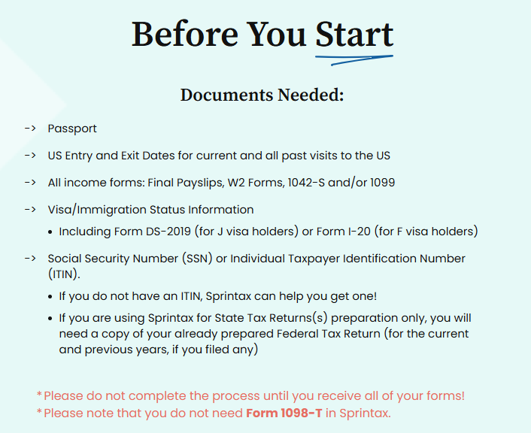
GETTING STARTED
WELCOME

Slide 18
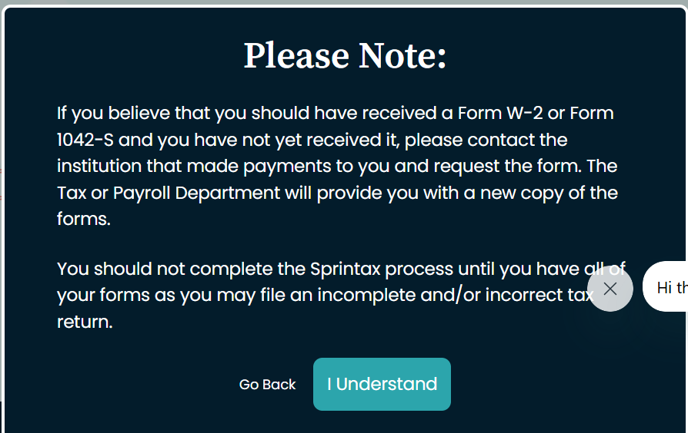
REQUIRED DOCUMENTS
WELCOME

Slide 19
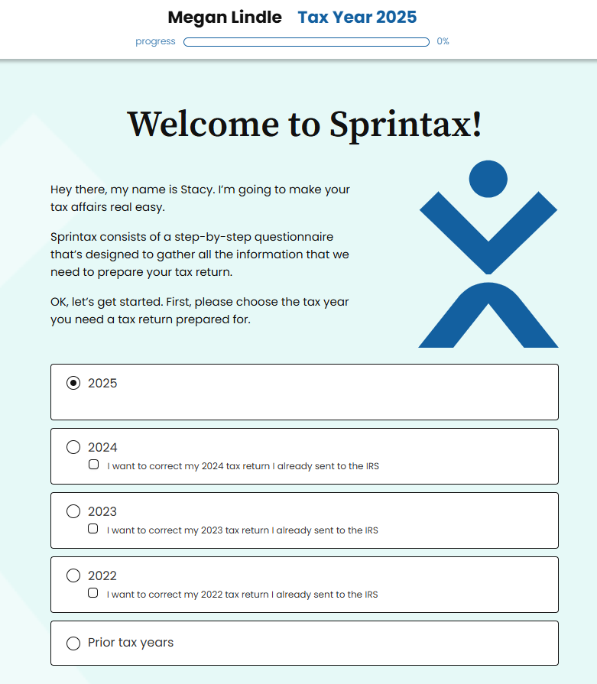
STEP 1
WELCOME
Remember: Choose the year that you are filing your taxes for.
You typically will be filing for the previous year. For example: If you are filing for the April 15, 2026 Tax Filing Deadline, you will be filing for the 2025 tax year and all documents should list that year.

Slide 20
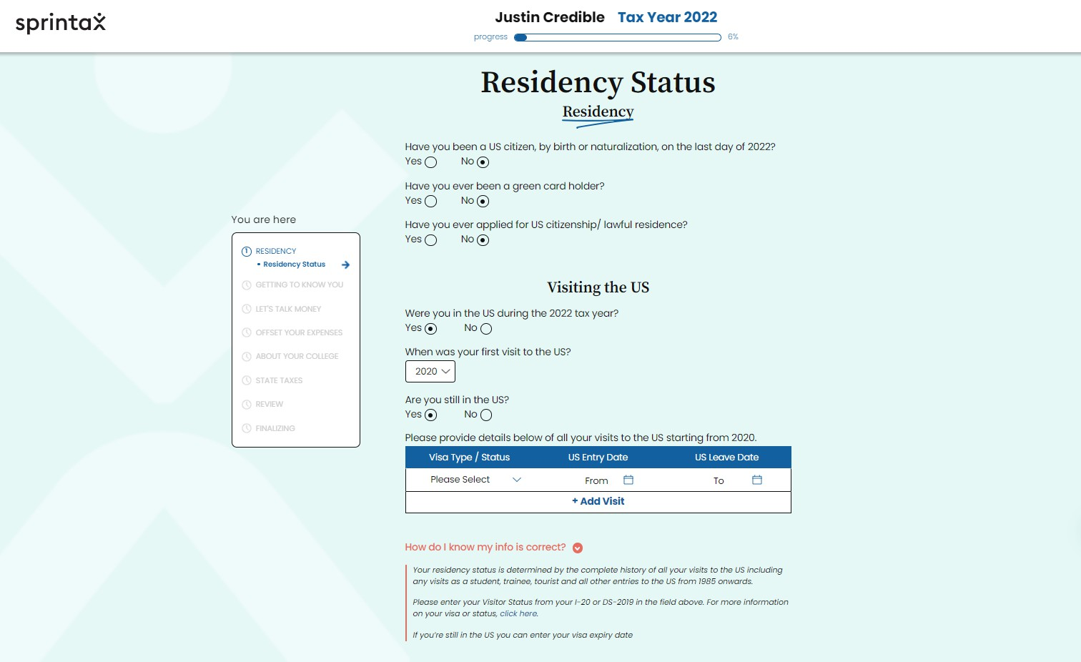
STEP 2
RESIDENCY DETAILS
Include all information for all visits to the U.S. (tourist visa, student visa, etc.)
Select "view travel history" on your I-94 record by entering your passport information here: https://i94.cbp.dhs.gov/home

Slide 21
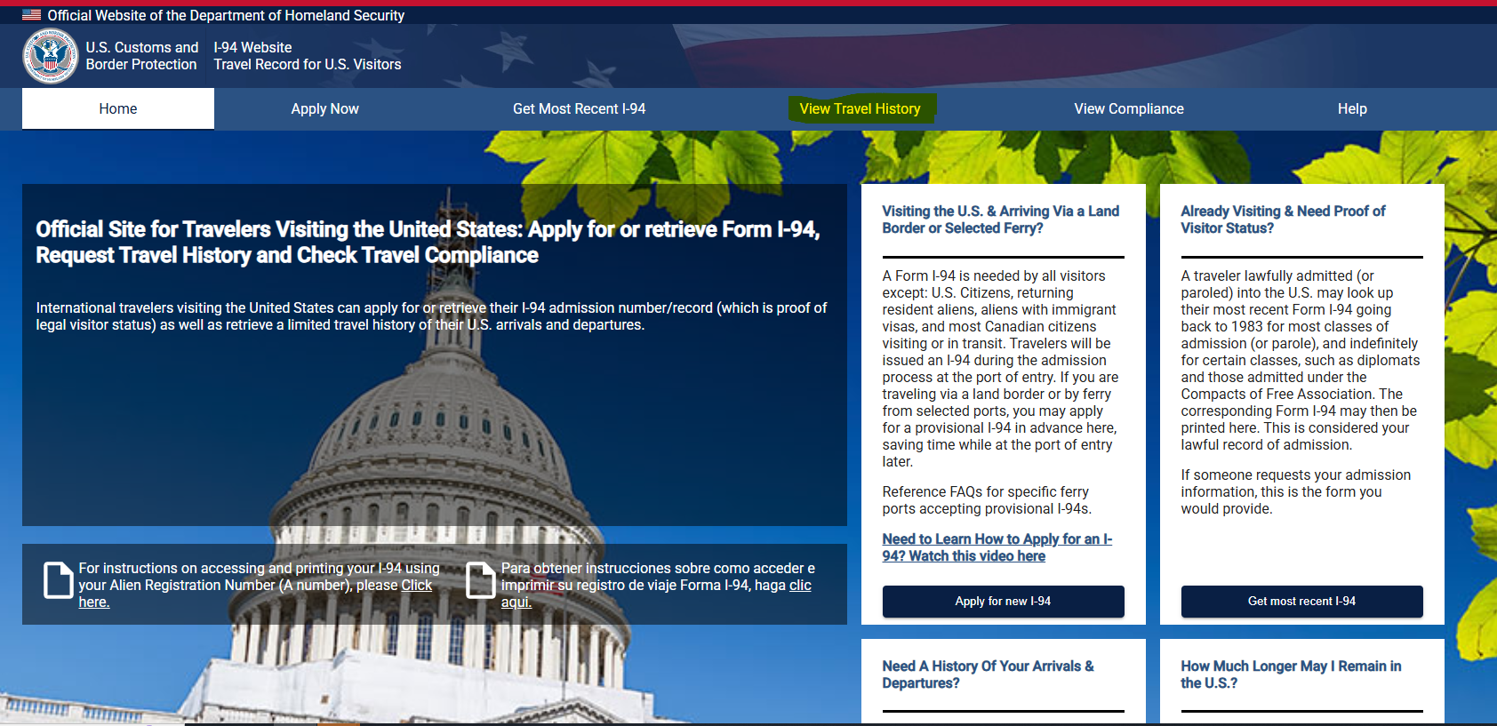
I-94 Travel History
View Travel History
https://i94.cbp.dhs.gov/home
Select "View Travel History"
Input Passport information

Slide 22
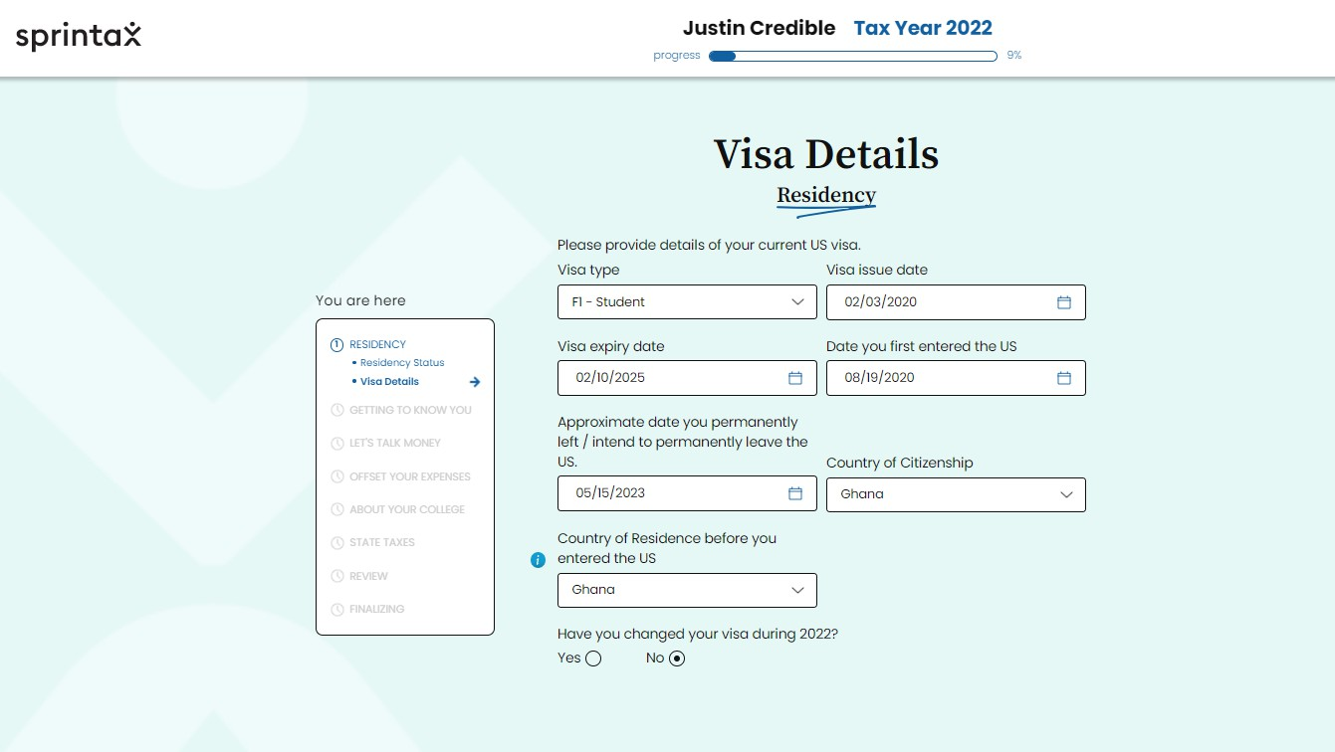
STEP 3
VISA DETAILS

Slide 23
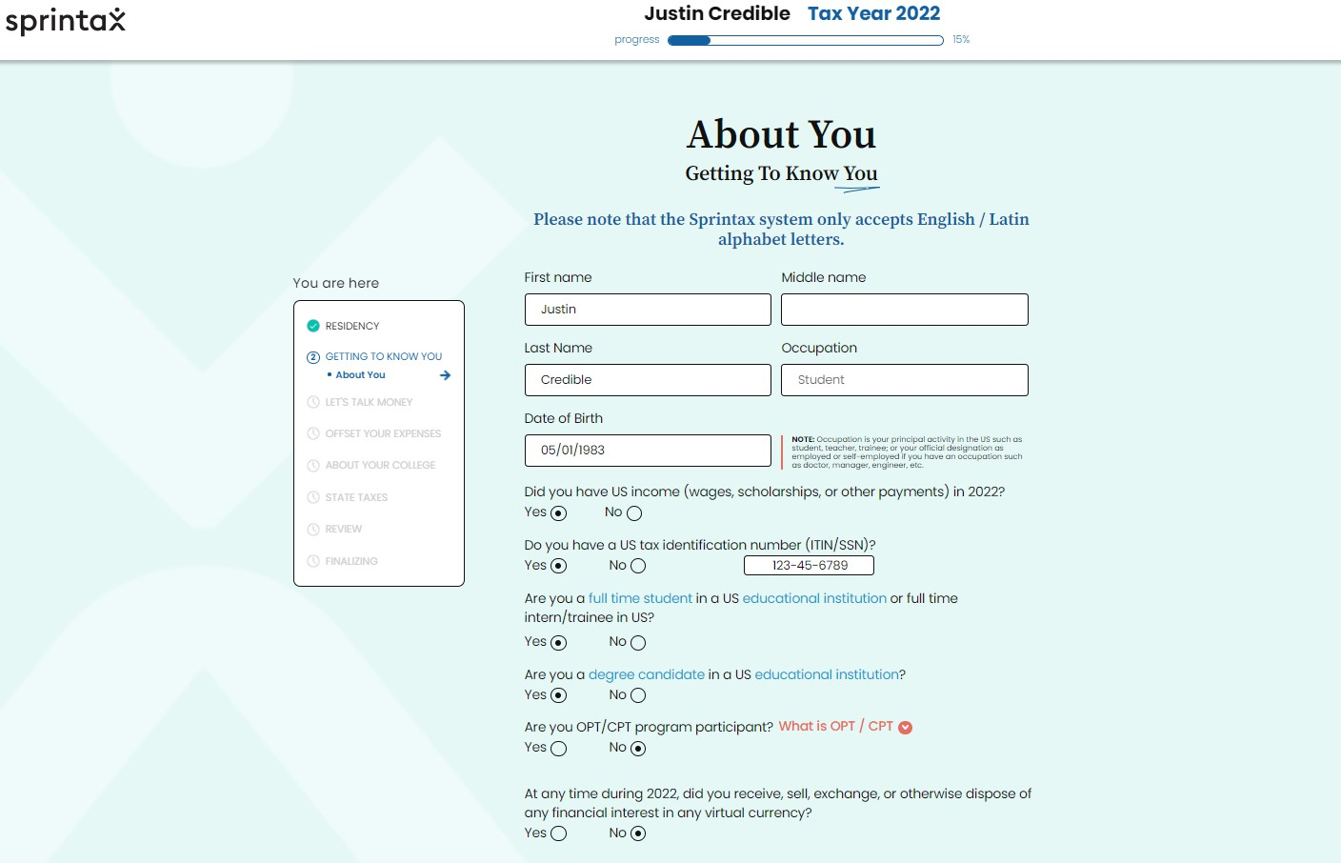
STEP 4
ABOUT YOU

Slide 24
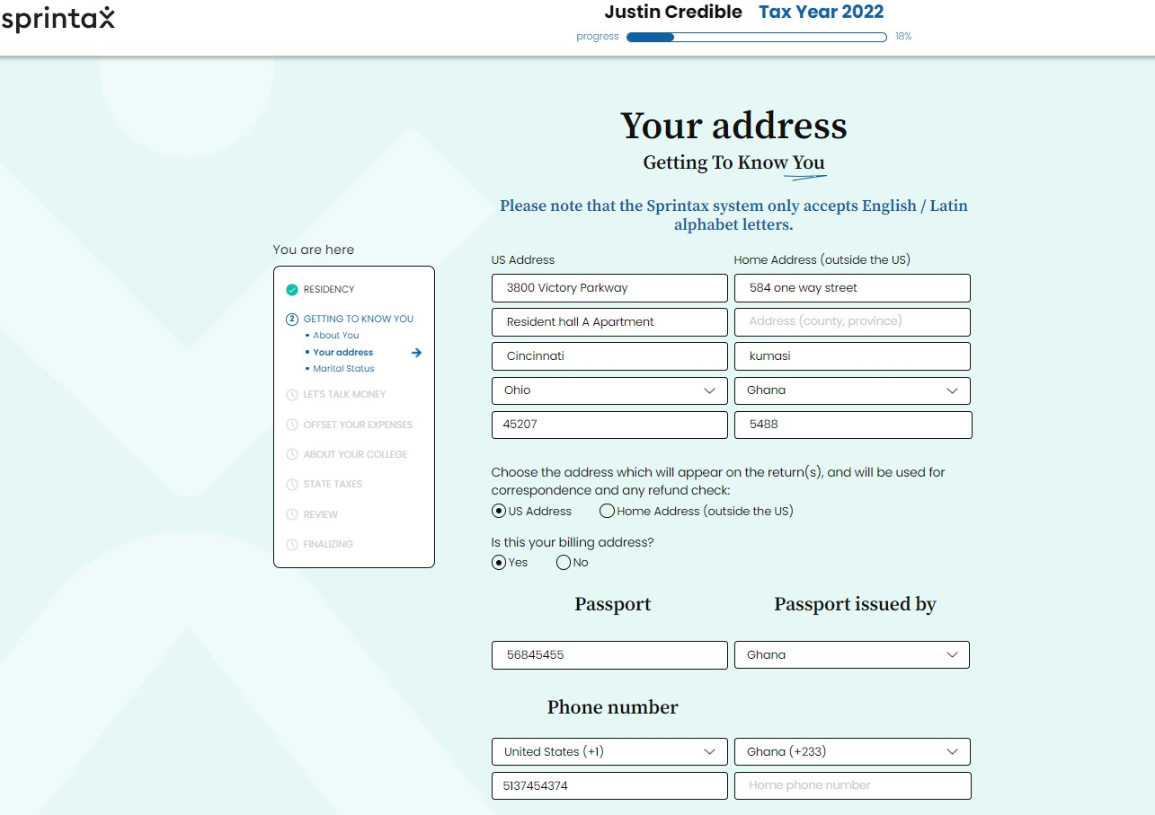
STEP 5
YOUR ADDRESS

Slide 25
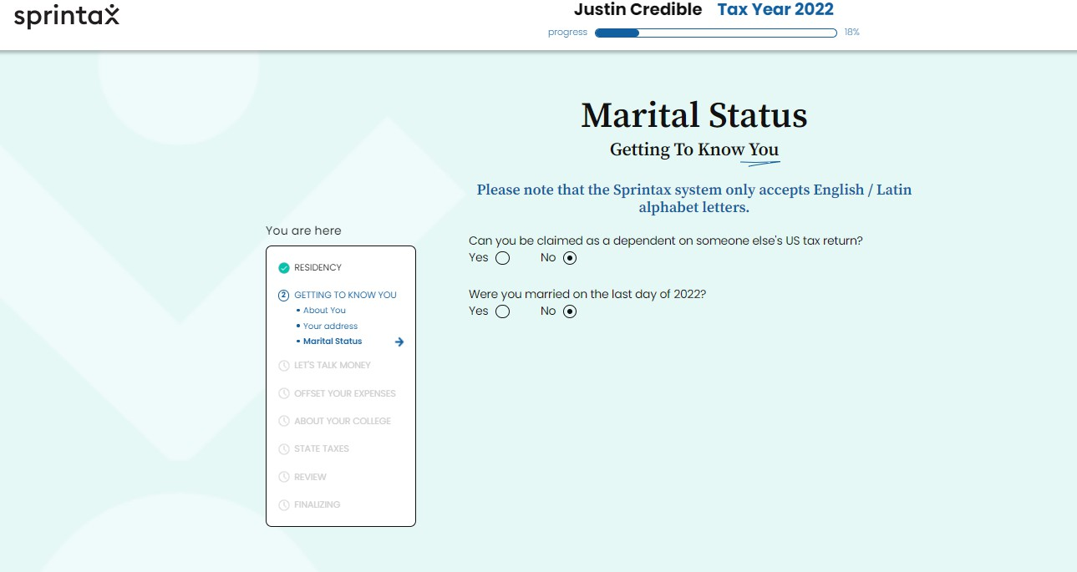
STEP 6
MARITAL STATUS

Slide 26
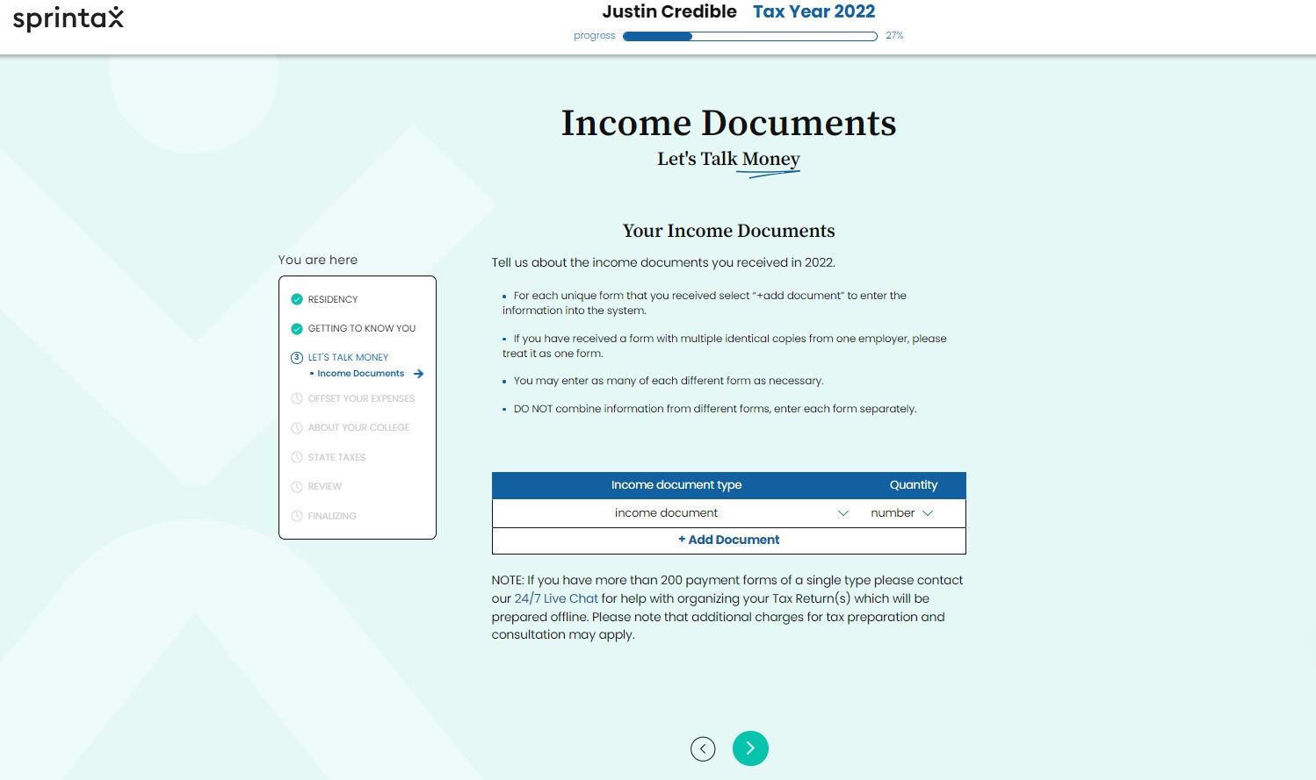
STEP 7
INCOME DOCUMENT PREPARATION

Slide 27
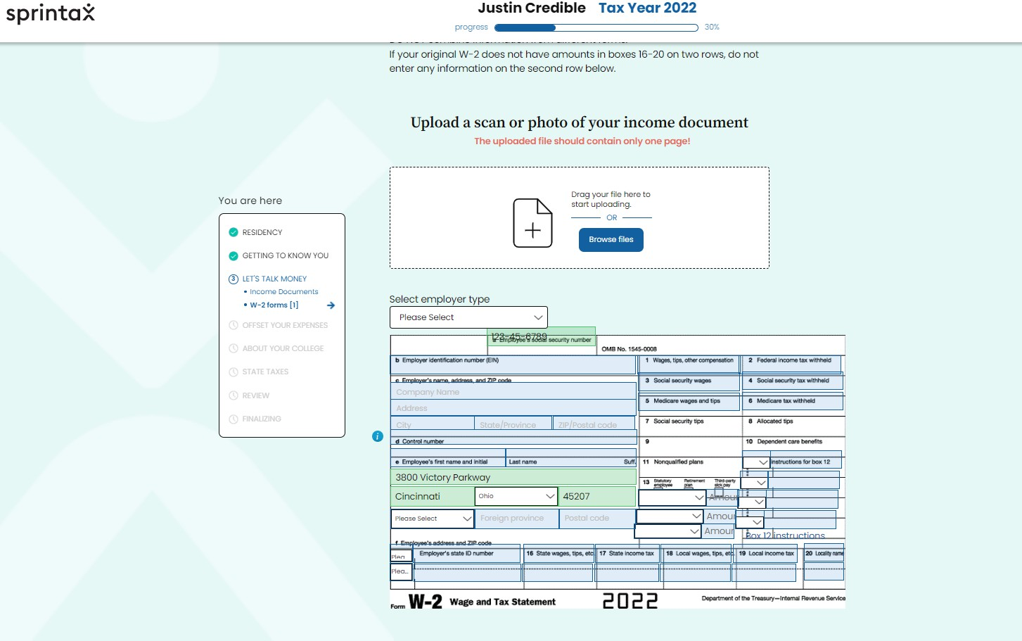
STEP 8
DOCUMENT UPLOAD W-2

Slide 28
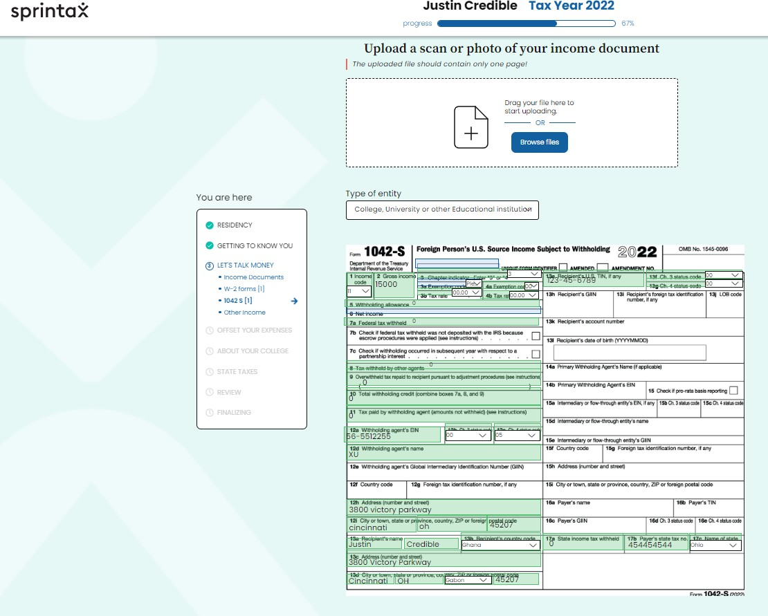
STEP 9
DOCUMENT UPLOAD 1042-S
Note: Box 17b will probably be empty on your 1042-S. Sprintax will not let you continue without filling in that box. The number for box 17b is:
510648389

Slide 29
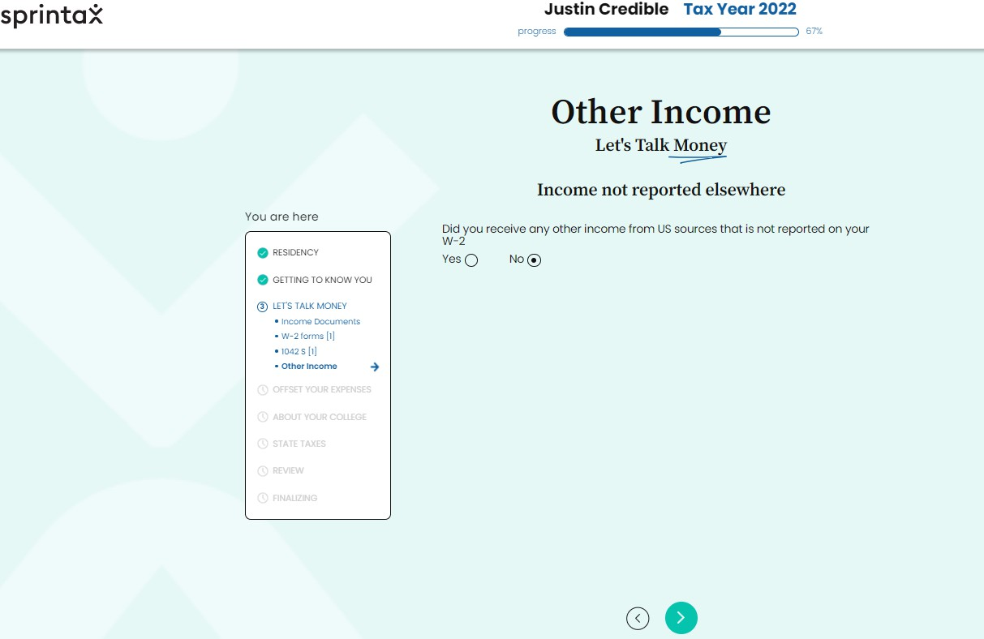
STEP 10
OTHER INCOME

Slide 30
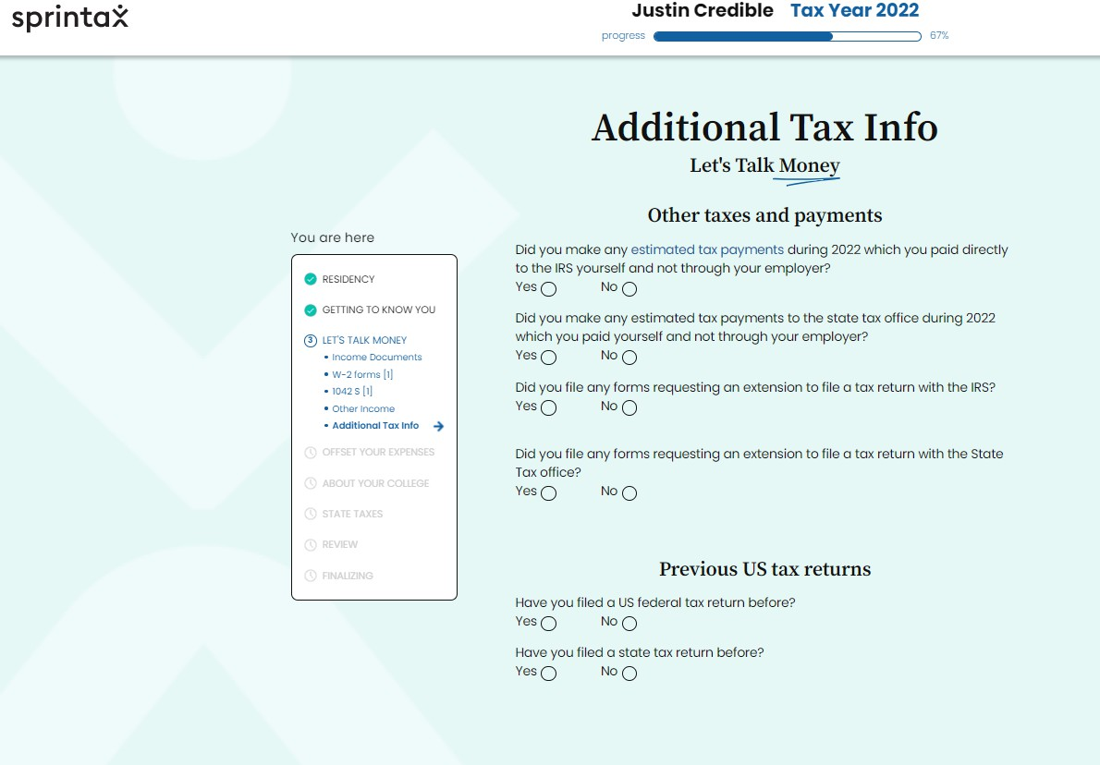
STEP 11
ADDITIONAL TAX INFO

Slide 31
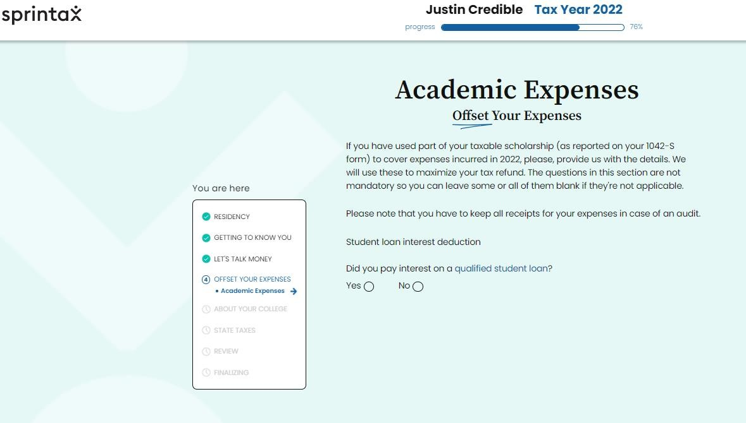
STEP 12
ACADEMIC EXPENSES

Slide 32
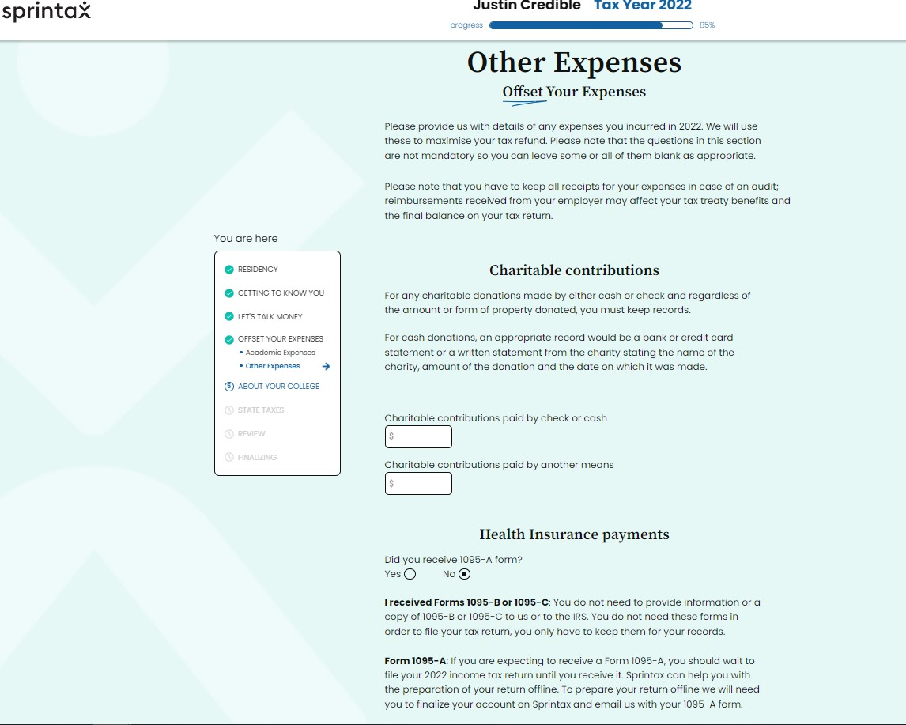
STEP 13
OTHER EXPENSES

Slide 33
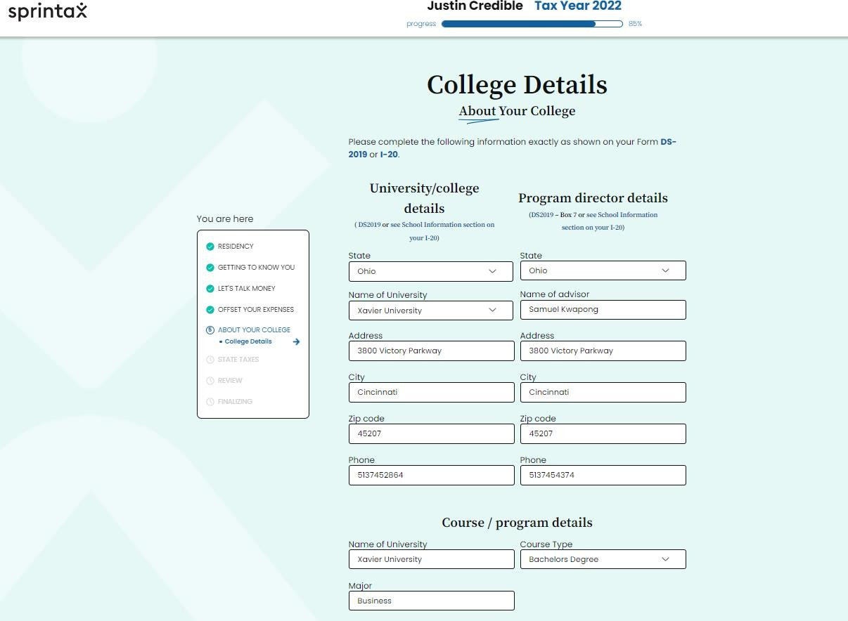
STEP 14
COLLEGE DETAILS

Slide 34
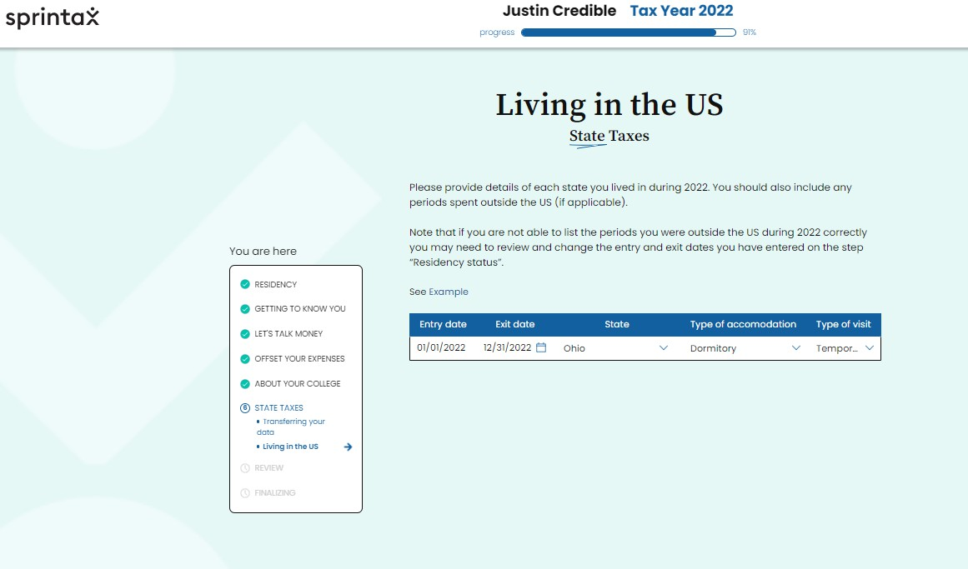
STEP 15
LIVING IN THE US

Slide 35
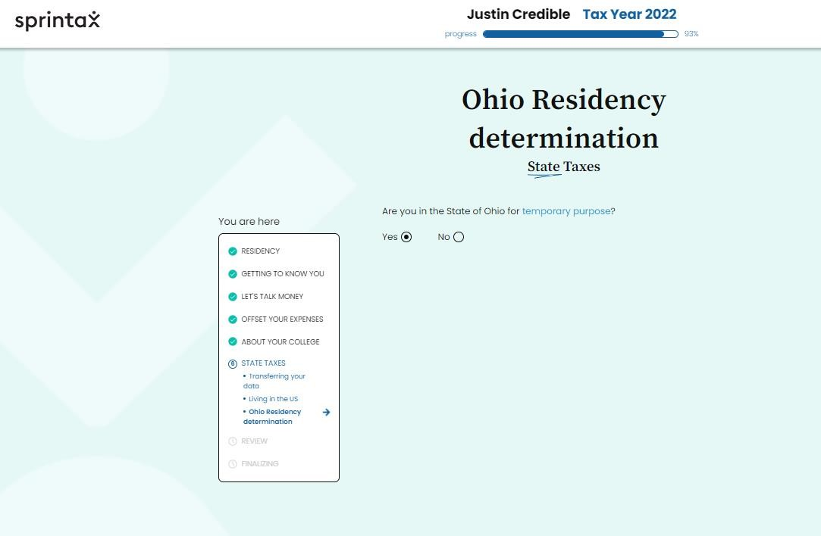
STEP 16
OHIO RESIDENCY DETERMINATION

Slide 36
Sprintax Resources
https://blog.sprintax.com/f1-visa-tax-return-guide-international-students

Slide 37
If you don't have a SSN...
If you need to file your taxes this year but do not have a Social Security Number, you will need to apply for an ITIN. The best way to apply for an ITIN is in person at the Cincinnati IRS office (550 Main St. Cincinnati, OH, 45202).
How to Apply:
Complete Form W-7/W-7(SP) (About Form W-7, Application for IRS Individual Taxpayer Identification Number | Internal Revenue Service)
  You can pay Sprintax to help you fill out the W-7 form, but you do not have to.
Request an ITIN Support Letter from the CIE office or work with our Liberty Tax Service contacts (certified acceptance agents that can assist with this filing for a fee)
Schedule an appointment at the Cincinnati IRS office by calling 1-844-545-5640 or work with our Liberty Tax Service contacts who will help prepare your certified copies of documents for mailing along with all completed tax forms (they will share a list of documents needed).
For your appointment with Cincinnati IRS, bring all the required documents and tax forms. Documents must be original and unexpired.
  Form W-7
  Proof of identity and foreign status
For more information, please click on this link: IRS Courseware - Link & Learn Taxes
  Please note: it is possible to apply for an ITIN by mail. However, this will require you mailing your passport and other immigration documents which may get lost in the mail, may be delayed in returning to you, or may be damaged in the process. For these reasons, we do not recommend applying for an ITIN by mail. DO NOT MAIL YOUR ORIGINAL PASSPORT or any other original documents!!! If needed, mail certified copies only.

Slide 38
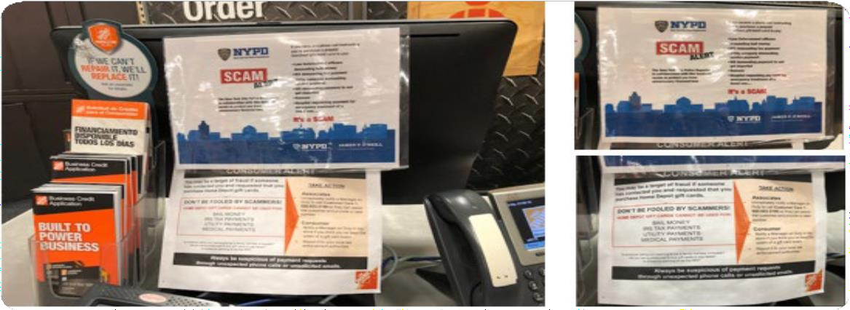
TAX SCAMS
Use caution and common sense
IRS would never ask for personal details without proper communication
IRS are not seeking to penalize anyone – they just want
to make sure that the fair and correct taxes are paid on time
Tax scams generally have the same format (internationally!)
Money Owed
“Instant” payment will make the problem go away
Voucher/prepaid credit card reference preferred payment option

Slide 39

OOPS!
FORGOT TO FILE?
Don’t panic!
  but do set the record straight
Never filed...
  Catch up
  Can back file at any stage
  Can only claim a refund for previous 3 years
Misfiled…
  1040X - Amended US Individual Income Tax Return
  Simple form, similar to 1040

Slide 40

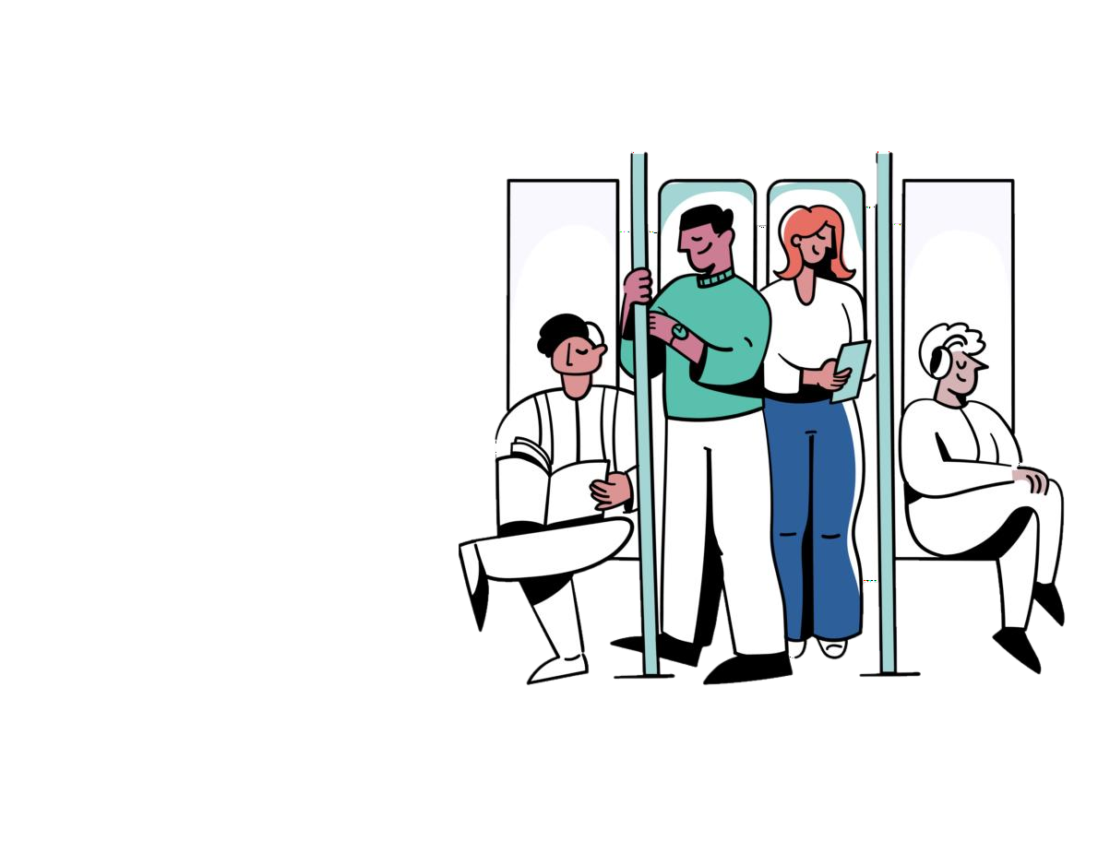
Implications of not filing
Nonresidents are required to comply with all US laws, including IRS & filing tax forms (even if only 8843).
Remaining compliant is part of maintaining visa status in the US.
Not filing could affect future immigration status (like H1B, LPR)
Fines, penalties and interest can accrue if the IRS are owed
Might be missing out on a refund!

Slide 41


Questions?
If you have any additional questions or concerns, please visit the resources provided within this slideshow (including Sprintax resources) and stop by during specified tax help walk-in hours in the Xavier CIE- ISSS office .
Otherwise, please schedule an appointment with us by emailing international@xavier.edu

