Slide 1
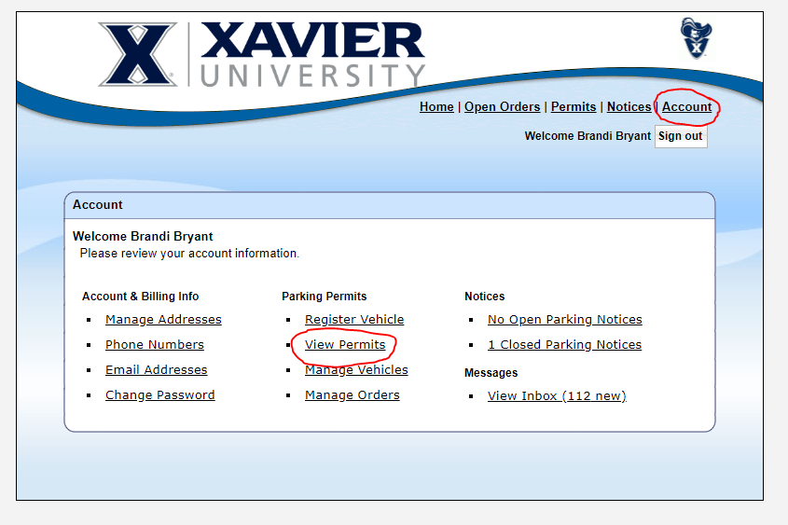
Here is the workaround if your temporary permit is not emailed to you.
Once you order your temporary permit, click account, view permits

Slide 2
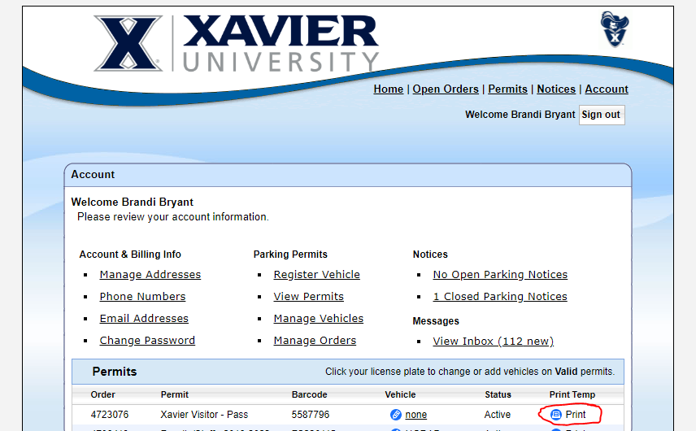
Find the most recent permit, click print and your temporary permit will open. You can now either print the permit or download it for emailing purposes.

Slide 3


